Slide 1
Healthy Homes Principles The Keep-Its
1. Keep it DRY
2. Keep it CLEAN
3. Keep it PEST-FREE
4. Keep it VENTILATED
5. Keep it SAFE
6. Keep it CONTAMINANT-FREE
7. Keep it MAINTAINED
Notes:
See if students can identify the seven principles.
Click to reveal complete list.
EXPLAIN:
We’re going to start looking at the IPMC and NHHS in more details now, and we’re going to use the Keep-Its to guide our discussion. While a lot of this is going to be familiar to you, it will probably not be familiar to the residents of the homes you inspect. We’ve found that using the 7 Principles can make it easier for you to communicate with those residents. If you start talk in terms of Code “308.2.1 of International Property Maintenance Code, 2015 edition” you are going to lose people. But if you remind them that having a covered container for their rubbish is a good way to help keep the house clean and therefore healthy, they’re more likely to get it, even if they aren’t thrilled about it.
So, to reiterate, we present you with the Keep-It’s as a tool to use when communicating with residents.
As we go through these codes, you should be thinking about how they compare to the codes you use locally. You can use Exercise #2 in your binder to take notes.
Refer students to Exercise #2: Reviewing Your Codes.

Slide 2
Codes Related to Moisture
IPMC | NHHS | Local
302.2 Grading & drainage | 1.2.3. Occupant’s actions
304.2 Protective treatment 304.6 Exterior walls 304.7 Roofs and drainage 304.16: Basement hatchways | 2.1. Structure
305.1 General 305.3 Interior surfaces | 2.2. Facilities
 | 2.3. Plumbing System
 | 6.1.1. Drainage system 6.1.2. Ext. wood surfaces 6.1.3. Grading, erosion prevention 6.1.4. Interior and exterior surfaces and coverings 6.1.5. Building material 6.1.6. Underlying cause
Notes:
EXPLAIN:
This is not the exhaustive list of codes related to moisture in either of these sources. And remember, these are just tow of many code sources available. But this gives you a sense of the type of issues covered in each.
Go through the list of codes, and discuss a few of them in a bit more detail.
ASK:
Consider whether the codes for your jurisdiction cover these issues. Are there any gaps? Is the language sufficient, or can see ways to improve it?

Slide 3
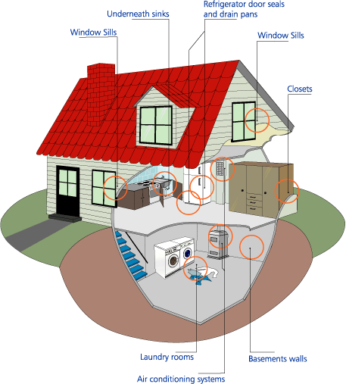
Keep It Dry: Mold
Mold is a health hazard;
NOT a violation!
Look for the source!
Notes:
ASK:
Is mold a code violation?
Give students a chance to respond, then click to reveal, “Mold is a hazard, not a violation.”
EXPLAIN:
It is important to remember that although mold is definitely a health hazard, it is NOT a code violation mold. It is, however, the RESULT of a code violation, most likely related to moisture or inadequate ventilation.
Click to reveal message “Look for the source!”
EXPLAIN:
Follow the mold to the moisture source to find the violation.
DISCUSS:
How do inspectors currently detect dampness and mold? Water stains, puddles, humid feeling, condensating windows?
If it hasn’t already been discussed, you can talk about how “mold” calls are passed around and who (what department) ultimately handles these types of issues. As mentioned above, it should always be referred to as a moisture-related issue.
Always focus on moisture issues rather than on mold (No moisture = no mold)
What happens to callers who are concerned about or mention mold?
Associated commonly with leaks or surface degradation, which are code violations
Is this always a landlord citation, or can tenants be cited as well? Examples?
List one hazard related to moisture found inside or outside the home that may impact occupant health?
Do your codes have a mechanism to address the hazard?
Are there additional resources or guidance you could provide to the family before leaving the home.

Slide 4
Interior Water Leakage
Sources of interior water leakage, 2011 American Housing Survey
8.5 % Interior Water Leak
Source of interior leak | % among total # of units
Leaking pipes | 3.6%
Fixtures | 1.9%
Broken water heater | 0.8%
Other or unknown | 2.4%
Notes:
NOTE: Replace with local data if available.
DISCUSS:
What % of homes had interior water leakage in a 12 month period? 8.5%, right? Although this table doesn’t show it, the 2011 American Housing Survey tells us that most of those homes were occupied by renters (11.2%) and those living below poverty (11.0%).
Now if I tell you that these statistics are based on 114.9 million homes, how many homes does that 8.5% represent? That’s 114.9 million homes with water leakage in 2011.

Slide 5
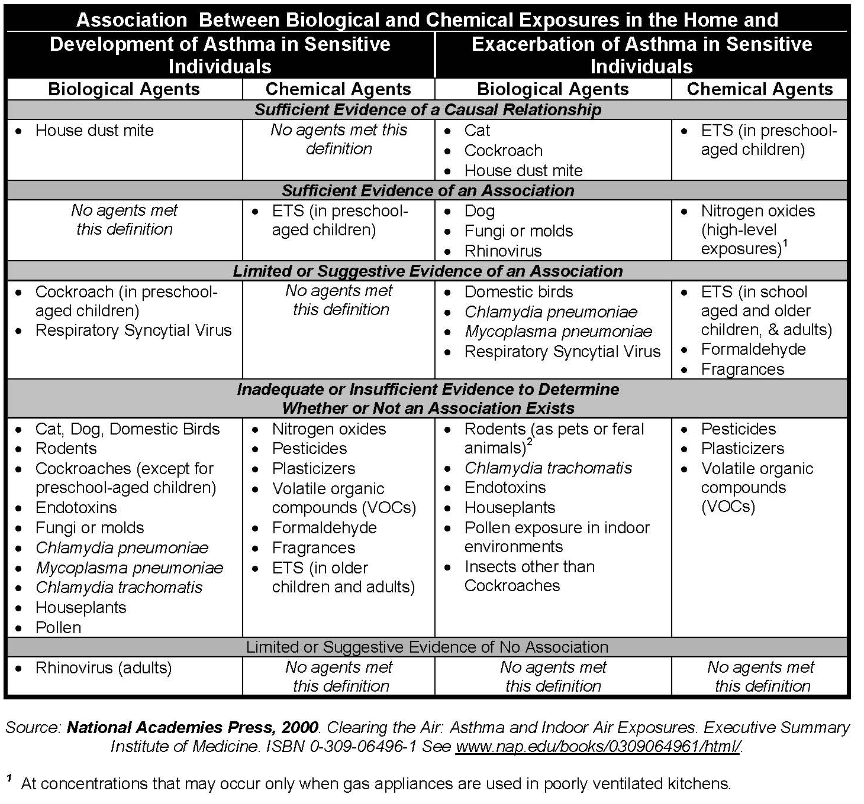
Institute of Medicine (2000)
Notes:
Refer students to the Institute of Medicine reports in the Reference section of their Student Manuals.
EXPLAIN:
At the beginning of the day, we looked at some data from the World Health Organization that showed factors for which there was sufficient, some, or insufficient evidence of a link to health.
In your binder, you have an NCHH Summary Report for that data. You also have a copy of two Institute of Medicine reports addressing the same issue. This 2000 IOM report, called “Clearing the Air,” addresses the connection between asthma and exposures in the home. It laid the foundation for the healthy homes effort.

Slide 6
Institute of Medicine (2004)
Notes:
EXPLAIN:
The 2000 IOM report and this 2004 IOM reports represent the authoritative sources for research findings showing the association between asthma and biological and chemical exposures in the home and between asthma and damp indoor environments. There are a number of more recent papers published that support the IOM conclusions and provide small updates.
Some of these updates show:
Stronger evidence on the association between asthma and mice
Stronger evidence on the association between asthma and rats
For a complete list of updates, please refer to the addendum in your student binder.

Slide 7
Codes Related to Cleanliness
IPMC | NHHS | Local
302.1 Sanitation | 1.1, 1.2 General
303.1 Swimming pools | 2.4.5. Kitchen floor 2.4.6. Bathroom floor
305.1 General | 2.7. Floors and floor coverings
308.1 Accumulation of Rubbish or Garbage 308.2 Disposal of rubbish 308.3 Disposal of garbage | 6.2. Solid Waste 6.2.1. Trash containers 6.2.2. Recyclables containers
308.3 Disposal of garbage
503.4 Floor Surface
Notes:
Go through the list of codes, and discuss a few of them in a bit more detail.
ASK:
Consider whether the codes for your jurisdiction cover these issues. Are there any gaps? Is the language sufficient, or can see ways to improve it?

Slide 8
Keep It Clean: 5 Steps
Start with people.
Limit moisture, dust, pest-born disease, accident-related hazards.
Improve ventilation.
Limit sources of contaminants.
Perform routine maintenance.
Notes:
In this module emphasize that cleaning is important. But an essential aspect of Keeping It Clean is that it be cleanable. Many surfaces are tough to clean. And corners and cubbyholes are tough to clean too. You could say that the goal is to keep it clean AND CLEANABLE.
These are steps to reduce household hazards. People are not born knowing that they must brush their teeth to prevent decay, they must learn it. So with household hazards, they must learn how to take care of themselves. Occupants know things about the building and themselves that can be learned nowhere else. Start with the people.
The second step is to keep the household in a certain condition:
limit moisture related problems,
limit dust and allergens,
limit pest borne disease,
provide local exhaust ventilation and general dilution ventilation to control unavoidable air contaminants,
provide a comfortable space by limiting hazards related to slips, falls, electric shock, drowning and poisoning.
Third, limit sources of contaminants like lead, asbestos, combustion fumes, VOCs (Volatile organic compounds) and radon. Note that products like scented candles and air fresheners release VOCs.
Fourth, maintain the house so it continues to provide dry, clean, comfortable and safe conditions.

Slide 9
Safe and Healthy Cleaning
Allergic reactions
Asthma and asthma exacerbation
Toxic exposure effects
Pesticides
Allergens
General chemicals
Notes:
EXPLAIN:
Remind residents that keeping it clean does not mean going out and buying every cleaning product on the market. In fact, many of the things consumers are encouraged to buy for the well-being of their homes and families may actually cause health issues.
Click to reveal first bulleted list and discuss what type of products we’re talking about here.
Click again to reveal the arrow and the list of potential complications.

Slide 10
Healthy Cleaning Guidelines
Don’t dry dust or dry sweep
Vacuuming:
Low-emission vacuum with beater bar
Very slowly (or use vacuum with dirt finder)
Wet cleaning:
Use “elbow grease”
Frequently change water
Notes:
EXPLAIN:
It is best to avoid dry dusting or sweeping. You should use a damp cloth for dusting and mist the floor for broom sweeping.
When vacuuming, it is best to use a low-emission vacuum that has a beater bar and vacuum slowly. The beater bar is the roller bar on the bottom of a vacuum cleaner that “beats” the carpet to bring up more debris for the vacuum to collect.
It is often better to use wet cleaning methods than dry dusting. It is important to use good technique and “elbow grease” when wet cleaning. In fact it may be more important than what type of product you use. Make sure that you do not contaminate the wash water and frequently change the rinse water and cleaning rags. The two bucket system for cleaning is the best option as it utilizes one bucket for cleaning and another for rinsing.

Slide 11
Make buildings more cleanable
Dust walk-off systems at entryways
Dust-creating activities away from people
Smooth, cleanable surfaces
Effective storage space
Flooring that is easy to clean
Vacuums with good filtration and easy to use
Notes:
EXPLAIN:
Here is a list of what we can do to make buildings more cleanable.
Install dust walk-off systems at entryways
Keep activities which create dust away from people.
Provide smooth, cleanable surfaces
Provide effective storage space (to help avoid clutter)
Choose flooring that is easy to clean
Use vacuums that have good filtration and can be emptied quickly and thoroughly

Slide 12
Codes Related to Pests
IPMC | NHHS | Local
302.5 Rodent harborage | 1.1.2. Owner and integrated pest management
304.5 Foundation walls 304.14 Insect screens 304.17 Basement window guards | 1.2.2. Occupant and integrated pest management
309.1 Infestation 309.2 Owner 309.3 Single occupant 309.4 Multiple occupancy 309.5 Occupant | 6.3.2.1 Stored materials 6.3.3. Adequate screens 6.3.4 No holes or open joints 6.3.4.1. Sealed with low-VOC caulk or closed-cell insulation 6.3.5. Infestation
Notes:
Go through the list of codes, and discuss a few of them in a bit more detail.
ASK:
Consider whether the codes for your jurisdiction cover these issues. Are there any gaps? Is the language sufficient, or can see ways to improve it?

Slide 13
Keep It Pest-Free
Pests/pesticides associated with variety of illnesses/diseases
Pests are a common (and contentious) issue in public housing
Who’s responsible for what?
Codes may include: insect screens, solid waste management, responsibility for pest management and control, etc.
Misapplication or application of pesticides by non-licensed professional is violation of the law
Notes:
EXPLAIN:
The main causes of insect accumulation is the availability of food and water and supportive living conditions? And why is this a problem?
Give students a chance to respond, then click to reveal first bullet.
EXPLAIN:
We know that pests impact health, but so do pesticides! Both are associated with a variety of illnesses and diseases. Think back to the first exercise we did this morning, Making the Connection. Can you remember some of the health issues we identified that were related to pests?
Give students a chance to respond. Answers may include any of the following:
Malaria. The foremost disease carried by insects is malaria.
Arboviruses. These diseases are caused by viruses that are biologically transmitted by the bite of mosquitoes.
Plague. Fleas are the vector for the plague (or black death), which infects man as well as rats and other rodents.
Enteric diseases. There are many bacterial diseases that are transmitted by some form of fecal contamination of food or water, either directly or indirectly.
Lyme disease. This disease is caused by an arachnid, the deer tick, which carries a bacterium called Borrelia bugdorferi.
Sleeping Sickness.
American Trypanosomiasis (trih-pan-uh-soh-mahy-uh-sis). This disease is also known as Chagas' Disease and invades the muscle cells of the digestive tract and heart, and sometimes also the skeletal muscle.
Click to reveal second bullet.
DISCUSS:
We know that pests are a common problem in public housing, but who’s responsible for what? The code places responsibility on the tenant for maintaining conditions that do not attract vermin, and says the owner should establish rules requiring tenant to maintain sanitary living conditions. Let’s talk about that for a minute. Who do you think is responsible for public places vs. private places, and who is responsible for the interior of a building vs. the exterior of it?
Give students a chance to respond, then click to reveal third bullet.
DISCUSS:
As we’ve already seen, there are various codes related to dealing with pests.
Click to reveal fourth bullet and discuss.

Slide 14
Integrated Pest Management (IPM)
INFESTATION. The presence, within or contiguous to, a structure or premises of insects, rats, vermin or other pests.
EXTERMINATION. The control and elimination of insects, rats or other pests by:
Eliminating harborage places
Removing sources of food
Sealing gaps
Using approved pest elimination methods
Notes:
ASK:
What is an infestation?
Give students a chance to respond, then click to reveal definition.
ASK:
What is extermination?
Give students a chance to respond, then click to reveal definition.
EXPLAIN:
Integrated Pest Management (IPM) is the preferred method of reducing or eliminating pests in a facility. We are eliminating, generally not exterminating, pests in residences as this is safer and healthier for the occupants and has unintended benefits (moisture reduction, increasing energy efficiency). Exterminating generally implies the use of pesticides to kill such as poisons, foggers, sprays which can have unintended consequences to human occupants and pets. Broadcast pesticides or spraying can be an ineffective option because they only reach a small number of pests in a home and pests can become resistant to them.
Integrated Pest Management consists of:
Click to reveal each associated bullet point.
Eliminating harborage sites (both inside and outside)
Sealing up any gaps, cracks, or other openings where pest can enter/exit the premises
Eliminate any food and water sources (primarily referring to inside the residence, however could involve the outside as well)
Targeted usage of baits, traps, and gels to minimize pests
Note: If infestation is severe, a pest management professional (PMP) may be required to knock down populations initially)

Slide 15
Codes Related to Ventilation
IPMC | NHHS | Local
302.6 Exhaust vents | 2.3.2. An adequate supply of heated running water 2.4.3.2. Kitchen range 2.5.5. Bathroom
403.1 Habitable spaces 403.2 Bathrooms 403.3 Cooking facilities 403.4 Process ventilation 403.5 Clothes dryer | 5.2.1. Venting and Air Supply for Heating Equipment
505.4 Water heating facilities | 5.3 Ventilation 5.3.1. ASHRAE Standard 5.3.2. Exhausted air 5.3.3. Pipes, ducts, conductors, fans, blowers 5.3.4. Basement
603.2 Removal of combustion products 603.5 Combustion air | 5.4. Air Sealing
607.1 General
Notes:
EXPLAIN:
Go through the list of codes, and discuss a few of them in a bit more detail.
ASK:
Consider whether the codes for your jurisdiction cover these issues. Are there any gaps? Is the language sufficient, or can see ways to improve it?

Slide 16
Keep It Ventilated
Bath, dryer, and range exhaust fans?
Gas stove used as heater?
Windows work?
Smoke alarm goes off?
Unvented gas or kerosene heaters?
Vented hot water heater?
Furnaces, boilers, fireplaces vented?
Rooms without windows?
Lingering odors?
Stale air?
Windows fog?
Notes:
EXPLAIN:
Local exhausts are easy enough to check – are they there, do they work? Because most residential buildings assume that operation of the local exhausts, wind and stack driven air flows, and operable windows provide enough general ventilation, it is more difficult to assess general ventilation.
The simplest way to get an idea is to ask the occupant whether odors linger, windows fog during cold weather, or does the air seem stale?
Refer back to the conversation about checklists and what they are using to inspect the home (this is in the notes section of the top 5 citations).

Slide 17
Codes Related to Safety
IPMC | NHHS | Local
302.3 Sidewalks, driveways 302.8 Motor vehicles | 2.4.3.1. Range/over 2.7. Floors, floor coverings
303.2 Pools, spas, hot tubs | 3.2. Locks/security
304.1.1 Ext Structure: Unsafe conditions 304.10 Stairways, decks, porches, balconies 304.12 Handrails and guards 304.18 Building security 304.19 Gates | 3.6. Walking Surfaces
305.1.1 Int Structure: Unsafe conditions 305.4 Stairs, walking surfaces 305.5 Handrails and guards | 3.7. Guards
307.1 Handrails and guardrails | 3.9. Pools, hot tubs, water features
605.1 Electric equipment | 4.1. Electrical System
702-704 Fire safety | 4.2. Outlets
Notes:
EXPLAIN:
Go through the list of codes, and discuss a few of them in a bit more detail.
ASK:
Consider whether the codes for your jurisdiction cover these issues. Are there any gaps? Is the language sufficient, or can see ways to improve it?

Slide 18
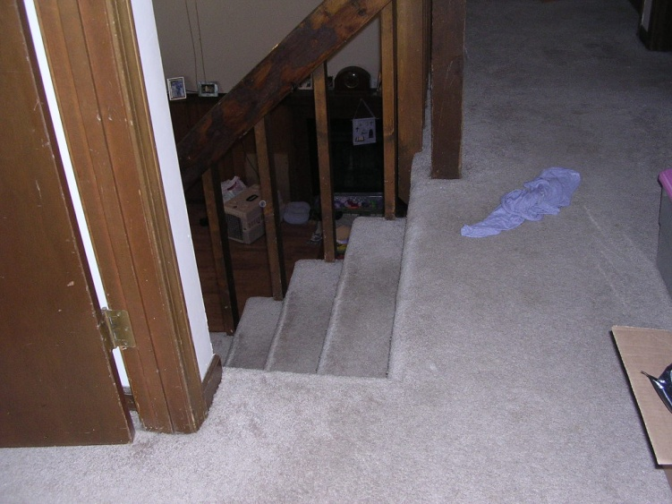
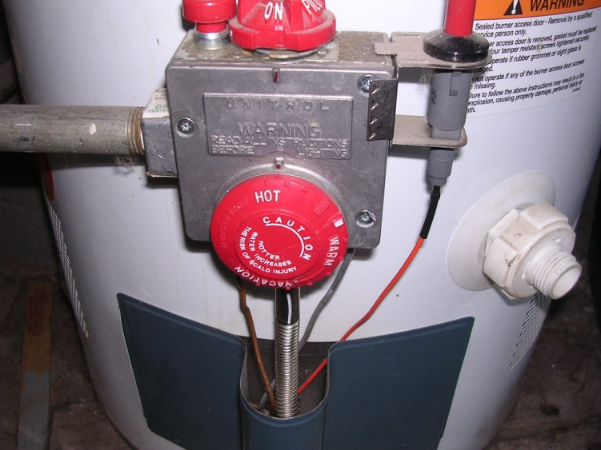
Keep it Safe
Age Group | Susceptibility
Infants | Choking/suffocation is the highest rate of injury death
Birth – age 14 | Nonfatal falls at home
1-14 years old | Highest rate of home injury death is fires and burns
Older adults | Nonfatal falls at home
Adults 80+ years | 20 times higher risk for death from injury than younger individuals
Notes:
EXPLAIN:
Children and older adults (70 and above) tend to be the most susceptible groups for home injuries:
Adults 80+ years of age are at 20 times higher risk of death due to injury (e.g. falls) than younger individuals. When the elderly do survive a fall, they take longer to recover and often do not fully recover.
However, falls are leading cause of nonfatal home injury for children from birth through 14 and for older population.
The highest rate of injury death for 1-14 year olds is fires and burns.
For infants, the highest rate of injury death is choking and suffocation.

Slide 19
What are the most common causes of home injury deaths?
Notes:
ASK:
What do you think are the most common causes of home injury deaths?
Give students a chance to respond, then click to reveal pie chart.
EXPLAIN:
As you can see falls, poisonings, and fires/burns, are the top three causes of home injury deaths. Falls account for 43% of all deaths, poisoning 34%, and fires 9%.
ASK:
How similar are your local statistics to these ones? What are the top three in this area, and why?

Slide 20
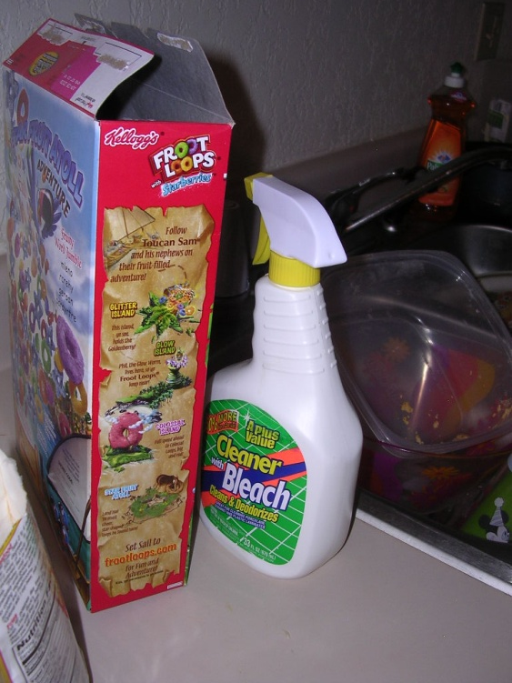
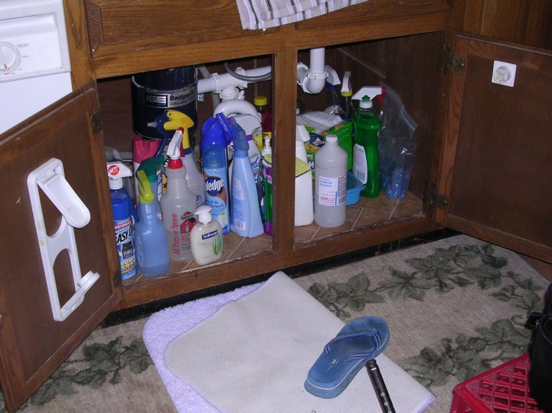
Chemical Issues
ETS
Including 2nd and 3rd hand smoke
Household products
Routing cleaning, pesticide use, etc.
Alternative chemicals
Hobbies/working from home
Pottery, stained glass, guns,etc.
Hair stylists, manicurist
Notes:
ASK:
What kind of chemical issues might be related to safety?
Give students a chance to respond, then click to reveal first bullet.
EXPLAIN:
Everyone is familiar with 2nd hand smoke, the smoke actually coming from the cigarette. Now there is 3rd hand smoke which is the off-gassing of particles and gases from an object and item that has absorbed smoke such as furniture, walls, carpet, people (clothing, hair), upholstery in cars, etc. This off-gassing is temperature related which is what causes the off-gassing.
Click to reveal second bullet.
EXPLAIN:
A number of hazardous or unsafe products are routinely used for cleaning of home without reading the label and understanding the impact on health. If Code officials could recommend using a safer alternative focusing on the signal words on the label: caution, warning, danger, poison with caution being the least toxic and poison being the most toxic.
Provide examples of alternative cleaning resources that code officials could provide to occupants.
Click to reveal third bullet.
EXPLAIN:
Hobbies/working from home: Code officials may encounter more hazardous conditions than they routinely would when they stumble across jobs performed inside the home such as a hair stylist or manicurist. Jobs such as these may expose occupants to toxic chemicals and fumes and lead to worsening health conditions. Same would apply to hobbies because of the products use to get their end results, pottery, stained glass, etc.
Tell students there are links to resources in the reference section of their binder.

Slide 21
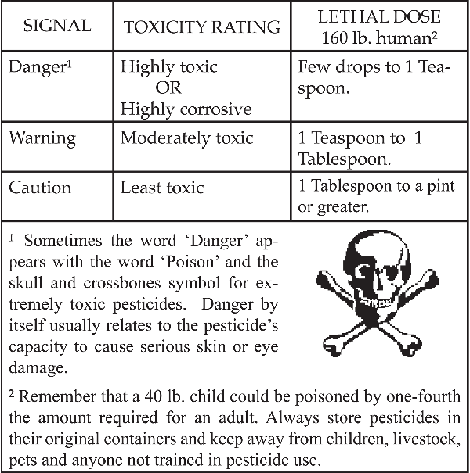
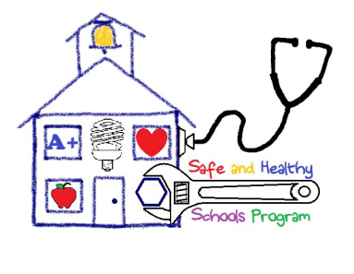
Pesticide Labels: Signal Words
Notes:
EXPLAIN:
Signal words indicated the level of potential danger or harm that can occur, and in this case, it is referring to ingestion.
This particular slide is focused on ingestion as the source of exposure. There may be other associations between expected exposures and particular types of hazards.

Slide 22
Protecting the Code Officer: PPE
N-95 Respirator
Rubber gloves
Safety goggles
Hard hat
Ty-vek suit
Booties
Notes:
EXPLAIN:
Remember Personal Protective Equipment: You need to keep yourself safe as well!
ASK:
How often do you use this equipment? What other equipment do you use?

Slide 23
Be aware of:
Significant structural defects and physical hazards
Visible and significant biological contamination
Fire and improperly stored combustible materials
Can you ask for a hazard to be removed?
Notes:
23
EXPLAIN:
In addition to wearing the right equipment, you need to be on the look out for unsafe situations.
Click to reveal the three bullet points, discussing each briefly.
ASK:
What types of unsafe situations have you encountered in your work?

Slide 24
Codes Related to Contaminants
IPMC | NHHS | Local
302.4 Noxious weeds 302.8 Motor vehicles | 2.3.3 Plumbing system: sewage disposal
403.4 Process ventilation | 3.5. Carbon Monoxide
505.2 Water System: Contamination | 3.8. Chemical Storage
506 Sanitary Drainage System | 7.2. Lead-Based Paint
 | 7.3. Asbestos
 | 7.4. Toxic Substances
 | 7.5. Radon
 | 7.6. Pesticides
 | 7.7. Methamphetamine
 | 7.8. Smoke in Multifamily Housing
Notes:
EXPLAIN:
Go through the list of codes, and discuss a few of them in a bit more detail.
ASK:
Consider whether the codes for your jurisdiction cover these issues. Are there any gaps? Is the language sufficient, or can see ways to improve it?

Slide 25
Keep It Contaminant-Free
Lead-Based Paint
Asbestos
Carbon Monoxide
Radon
Chemical and biological contaminants
Notes:
ASK:
What types of contaminants are you looking for during an inspection?
Give students a chance to respond, then click to reveal the five bullet points, discussing each briefly.
For this section, we are not specifically talking about how the hazard affects health, but rather what role the code inspector plays as far as addressing these issues. Once these issues are discussed, it would be good to mention that issues such as lead, CO, radon, chemicals, clutter and hoarding are examples of the core healthy home principles discussed early and in other healthy home courses.
What are considered special issues in the area that the training is being delivered in? For example…are chemical contaminants a “special issue”?

Slide 26
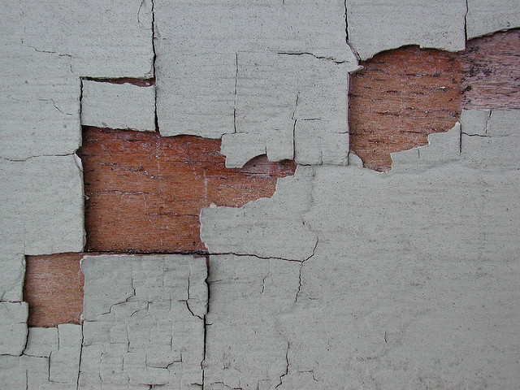
FLAKING PAINT IS A
CODE VIOLATION!
Notes:
ASK:
Why is flaking paint a code violation?
DISCUSS:
Give students a chance to share their thoughts. Write their responses on a flip chart. Even the following are not mentioned, add them to the list:
allows rot of siding materials
allows water penetration into structure
allows vermin an access point into building
if leaded, this is poisonous, especially to the brain and body of young children.
DISCUSS:
Is there additional urgency when children are in the home?
Is there any way to verify landlords have provided lead disclosure information to tenants in pre-1978 homes?
Can you cite landlords for lack of lead disclosure?
If children are in the home, what moral responsibility does the code inspector have to refer the family to the local health department who could follow up for case management?

Slide 27
Lead Renovation, Repair and Painting (RRP)
Only Lead-Safe Certified Firms may disturb paint in pre-’78 housing
“Certified Renovators” Supervise Work
Mandatory Work Practices
Post-renovation Cleaning Verification
Documentation!
Notes:
EXPLAIN:
While local code officials are not required to perform RRP (Renovation, Repair, and Painting) enforcement unless it’s locally adopted, you can take supportive action. You can inform contractors about the requirements and refer them to training.
The permit application can require RRP firm and renovation certification numbers for work done on pre-1978 homes and child-occupied facilities. Unsafe practices can be stopped through local codes or referrals to EPA for federal enforcement.
Those enforcing the rule may be the state health department.
Click to reveal the first bullet point.
EXPLAIN:
In order to disturb in homes built prior to 1978, each company that receives compensation for their renovation work must register as a lead-safe certified firm with the EPA or enforcement state. This includes large companies and solo practitioners, general and subcontractors, and landlords and property management companies. The EPA registration certificate is good for five years; individual states require renewal anywhere from annual to every five years.
Click to reveal the second bullet point.
EXPLAIN:
Each lead-safe certified firm must have at least one EPA-certified renovator supervising the job site, ensuring that correct lead-safe work practices are being followed. To become a certified renovator, students must attend an EPA-approved training session and pass an exam every five years (some states require recertification every three years).
Click to reveal the third bullet point.
EXPLAIN:
Among the most important lessons taught in RRP training are to isolate the work area, so that no dust escapes to other areas of the house or apartment; to contain dust while working, using plastic sheathing, sticky mats, ZipWalls, et cetera; and to clean up the work area thoroughly for debris and dust, using HEPA vacuums.
Click to reveal the fourth bullet point.
EXPLAIN:
Once the work is complete and the area appears to be clean, the RRP rule requires a cleaning verification test to ensure that only trace amounts of construction dust remain. Each certified renovator receives a laminated cleaning verification card depicting the minimum allowable residue on a dust wipe pad.
Click to reveal the fifth bullet point.
EXPLAIN:
If audited by the EPA, the renovation firm will need to prove that they educated their customer about lead poisoning and how it relates to the work they’ll be doing. Renovation firms must give each client a copy of Protect Your Family from Lead in Your Home and document that it was received by the client.

Slide 28
Asbestos
Mineral fiber that causes a variety of severe health issues and is present in many older building materials
As a code inspector, it may be difficult to determine what materials contain asbestos without having the materials tested
Do not disturb any suspect asbestos-containing materials, especially if friable
Notes:
ASK:
What is asbestos?
Give students time to respond, then click to reveal definition.
Click to reveal second bullet point, and discuss briefly.
ASK:
What are the health issues associated with asbestos?
Give students time to respond. Answers should include: mesothelioma, asbestosis, respiratory/breathing problems, lung cancer, etc.
ASK:
What experiences have you had in dealing with asbestos?
Give students time to respond. Note that common places for asbestos are insulation (such as pipe and boiler insulation), siding, floors roofing shingles and popcorn ceilings.
ASK:
Are there code requirements related to asbestos and if so, how often are they cited?
Give students time to respond, then explain.
EXPLAIN:
Although there are health issues related to long term exposure, asbestos is largely exempted by the federal rules for a single family home. There would be no code violation in finding friable asbestos. In fact, even disposal of friable (easily crumbled) asbestos is exempted from the federal regulations for single family homes.
Click to reveal third bullet point.
Note that disposing of asbestos should be done by an accredited asbestos inspector.
ASK:
Codes inspectors inspect single family homes as well as multi-family dwellings. Is their responsibility different when it comes to multi-family dwellings? What is the law?
Give students time to discuss.

Slide 29
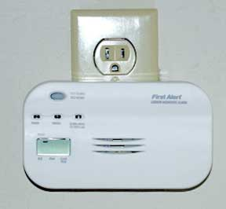
Carbon Monoxide: It’s Alarming!
Why do so few residents use CO alarms?
Smoke detector: 92.9%
CO alarm: 41.6%
The answer is in the code!
Notes:
EXPLAIN:
Known as "the silent killer," Carbon Monoxide (CO) is a colorless, tasteless, odorless gas that comes from the incomplete burning of fuel. Just about anything you might burn in or around your home -- whether it's gasoline, wood, coal, propane, natural gas or oil -- can produce carbon monoxide in the right conditions. Without enough ventilation, the gas can build up to deadly levels. And it doesn't take much fuel to be dangerous: Even small tools like chainsaws can release enough CO to make you sick.
So then why aren’t residents using CO alarms?
Click to reveal the statistics related to smoke detectors, then click to reveal the statistics for carbon monoxide alarms.
EXPLAIN:
2011 AHS data says that 41.6% of homes have working carbon monoxide detectors (their term) and 92.9% of homes have a working smoke detector.
ASK:
What do you think is going on here?
Give students time to discuss briefly, then click to reveal the answer.
EXPLAIN:
It has to do with smoke alarms being part of the code and carbon monoxide alarms not being part of the code.

Slide 30
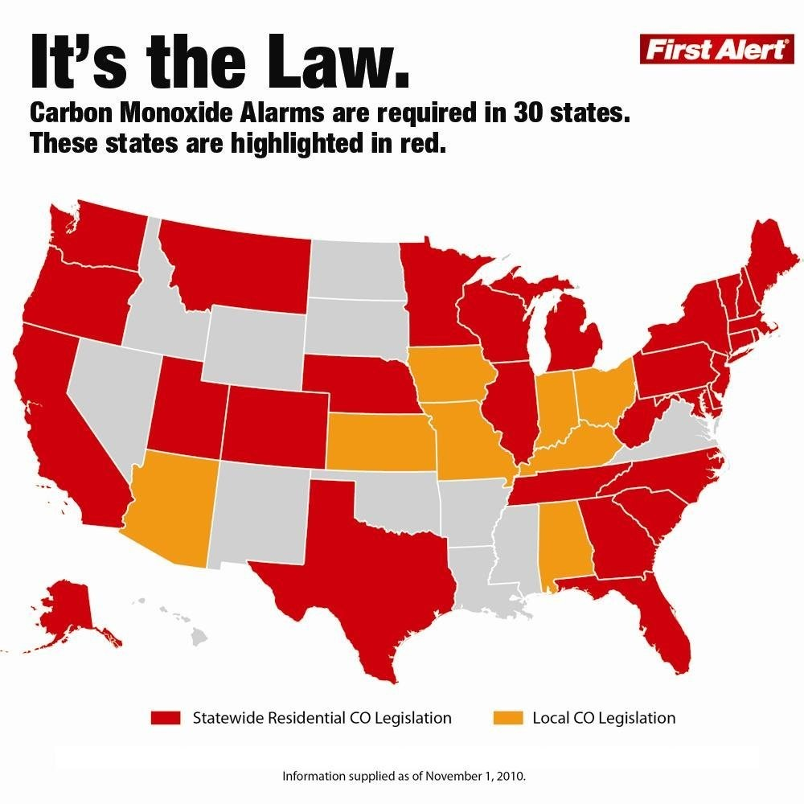
Notes:
Trainers should always verify if the state they are teaching in requires CO alarms to be installed. If it is the state law, is the law retroactive for existing homes or does it apply to new homes only? Ask if local codes call for hard wiring of CO alarms.
NOTE: Laws tend to change. Per the National Council of State Legislatures: “As of August 2015, 29 states have enacted statutes regarding carbon monoxide detectors, and another 11 have promulgated regulations on CO detectors.“
Unfortunately this map is already out-of-date. There was not a new map available when this document was printed, but trainers should check online prior to training to see if they can find a current map.

Slide 31
Carbon Monoxide in the Home
Notes:
Discuss this diagram, which illustrates the variety of potential sources for carbon monoxide in the home.

Slide 32
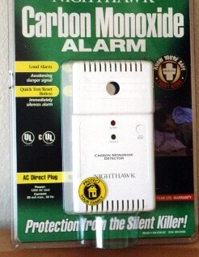
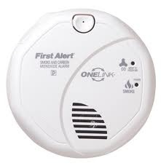
Carbon Monoxide Alarms
Consumer Product Safety Commission (CPSC) recommends:
Place near sleeping area
Put on every level of a home to provide extra protection
Do not install directly above or beside fuel-burning appliances
Combination smoke and CO alarm
Notes:
ASK:
How many of you have a working carbon monoxide alarm in your home?
EXPLAIN:
Proper placement of a carbon monoxide alarm is important. If you are installing only one carbon monoxide alarm, the Consumer Product Safety Commission (CPSC) recommends it be located near the sleeping area, where it can wake you if you are asleep. Additional alarms on every level and in every bedroom of a home provides extra protection.
Install a battery-operated CO alarm in your home and check or replace the battery when you change the time on your clocks each spring and fall.
Homeowners should remember not to install carbon monoxide alarms directly above or beside fuel-burning appliances, as appliances may emit a small amount of carbon monoxide upon start-up. A alarm should not be placed within fifteen feet of heating or cooking appliances or in or near very humid areas such as bathrooms.
Carbon Monoxide alarms should not be thought of as a REPLACEMENT for proper use and maintenance of fuel-burning appliances. It is important for students to know that the technology of CO alarms is still developing, that there are several types on the market, and that they are not generally considered to be as reliable as the smoke detectors found in homes today. Some CO alarms have been laboratory-tested, and their performance varied. Some performed well, others failed to alarm even at very high CO levels, and still others alarmed even at very low levels that don’t pose any immediate health risk. And unlike a smoke detector, where you can easily confirm the cause of the alarm, CO is invisible and odorless, so it’s harder to tell if an alarm is false or a real emergency.

Slide 33
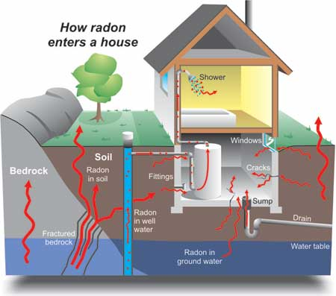
Radon
May not be a housing code issue, but rather a building code issue
Does the landlord have to notify tenants of elevated radon levels (if tested for)?
Notes:
ASK:
What is radon and why is it harmful?
Give students time to respond, and discuss briefly.
Note how radon levels can vary from house to house and how bare soil and crawlspaces can increase levels.
Click to reveal first bullet point.
EXPLAIN:
Although it is a building code rather than property maintenance code, the code inspector has a moral responsibility to handle radon issues.
This illustration is useful to help you understand the mitigation process rather than focus on legal issues.
Discuss, referencing the diagram.
Click to reveal second bullet. Discuss.

Slide 34
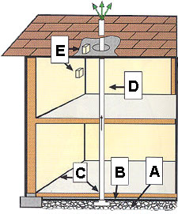
Passive Sub-Slab Depressurization System (New Construction)
A.
B.
C.
D.
E.
Gas-Permeable Layer
Plastic Sheeting
Seal and Caulk
Vent Pipe
Junction Boxes
Notes:
This slide is taken from EPA’s webpage at www.epa.gov/radon/construc.html
This system should be used for new construction. EPA does not recommend a passive system for existing sub-slab construction.
Five important steps in a passive system:
Put a gas permeable layer beneath the slab or flooring system to allow soil gas to move freely underneath the house.
On top of the gas permeable layer, put plastic sheeting to help prevent the soil gas from entering the home.
Seal and caulk all below grade openings in the foundation and walls to reduce soil gas entry into the home.
Install vent pipe – 4 inches preferred – from gas permeable layer to roof to safely vent radon and other soil gases to the outside.
Install junction boxes to make wiring and installation of a vent fan for an active system easier. Active systems are recommended for existing homes.
For systems in crawl spaces, cover the floor with poly sheeting, lay a perforated collection pipe below the poly sheeting and connect the pipe to a radon vent riser. It is also important to close openings between the crawl space and basement or crawl space and the living areas. The recommended installation is a T- joint at the bottom of the stack with corrugated pipe running in both directions.
Please note that the pipe (stub up) must be connected to a vent pipe that goes through the interior of the house and vents to the outside. Otherwise, it is not a passive system and radon is vented in the house instead of outside or creating a situation where the pipe (stub up) could be misused for something else such as a commode. Vent pipes passing through the house are required to be labeled.

Slide 35
Codes Related To Maintenance
IPMC | NHHS | Local
302.4 Weeds 302.7 Accessory structure 302.9 Property defacement 303.1 Swimming pools | 2.2. Facilities 2.3 Plumbing System 2.4 Kitchen 2.5 Bathroom 2.6. Minimum Space
305 Interior Structure 306 Component Serviceability | 3.6. Walking Surfaces 3.7. Guards 3.9. Pools, Hot Tubs, and Other Water Features
504 Plumbing Systems and Fixtures 505 Water System 506 Sanitary Drainage System 507 Storm Drainage | 4.1. System 4.2.2 Outlets
603 Mechanical Equipment 604 Electrical Facilities 605 Electrical Equipment 606 Elevators, Escalators 607 Duct Systems | 5.1. Heating, Ventilation, and Air Condition Systems
Notes:
EXPLAIN:
Go through the list of codes, and discuss a few of them in a bit more detail.
ASK:
Consider whether the codes for your jurisdiction cover these issues. Are there any gaps? Is the language sufficient, or can see ways to improve it?

Slide 36
Keep It Maintained
Clutter
Unsanitary conditions
Hoarding
Notes:
ASK:
What types of things are we talking about when we say, “Keep it maintained”?
Give students a change to answer, then reveal the three bullet points.
Encourage students to share their own stories on this topic.

