Slide 1
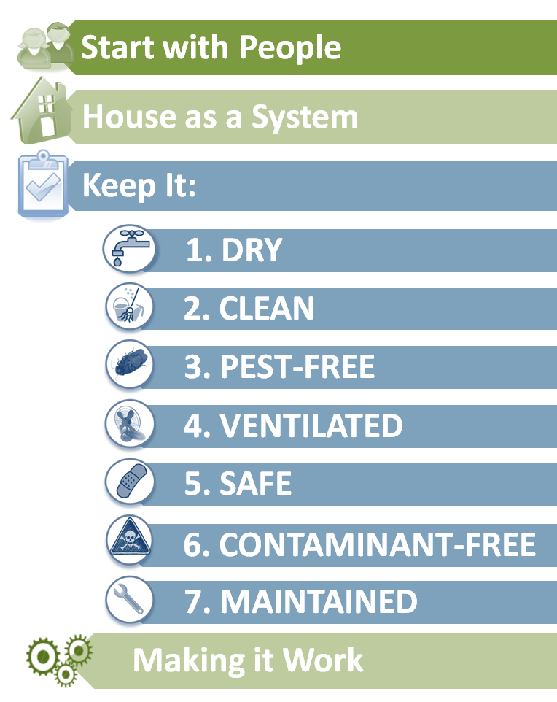
Start with people
Steps to Healthier Homes
Notes:
You need to start with people to have a healthy home. A home is only healthy if it works for the resident. And people come in all shapes and sizes with varying needs. For example, a child with asthma will have special needs that take special attention to the asthma triggers. For an elderly person, you need to be especially sensitive to the risk of falls.
This module explains how they can start with people.

Slide 2
Learning Objectives
EXPLAIN how to work with people to get important information from them about potential hazards in the home.
IDENTIFY key routes of exposure and their relationship to housing hazards.

Slide 3
Why do you go into houses?
Notes:
Ask the students why they go into houses to help identify the different purposes and motivations. Discuss how that changes the dynamic and relationship.
For example, a nurse is going to provide care and is usually a trusted resource. A home inspector is paid to identify problems in the sale of a house. When a home is being sold, there are opportunities to make important repairs. A code inspector is responding to a complaint and may be seen as government and not trusted by the resident.
Let the discussion flow but don’t dwell too long on this slide. The next slide will provide focus for the discussion.

Slide 4
Why Start with People?
What good are they?
What’s difficult about people?
How can you deal with people?
Notes:
Usually this slide gets a chuckle from the audience. But after the chuckles die down, ask them to seriously consider what role people serve. They are a source of information about the home. They can point out problems that occurred in the past and may only be obvious at night (like pests).
You need to recognize the resident’s agenda. They usually have a story that they want to tell. Until they tell the story, they may not be able to listen. The story may be a battle with a landlord or frustration with a contractor. They need to listen and then as questions.
You can also ask the students to identify when the resident can be difficult often giving a biased view of an issue. Usually the nurses have some good stories to tell that will help during the rest of the course.
Wrap up this slide with a discussion of the different ways to get the information you need. The next two slides will provide two specific strategies they should consider.

Slide 5
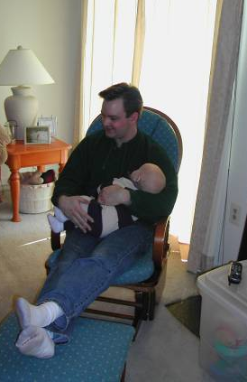
Open v. Closed Questions
Open-Ended or Indirect
How
What
Tell me about
Describe for me
Closed-Ended or Direct
Are
Is
Do
Notes:
Closed-ended or direct questions are likely to get yes or no answers. These answers often miss the detail that help get at information you need to know.
Open-ended questions are more likely to get more details. These details can help you understand hidden problems or past problems that may be hard to see.
You should note the challenge of checklists. Checklists naturally are based on closed-ended questions. The box either gets a check or it does not. If the student relies on checklists, they are likely to miss important information.
You may want to note that the problem is especially difficult with research projects since the researcher wants to structure the interview in a structured way. The structure may limit opportunities for discussion. It is not a problem that is easy to fix so acknowledge the conflict and move on to the two strategies.

Slide 6
Bracketing
Method to:
Stay Calm and Non-Judgmental
Keep Ability to Listen
Notes:
The first strategy is bracketing. Bracketing is an internal technique for staying calm and non-judgmental, and keeping the ability to listen and to coach. Here’s what can get bracketed:
1. The negative feelings and critical statements communicated to you by others.
2. Your negative feelings and judgments of others.
Bracketing means to put a temporary container around negative feelings and thoughts so that they can be safely examined and explored. It's like putting something in a clear plastic container for awhile so that you can discuss with someone what it means and what to do about it, while you continue to work together and keep a sense of humor.
Health service inequities may result from differences in expectations, assumptions, knowledge, and in perceived values that individual workers and residents may have. Recognizing when these differences affect one's ability to provide services is an important step in recognizing potential service disparities. Always consider the question: What barriers are preventing me from providing information to a client in the best way possible?
You may want to explain that people can be very good a reading your expressions. You may think you are carefully hiding your impression but they often can see it. A person who is illiterate has survived by reading expressions. Bracketing can help you acknowledge and move on rather than trying to hide it.
Example: You are in a residence providing a lead hazard evaluation. The house is a mess and you see lots of alcohol bottles around.
Your internal thought: I'm starting not to like these residents - they are so messy, there is dust everywhere and it looks like they drink a lot. They don't seem to care one way or the other about lead.
Internal Bracket: [Your negative feelings about the residents; your judgments about their cleaning and lifestyle.]
Your revised internal thought: I may have negative feelings about these residents, but they may really need my coaching. Besides, they may not know that dust may be a lead hazard, or where the hazards can come from.
Your Verbal Response: "Would you like to sit down with me and find out what sorts of potential lead problems we found in your home?"
Result: You put aside (suspend) your feelings and judgment, and lay the foundation for the coaching partnership by proceeding with the non-judgmental assessment.

Slide 7
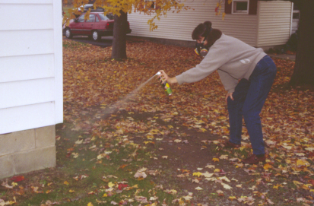
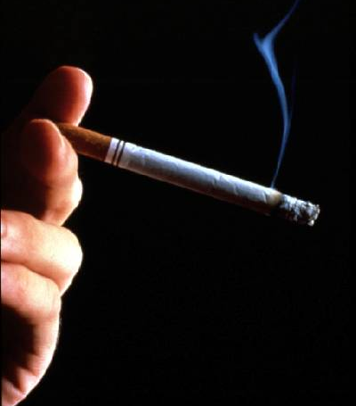
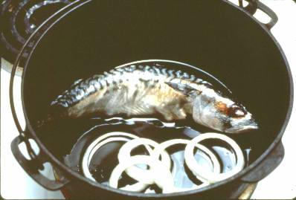
Notes:
Many of the hazards people are exposed to in their homes are the result of sources that they bring in themselves and are used within arm’s reach. ^{[1]} Some examples: Tobacco smoke is an important contaminant source in indoor air. From the “Harvard 24 cities project” we know that children who have a smoking parent are three times more likely to have respiratory symptoms than children who live with non-smoking parents. ^{[2]} Frying foods releases large numbers of fine particles – a range hood helps to reduce their spread. ^{[1]} Pesticides used in the home are the largest pesticide exposure to US citizens. ^{[1,3]}
While these activities are common, sometimes people do fairly odd things in their homes that result in hazards including:
Melting and casting lead
Injecting molding plastics
Welding
Barbequing indoors
This slide can help you identify resident behaviors that are important to consider. For example, most residents know that smoking is a problem. Often they will explain that they do it outside. But you can see ashtrays around the home. They are hiding the truth.
The person spraying the pesticides – most likely to deal with wasps – misunderstands the danger. She is wearing a respiratory but no gloves. With her finger on the nozzle, it is the most likely route of exposure.
For the frying food, they may not realize that along with the smell of frying goes particulates that may particles that may irritant the lungs of some people. It is not that the activity is dangerous but it can be a problem for some people. And this is the Start with People module afterall.

Slide 8
Special Communication Issues
Language
Cultural
Shoes in the Home
Men and Women
Responding to Problems
Hoarding
Tolerance for Clutter and Pests
Notes:
Discuss the communication problems people have had. Ask them whether they have encountered the situations and let them tell some stories. Use the list above to prime the discussion but let people add more.
On the cultural issues, shoes are best left by the front door.
Highlight the cultural problems if the student is a man and the resident is a married woman. In some cultures, the woman cannot let people in.
For hoarding, acknowledge the challenge and discussion possible responses. It takes a sustained effort. A social worker is often particularly adept at dealing with the problem. A simple cleaning is usually not sufficient. The problem will recur. There are also support groups such as Hoarders Anonymous or Messies Anonymous.

Slide 9
Resident Choices
Health
Comfort
Cost
Notes:
Residents need to make difficult choices. Too often they need to balance their health, their comfort and the cost of the correction.
Use this slide to wrap this part of the module so you can move on.

Slide 10
What’s going on in the neighborhood?
Land use
Zoning
Services
Water
Sewer
Solid waste
Water supply
Notes:
In addition to identifying what is going on in the home, you need to understand what is going on in the neighborhood. Some neighborhoods have a history that predisposes houses to problems. Houses built on industrial, waste disposal or agricultural sites may have contaminants in the soil.
Where do people get their drinking water? Where does the sewage go?

Slide 11
Routes of Exposure
Inhalation
Ingestion
Skin Absorption
Injection
Built-In Protection Mechanisms
Notes:
To understand how a contaminant can hurt a resident, you need to understand the primary routes of exposure. The Contaminant Guide in the references (or front pocket) of the course materials can help here.
Normally, inhalation is the most important route of exposure. The resident cannot avoid breathing. And what enters the lung can be directly absorbed into the blood through the alveoli, especially if it is a solvent or volatile organic compound. In addition, the lung has limited ability to repair damage. The body defends the lung with mucous and hair in the nose and cilia in the bronchi. The cilia collects the contaminant and moves it up the lungs until it is dumped into the throat where it is swallowed or coughed up.
Smoking paralyzes the cilia. So particulate and other contaminants penetrate the lung deeper. That is why the risk is greater for radon and asbestos for smokers. When the smoker stops smoking for awhile – like when they are sleeping – the cilia “wake” back up and dumps the collected material in the throat. The smoker wakes with the characteristic “smokers hack.”
Ingestion is typically less important than inhalation but still significant. People can usually avoid ingesting contaminants by washing their hands and wearing gloves. But children paly on the floor and suck their thumbs. So ingestion is a bigger worry for them. The stomach protects itself with acids that digest the contaminants. However, for some contaminants like lead, the acid dissolves the lead so it can be more easily absorbed. Finally, the stomach can repair itself regularly replacing its inside lining.
Skin absorption is relatively uncommon especially in the home environment. Few chemicals can be absorbed through the skin. Usually these chemicals are found in harsh cleaning products or in hobbies. Phenol and methanol are examples.
The skin repairs itself by regularly replacing itself. This will occur unless it has been irreversibly damaged. Irreversible damage can occur when exposed to a chemical labeled “corrosive.”
Injection is very unusual but when it occurs it can be serious. It can occur with splinters. Splinters from treated lumber, especially lumber from before 2004 that may be treated with arsenic, are a common route of injection. They should not be a problem if the splinter is entirely removed.
Built-in protection mechanism such as cilia and stomach relining help the body protect itself from contaminants. Wrap-up with the key point that risk requires exposure to a contaminant. If you reduce exposure, the person will have less risk and be safer.

Slide 12
Housing Related Disease
Signs and Symptoms
Signs are objective
Blood pressure, heart rate, peak flow
Bloody nose, rash
Symptoms are subjective
Back pain, fatigue, headaches
Some can be a combination
Shortness of breath
Notes:
How would you be able to start to detect signs and symptoms of diseases related to housing?
First, signs of disease are things you can measure or an outside observer can see, and therefore are more objective. Examples of things you can measure include blood pressure, heart rate, and peak flow meter measures if you are visiting someone with asthma. It can also include observations of the person, like seeing evidence of a bloody nose or a rash. It can also include your physical examination of the person if you would normally do that.
Symptoms of disease are things experienced and described by the person and therefore are more subjective. Examples include back pain, fatigue, headaches, etc.
There are some examples that are both a sign and symptom, something like shortness of breath, which can be observed sometimes and described by the patient.
None are more important than others in determining a relationship between housing and health issues.

Slide 13
Housing Related Disease
Signs and Symptoms
Timing
Location
Corroboration
Notes:
Timing and corroboration become important when trying to tie a sign or symptom to an environment.
Timing becomes crucial since most people will describe a connection between a certain time of day or certain environment. Do the signs and symptoms occur at the same time each day? The same place each day? Is there a seasonality, where they only occur in certain times of year, which may rule it out housing if it is more related to outdoor pollens, but may rule in housing if during rainy season the roof leaks and leads to more mold growth in the house.
Corroboration becomes important also. Are there other people with the same signs, symptoms and timing? This is not crucial to identifying a housing related health problem, but does offer more evidence to suggest one exists.
Lastly, do these symptoms resolve after the person leaves the environment? This again goes to timing and location of when signs and symptoms occur and that they are not always present.
Use the example of carbon monoxide. People may experience high levels in the morning when the gas furnace turns on to warm up the house or someone warms up the car in the garage.

Slide 14
Mental health
Poor housing conditions
Poor-quality multifamily homes
Lack of light
Dampness or mold and depression
Bed bugs
Notes:
Poor housing conditions, including crowding and inadequate lighting, are associated with risk for poor mental health.
Poor-quality, overcrowded, multifamily homes are associated with outcomes that include aggression and withdrawal, lower general health status (Dunn et al. 2004; Evans et al. 1996; Lepore et al. 1992; Regeoczi 2003), and psychological distress, particularly among women and children (Evans et al. 2001).
Lack of light (e.g., from inadequate number and placement of windows) is related to depression (Golden et al. 2005; Kripke 1998).
Although some studies have suggested an association of dampness or mold with depression (Shenassa et al. 2007), the Institute of Medicine concluded that evidence is insufficient to determine whether an association exists between either damp indoor environment or presence of mold and neuropsychiatric symptoms (Institute of Medicine 2004).
In its Joint Statement on Bed Bug Control in the United States from the U.S. Centers for Disease Control and Prevention (CDC) and the U.S. Environmental Protection Agency (EPA), CDC reports that bed bugs may also affect the mental health of people living in infested homes. Reported effects include anxiety, insomnia and systemic reactions. (Anderson A, Leffler K. Bed bug infestation in the news: a picture of an emerging public health problem in the United States. Journal of Environmental Health. 2008;70(9):24-7, 52-3.)

Slide 15
Don’t overlook or ignore housing conditions that may affect health.
Notes:
How can you identify the housing conditions that may affect health?
First, many people may recognize some signs and symptoms, but not be able to identify environments, because they are overlooked or ignored.
Many exposures are only found out about because someone asks.

Slide 16
Often OVERLOOKED
Sources of health problems
Lead
Was your home built before 1978? 1950?
Radon
Was your home ever tested for radon?
CO (Carbon Monoxide)
Do you have a carbon monoxide detector?
Notes:
Some problems in the home are often overlooked, mostly because you can’t see them or smell them so they are difficult to detect. Examples include lead, radon, CO.
For lead, a simple question about whether a home was built before 1978 should help determine if lead based paint could be present, since leaded paint was outlawed after that date. If the house is built before 1950, the likelihood of lead paint increased substantially since older homes had more concentrated amount of leaded paint. Lead paint has been associated with developmental delays and lower IQ in children exposed to it.
For Radon, simply asking about whether a home was ever tested for radon is crucial. Radon is an odorless gas that is the second leading cause of lung cancer.
For Carbon monoxide, asking if a resident has a carbon monoxide detector will potentially save someone’s life. Low dose chronic carbon monoxide exposure can also be a health hazard.

Slide 17
Often IGNORED
Sources of health problems
Environmental Tobacco Smoke
Does anyone in the family smoke?
Do they want help quitting?
Consumer chemicals
What cleaning chemicals do you use?
Where do you store them?
Pesticides
Any Pesticides used?
Which ones?
Notes:
Other potential sources of housing related health problems are one that people may be aware of in their home but are often ignored, such as ETS, consumer chemicals, and pesticides.
ETS, or environmental tobacco smoke, is a hazard that is brought into the home and is harmful to both the smoker and the people exposed through second hand smoke. Asking whether that person wants help with quitting is an essential first step to getting ETS out of the home permanently. Asking if anyone who visits the home smokes may also be important, and whether the people smoke outside (not just in the other room or with the window open) is crucial.
Consumer chemicals is a broad category, but generally just asking what chemicals are used in the home is an important first step. Asking about cleaning chemicals is good since many people may not connect the headache they get every time they use the ammonia to clean the kitchen floor. Asking where they are stored is important to prevent accidental poisonings from children. Other consumer chemicals include air fresheners which can have chemicals that cause cough and runny nose in sensitive individuals.
Lastly pesticide use is often a necessary evil if people are trying to get rid of pests, such as mice or cockroaches. Asking which chemicals are used, and if people do not know, having them ask the pest exterminator, can be a vital first step. Exposure from pesticides is much higher with sprays and bombs and are much lower with gels. Baits and even over the counter sprays, such as Raid, have pesticides, which many people may not realize.

Slide 18
Epidemiologic Triangle of Disease
Host
Transport Mechanism
Agent
Environment
Notes:
Use this slide to introduce the student to the epidemiologic triangle.
Most public and environmental health professionals think of disease in terms of this epidemiological triangle. This Epidemiological Model is an excellent tool that professionals use to analyze a complex situation. It identifies three groups of factors that combine to cause an adverse health affect (disease or injury). You might also think of this as the who, what, and where triangle of disease.
The HOST is the PERSON or the who.
The AGENT is the SOURCE or what, that can bring about changes in a person’s health: Agents of disease and injury can be biological, chemical, and physical.
The ENVIRONMENT is the WHERE or the place that one lives – the home environment. Environmental factors we will consider include geography, climate, type of community and factors of the home itself.
The TRANSPORT MECHANISM is any mechanism, direct or indirect, by which an agent is spread from the environment to the host. Transport mechanisms are either a VECTOR or a FOMITE. A transport mechanism ties the three factors together.
A VECTOR is an insect or any living carrier which transports a pathogenic microorganism from the sick to the well, inoculating the latter. A FOMITE is an inanimate object that transports the agent to the host.
In this course, we do not rely heavily on the epidemiologic triangle because the host is usually the resident and the environment is the home. With two legs established, it is simpler approach.

Slide 19
Learning Objectives
EXPLAIN how to work with people to get important information from them about potential hazards in the home.
IDENTIFY key routes of exposure and their relationship to housing hazards.

