Slide 1
Code Inspection for Healthier Homes
Notes:
Version 2.2

Slide 2
Learning Objectives
Describe the importance of a holistic code inspection to identify hazards
Describe the legal aid referral process and how to refer clients to other agencies for assistance and resources
Identify three types of codes that can be used to address health concerns
Notes:
The other agencies could include other legal resources as legal aid may not be an option in every jurisdiction.

Slide 3
Code Inspection Course Outline
Overview: A holistic approach to healthier homes
Code Enforcement Strategies to Handling Legal Concerns
Using Codes to Address Housing Hazards
Notes:
Insert objectives again at the end of the presentation to recap

Slide 4
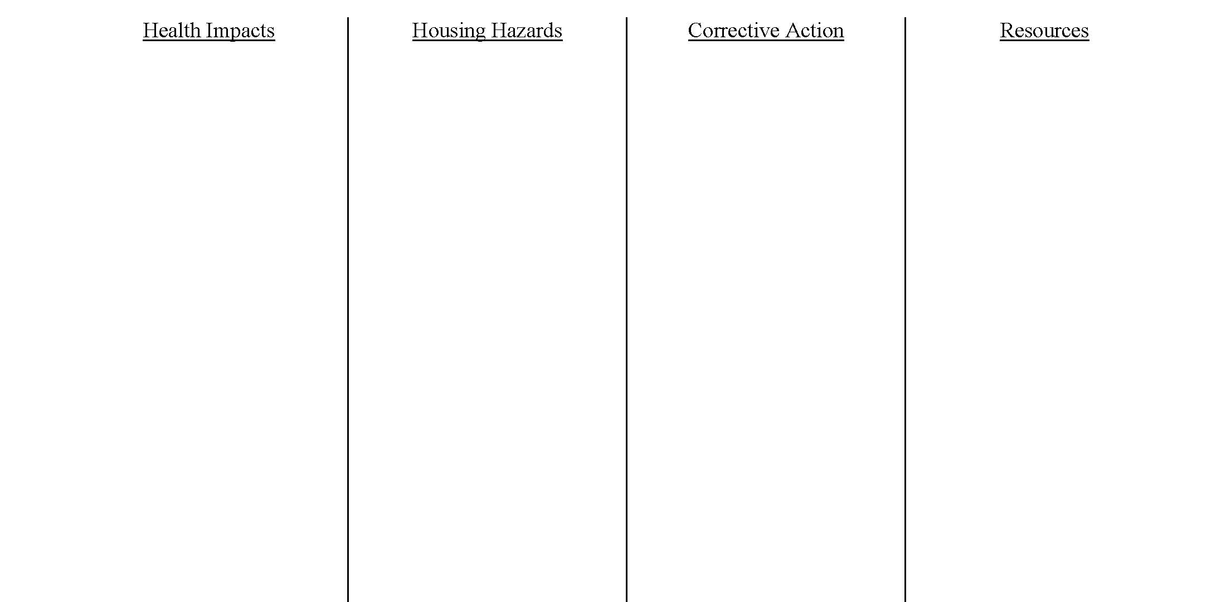
Exercise #1 Making the Connection
Notes:
Walk them through Exercise #1.
The instructor could have each student write out two answers for each column, then fill in the rest with the answers people share with the group. The instructor will write the answers on the white board or large post its placed on the wall in the shape of a T, as long as they are allowed to put the post its on the wall and use sharpies.

Slide 5
What is Healthy Housing?
Healthy Housing is:
Designed,
Constructed,
Maintained, and
Rehabilitated
In a manner that is conducive to good occupant health, safety and sense of well-being.
Notes:
This is the definition of healthy housing that the National Center for Healthy Housing uses. There is not statutory or regulatory definition. Note that the definition brings in occupant health – starting with people.
Very Important to mention the guiding principle (purpose) of codes…to preserve health, safety and sanitation of buildings.
Good time to connect the dots fort he students and have them discuss how the two guiding principles go hand-in-hand!

Slide 6
Guiding Principle of Codes
To preserve health, safety and sanitation of buildings.
How does this tie into the purpose of healthy homes? Make the connection.
Notes:
Engage them here by tying the definition of healthy housing back to the guiding principle of code enforcement

Slide 7
Different Approaches
HEALTH
Primary Prevention
Secondary Prevention
Epidemiologic Triangle
HOUSING
Well constructed
Well maintained
Comfortable
Affordable
Clean
Sanitary
ENVIRONMENTAL
HEALTH
Lead
Radon
Allergens/asthma
Combustion products
Unintentional Injuries
Insects & Rodents
Mold & Moisture
Pesticides
Asbestos
Notes:
Susan, please add different approaches to healthier housing as we are unable to do this because of the formatting.
Health and housing - why is it together? This slide shows the amount of overlap between health and housing, illustrating why bringing the two disciplines together is essential. Understanding the landscape can help you navigate your public agencies providing health and housing services.
Health in this slide refers to public health, as well as environmental health. Often environmental health is a department within the department of public health. However, it may also be a stand-alone department.
We have epidemiologic triangle under health, so this would be a good time to bring in the concepts of the triangle to make it more applicable and not so abstract. Instructors can use the example of the person who is allergic to animals including mice from exercise #4 in the Essentials course.

Slide 8
Holistic Approach
Integrated approach that considers:
People living in the home
The structure
Potential health hazards
Notes:
Today we are introducing a different way of thinking about the home environment. We are proposing that instead of using a categorical approach, we should be using a holistic approach. This is an integrated approach that considers the people living in the home, the structure, and the potential health hazards. Considering health and housing problems together in a coordinated way is more efficient and prevention-effective.
Healthy Homes programs offer a comprehensive and coordinated approach by promoting interagency collaboration, community participation, and cross training.
The holistic approach allows the CEOs as well as the occupants and landlords to be more proactive in improving building conditions, which will ultimately improve health of the occupants.

Slide 9
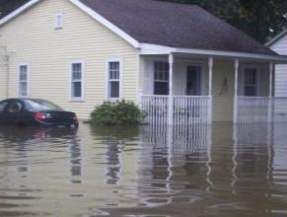
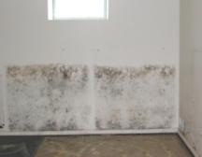
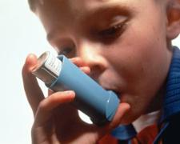
Moisture/water intrusion
Writing Citations for Healthier Homes-a holistic approach
Mold
Asthma exacerbation
Notes:
Let’s look at this concept in greater detail……………
Deb Millette of CDC developed these charts to emphasize the connections between the problems. Asthma exacerbation means trigger an asthma attack is a sensitized person. The next charts develop the connections.
Use these slides to reaffirm the connections developed from Exercise #1 and why a holistic approach is necessary.
Writing citations may help the code inspectors take a proactive approach to creating and maintaining healthy homes. For example, if you start with a moisture issue and the inspector issues a code citations, this may prevent the other issues from developing such as asthma symptoms, pests, lead deterioration, etc and promote better occupant health.
This is fine, but what are the exceptions, limitations, etc. of writing citations? We’ve heard a number of them mentioned such as citing a landlord versus an elderly person on a fixed income. Also, CEOs have indicated that often times the person responsible for the violations won’t respond until legal action begins, which often prolongs the process unnecessarily.
Instructors should be able to address this during exercise #3 (case studies) when they are determining who is responsible and what are the barriers for that individual. They could include exceptions, limitations for the CEOs as well.

Slide 10
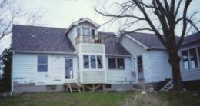
Moisture/
water intrusion
Structural damage
Notes:
Illustrate that one thing leads to other deteriorating conditions.

Slide 11
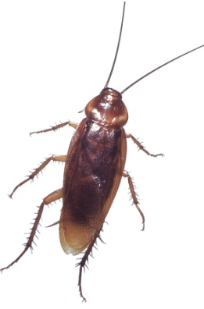
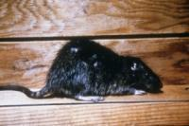
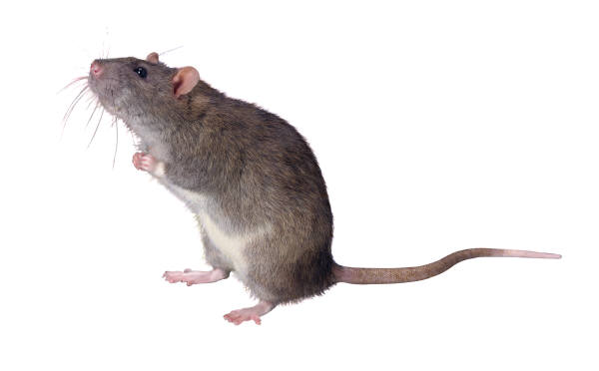
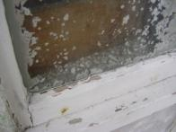
Structural damage
Pests
Deteriorated lead paint/
lead poisoning
Fire
Injuries
Notes:
Propose it as a question and then explain it: One thing leads to another…and another…and another…eventually to building failure. Has anyone ever heard of the TV series…Life after people? Explain it to the students.
It is a TV series where people are suddenly removed from the earth leaving everything behind such as pets and livestock to fend for themselves. What may occur when people discontinue the maintenance of buildings and urban infrastructure. Each episodes contains a segment in which they have looked at real locations that have been abandoned by people, ghost towns and the deterioration that results.
Show a clip of the TV series from You Tube if the instructor has access to Internet

Slide 12
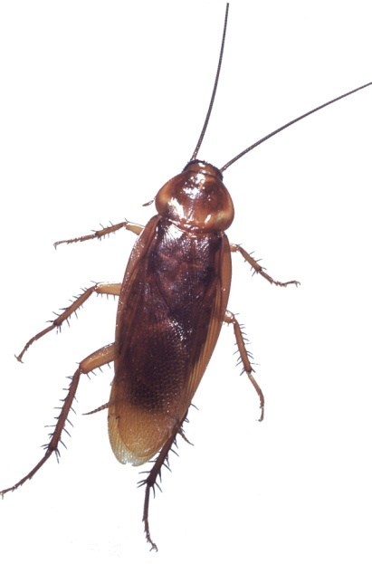
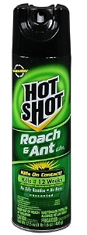
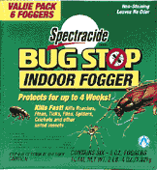
Pesticides
Pests
Asthma & allergy exacerbation
Notes:
Continue with the discussion that one thing leads to another. Here we have the presence of pests as a result of structural damage from moisture. With the presence of pests, pesticides are commonly used.

Slide 13
Pesticides
Notes:
Continue with the discussion that one thing leads to another. Because of the pests issue, pesticides may be used and lead to food contamination. The sprays in the photo would not typically be associated with Integrated Pest Management (IPM) because of the potential health and safety implications to occupants. We will discuss IPM in greater detail later.

Slide 14
Notes:
This chart is the summary of the previous slides. It is designed to be confusing – to show the interconnections from one particular hazard leading to many others. Which results in a web of problems.

Slide 15
Triangle of Disease and Injury
Who
Transport Mechanism
What
Where
Notes:
This would be good to help them understand the connection to health and how their practices could intervene in the transport mechanism and minimize or eliminate exposure to the occupants. We have removed the word epidemiologic” to make it less formal and confusing and changed it to the who, what, where triangle of disease and injury.
Most public and environmental health professionals think of disease in terms of this epidemiological triangle. This Epidemiological Model is an excellent tool that professionals use to analyze a complex situation. It identifies three groups of factors that combine to cause an adverse health affect (disease or injury). You might also think of this as the who, what, and where triangle of disease.
The HOST or PERSON is the who.
The AGENT is the SOURCE or what, that can bring about changes in a person’s health: Agents of disease and injury can be biological, chemical, and physical.
The ENVIRONMENT is where one lives – the home environment. Environmental factors we will consider include geography, climate, type of community and factors of the home itself.
The TRANSPORT MECHANISM is any mechanism, direct or indirect, by which an agent is spread from the environment to the host. Transport mechanisms are either a VECTOR or a FOMITE. A transport mechanism ties the three together.
A VECTOR is an insect or any living carrier which transports a pathogenic microorganism from the sick to the well, inoculating the latter. A FOMITE is an inanimate object that transports the agent to the host.
In this course, we do not rely heavily on the epidemiologic triangle because the host is usually the resident and the environment is the home. With two legs established, it is simpler approach.

Slide 16
Notes:
According to the CDC, 1 in 16 homes have high radon levels; 1 in 10 homes have water leaks; 1 in 6 have structural problems; 1 in 4 have lead-based paint and 1 in 4 have a non-working smoke alarm.
Think about the connections you just saw and how they all relate back to one hazard. The things we identified in the examples are basically your core healthy home principles
Think about the conditions or behaviors that may lead to these hazards in homes. Taking a proactive, holistic approach will allow the code enforcement officer to act on certain issues as soon as possible, eliminating other hazards from occurring in the first place. Which leads to the discussion of the core principles to healthy housing, keeping the home dry, clean, ventilated, pest-free, safe, contaminant-free, and maintained.

Slide 17
Healthy Homes Principles
Keep It:
Dry
Clean
Ventilated
Pest-Free
Safe
Contaminant-Free
Maintained
Notes:
Healthy homes is a systems level approach. We have few programs that look at the whole home environment and the total needs of a family. In this training, we are introducing a new way of thinking about the home environment – an integrated approach that considers the people living in the home, the structure, and the potential health hazards. Considering health and housing problems together in a coordinated way is more efficient and prevention-effective. Many of the core healthy homes principles are captured in the codes and regulations designed to protect residents.
“Healthy Homes” programs offer a comprehensive and coordinated approach by promoting interagency collaboration, community participation, and cross training. By design, we have recruited public health, housing, and environmental health and legal professionals. Healthy Homes” programs offer a comprehensive and coordinated approach by promoting interagency collaboration, community participation, and cross training. That is why we have convened this multi-disciplinary training.
What codes would help keep the home dry? What codes would help keep the home clean? Ventilated? Pest-free? Safe? Contaminant-free? Maintained? This is an opportunity for discussion with the participants.

Slide 18
Key Provisions of Codes
Structural Integrity
Weatherproof
Maintained
Cracks & Holes
Loose or Rotting Materials
Dampness & Deterioration
Peeling Paint
Ventilation / Windows
Infestation
Sanitation & Trash
Cleanability
Clothes Dryer
Space Heater
Notes:
The CEOs will most likely mention most of these provisions in the discussion on the previous slide. These are common provisions in a housing or a health code. Review the local code (if any) that NCHH gave you to give to students. You may have to do a little research to find the local code and to apply it to the course.
You must have a condensed or summary version of local codes as a requirement of each training.

Slide 19
Model Codes for Housing
Building Construction – Int’l Building Code
Residential Construction – Int’l Residential Code
Rehab – Int’l Existing Building Code
Electrical – ICC Electrical Code
Fire – Int’l Fire Code and National Fire Protection Association
Ventilation – Int’l Mechanical Code
Plumbing – Int’l Plumbing Code
Sewage – Int’l Private Sewage Disposal Code
All Existing Buildings – Int’l Property Maintenance Code
Notes:
These are the nation’s model codes as adopted by the International Code Council. See www.iccsafe.org. The IPMC is the most important one because it applies to all buildings, most importantly it applies to existing building. When a state or community adopt a model code, they often modify it – adding, deleting or changing the requirements.

Slide 20
Int’l Property Maintenance Code (IPMC)
Adopted in
More than 600 communities
Two states – New York & Virginia
Several states including Georgia & Oklahoma recommend it as a model for locals codes
Applicability
Existing Buildings
Rental and Owner Occupied Homes
Local Variations
Code Official Enforces
Notes:
Int’l Property Maintenance Code = IPMC
If the local jurisdiction has adopted the IPMC, make sure you mention it at this time. So, more than 600 communities have adopted the IPMC, include (state the name of the jurisdiction here).
Code official Enforces-make sure you mention this is dependent upon the humanity/understanding/sympathy of the CEO, this could evolve into a different scenario. It may cause the CEOs to act differently than they normally act.

Slide 21
Top Five Code Violations Cited
What are the top five code violations cited by inspectors in the city of Greensboro?
Who is generally cited for each violation?
Local Code violations-are they issue driven or holistic in nature?
Notes:
Do any of the CEOs use a current checklist when inspecting the home? Do they have a methodical process or are they using their eyes, ears, nose. If they don’t have an assessment process, how are they doing it, is it random, who taught them and why do they look for the things they are looking for? Are they only looking for the top 5 code violations? If so, they may be missing other issues. If they currently have an assessment checklist, it would be good to introduce it here and see how it applies to healthy homes. Maybe we should add a screen shot of the checklist here. If they don’t have one, we could add an example here. We could see if the city of Kansas City has one and add it here and use it only if they can’t provide one. Waiting to hear back from the CEO supervisor.
Ask the participants what the top 5 violations are for their area? Open this up for discussion. Instructor is responsible for collecting information for the top 5 code violations in the city where training is taking place, if available, and trainer can ask the host organization for the information as well. Use these examples to compare to the answers provided by the CEOs to see if there are differences and discuss.
Depending on the nature of the code violation, the occupant or owner may be responsible.
If you are called due to an issue on the outside of the home, is CEO able to perform an interior inspection? If not, would the top 5 violations be the same because of your accessibility to the interior of the home?

Slide 22
Exercise #2: Identify the Code Violations
Notes:
Be sure to rule out those aspects of healthy housing suggested that are not part of code enforcement. This includes neighbor complaints of use of the building (business, parking on lawn, late night parties, noise, etc), blocking neighbors’ view of landscape, etc. These are Zoning issues not property maintenance, so if the participants mention these, direct them to back to healthy housing aspects of the code.
For this exercise, the instructor could ask the local organizations if they can provide pictures from actual homes in their areas that have been cited for code violations. 6-7 interior and 3-4 exterior for a total of 10 pictures could be obtained in advance and made into copies like we use for the other HH courses if possible. Then, the instructor would have the CEOs identify the potential code violations by using the local codes when applicable.
Photos should include as many code violations as possible.

Slide 23
American Housing Survey
Conducted:
Every two years since the 1980s
Periodically for 46 Metropolitan Statistical Areas (MSA)
Consistent set of homes
Phone survey since 1997
Notes:
An overview of the American Housing Survey. See www.census.gov/hhes/www/housing/ahs/ahs.html. As we discussed, if you can get local data, you can always use that for these slides and if not, the national data would be used. If the local AHS data is available, the CEOs can see how it matches up with the top 5-10 code violations. Have a copy of the most current AHS for them to look through on a break, you don’t have to provide a copy to each student. They will have the information if they want to visit the website and print it out for themselves.
Summary of AHS:
Page 1 - General Description of Housing (including year built and type of foundation)
Page 2 - Exterior Problems (including exterior water leakage)
Page 3 - Interior Problems (including interior water leakage, rodents, and electrical)
Page 4 - Sanitation/Water Problems & Safety Devices
Page 5 - Heating/Fuel (including main heating, water heating, clothes dryer, problems)
Page 6 - Selected Physical Problems & Overall Opinion of Structure
Page 7 - Overview and Key Definitions
Page 8 - More Definitions. Note the tests for holes in floors and open cracks at end
Page 9 - Rating System. Help the students understand what moderate and severe physical problems means. These homes have serious problems.
Page 10 - Potential Errors in AHS. Help the students understand that a high level of inconsistency means that they need to use caution using these numbers as being too precise.
Page 11 - Potential Errors in AHS (cont.). Note that people know whether their clothes dryer is gas or electric.
Page 12 - Table Showing Relationship Between Interior and Exterior Problems
Page 13 - Explanation of the Table.

Slide 24
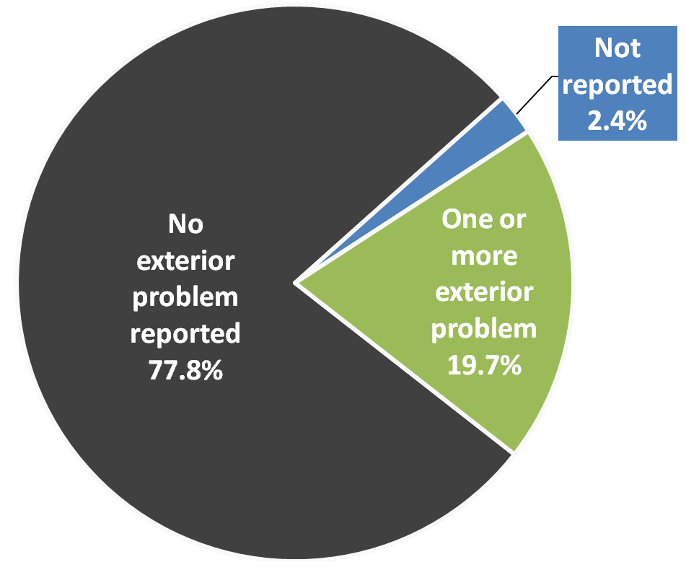
Exterior Physical Condition
Occupied housing units, 2009 American Housing Survey
Exterior condition | % among total # of units
Missing roofing material | 5.2%
Broken windows | 3.3%
Missing outside wall material | 2.6%
Foundation crumbling/crack/hole | 2.5%
Sagging roof | 2.1%
Hole in roof | 1.6%
Sloping outside walls | 1.3%
Boarded up windows | 0.9%
Notes:
As we discussed, if you can get local data, you can always use that for these slides and if not, the national data would be used. If the local AHS data is available, the CEOs can see how it matches up with the top 5-10 code violations. Have a copy of the most current AHS for them to look through on a break, you don’t have to provide a copy to each student. They will have the information if they want to visit the website and print it out for themselves.
Exterior physical condition of homes
19.7% of homes have some physical condition contributing to leaks
Overall:
2.1% have sagging roof (10.7% among those with one or more problems)
5.2% have missing roofing material (26.2% among those with one or more problems)
1.6% have hole in roof (8.2% among those with one or more problems)
2.6% are missing bricks siding or other outside wall material (13.1% among those with one or more problems)
1.3% have sloping outside walls (6.6% among those with one or more problems)
0.9% have boarded up windows (4.6% among those with one or more problems)
2.5% have foundation crumbling or has open crack or hole. (12.6% among those with one or more problems)
From American Housing Survey – 2009
Note that this excludes multi-unit housing (so you have to subtract those homes from the denominator) and that since conditions are not mutually exclusive (e.g., one can have both broken windows and missing roofing material), the numbers in the table do not sum to 100%.
Discuss and confirm these numbers with attendees. What is different and why? - LG

Slide 25
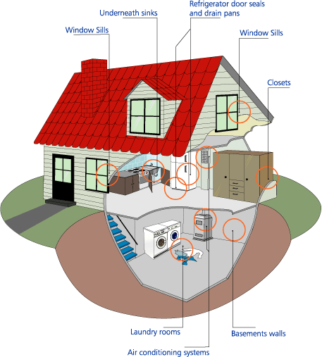
Dampness and Mold
Important to focus on moisture issues rather than on mold (No moisture = no mold)
What happens to callers who are concerned about or mention mold?
Associated commonly with leaks or surface degradation, which are code violations
Is this always a landlord citation, or can tenants be cited as well? Examples?
Notes:
This illustration is to discuss the common locations where mold is found. It is important to mention that mold is the end result of a moisture issue or may be due to inadequate ventilation. The prior two are examples of code violations, unfortunately mold is NOT. It is simply the health hazard caused by the code violation. We cannot call it a code violation any more than we could call fire a code violation.
We’ve had the discussion in both trainings regarding how “mold” calls are passed around and who (what department) ultimately handles these types of issues. As mentioned above, it should always be referred to as a moisture-related issue.

Slide 26
IPMC Requirements Related to Moisture
302.2 Grading and drainage. All premises shall be graded and maintained to prevent the erosion of soil and to prevent the accumulation of stagnant water thereon, or within any structure located thereon.
304.7 Roofs and drainage.
The roof and flashing shall be sound, tight and not have defects that admit rain.
Roof drainage shall be adequate to prevent dampness or deterioration in the walls or interior portion of the structure.
Roof drains, gutters and downspouts shall be maintained in good repair and free from obstructions.
Roofwater shall not be discharged in a manner that creates a public nuisance.
Notes:
From IPMC – See page 9 of 48 in Reference Tab Codes Section
If local codes are available, the instructor would used the local codes applicable to moisture in these slides.
In thinking about situations such as the ones in the photo with the tarp, ask the CEOs what would cause the codes inspector to condemn the property or deem it uninhabitable until structural evaluation and repairs are made?

Slide 27
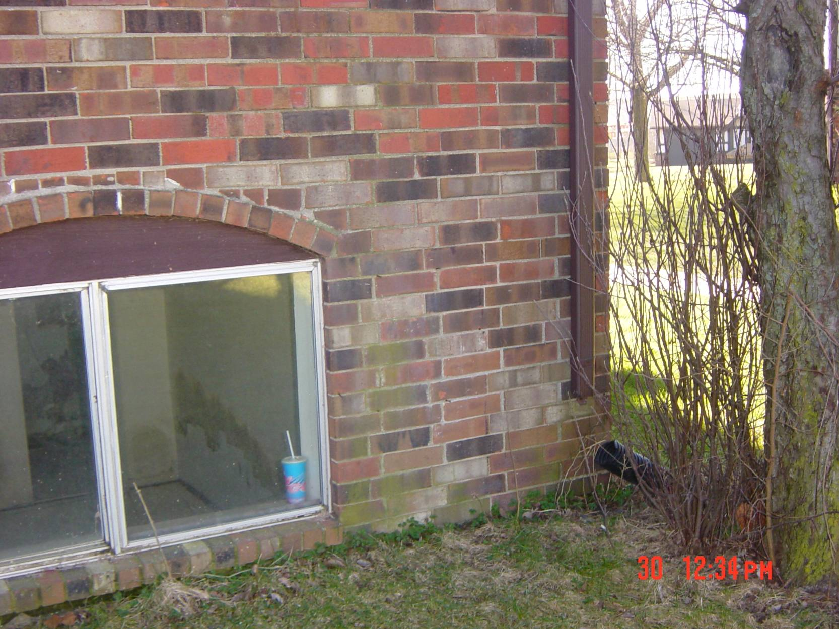
Notes:
The green discoloring on brick may not be mold but moss. Moss is a very simple plant that lacks conventional roots, stems, and leaves. Because of its lack of these traditional components, its growth is limited to moist locations. But if this criteria is met, you’ll find that moss is very capable of growing anywhere it pleases. Mold is a fungus that is made up of multiple cells and gets energy from the organic matter it lives on. Mold reproduces in spores, which can be airborne and are not visible to the naked eye. When you can see mold on a house or sidewalk, you are seeing a “colony.” A colony is a single organism that grows in long branching cells called hyphae.
We mention a number of other things taking place in the slide as well:
Visible mold on inside wall
Lack of weep holes or that they are covered up
Brick façade in contact with ground
Disconnected extension tube on the downspout
Large tree adjacent to building foundation (footings)

Slide 28
IPMC Requirements Related to Moisture
304.6 Exterior walls. All exterior walls shall be free from holes, breaks, and loose or rotting materials; and maintained weatherproof and properly surface coated where required to prevent deterioration.
304.2 Protective treatment.
All exterior surfaces, including but not limited to, doors, door and window frames, cornices, porches, trim, balconies, decks and fences shall be maintained in good condition.
Exterior wood surfaces, other than decay-resistant woods, shall be protected from the elements and decay by painting or other protective covering or treatment. . . .
All siding and masonry joints as well as those between the building envelope and the perimeter of windows, doors, and skylights shall be maintained weather resistant and water tight.
Notes:
If local codes are available, the instructor would used the local codes applicable to moisture in these slides.

Slide 29
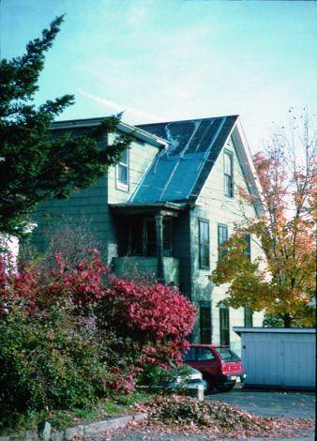
Notes:
What violation(s) are present in this photo?
Again, if we could use local pictures, that would be even better.
Issues in the picture:
Flat roof draining onto pitched roof surface (where the blue tarp is located) may be increasing deterioration of roof surface
Cannot see flashing to the left of the tarp adjacent to the exterior dormer wall
Where is the drainage for the small, flat roof that appears to cover a porch
Vegetation and brush adjacent to and in contact with building exterior
Can students identify any damaged surfaces on the exterior or any with flaking paint

Slide 30
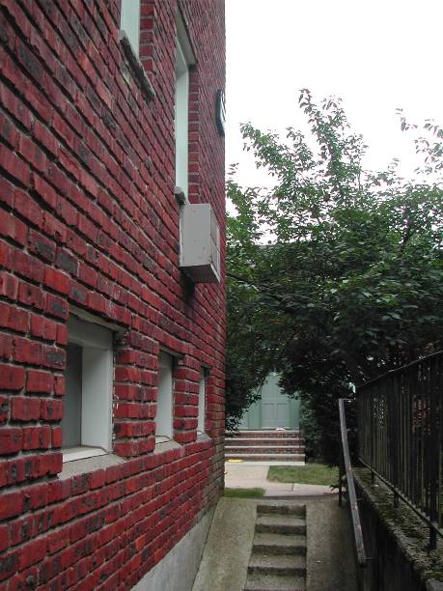
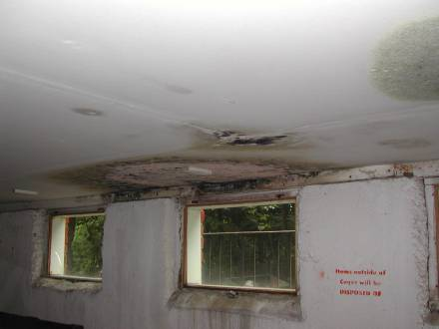
Air conditioner condensate drains into building
Notes:
The through-the-wall air conditioner tilts towards the wall. Condensate water from the cooling coil runs into the building rather than out of the building.

Slide 31
Interior Water Leakage
Sources of interior water leakage, 2009 American Housing Survey
Source of interior leak | % among total # of units
Leaking pipes | 3.4%
Fixtures | 1.9%
Broken water heater | 0.9%
Other or unknown | 2.1%
Notes:
As we discussed, if you can get local data, you can always use that for these slides and if not, the national data would be used. If the local AHS data is available, the CEOs can see how it matches up with the top 5-10 code violations. Have a copy of the most current AHS for them to look through on a break, you don’t have to provide a copy to each student. They will have the information if they want to visit the website and print it out for themselves.
Ask a question - What % of homes had interior water leakage in a 12 month period?
Answer: 8.1% (of 111 million homes) had interior water leakage in 12 month period.
Note that: Worse for renters (10.8%) and manufactured housing (9.3%). Almost 5% of homes built from 2005 to 2009 have interior water leaks (actual:4.8%) From American Housing Survey – 2009
Ask another question: How many homes does that 8.1% represent?
Answer: Remind people that there were 111 million homes in 2009. 8.1% is 8.9 million.
Among the total number of occupied housing units:
3.4% had leaking pipes
1.9% had leaks associated with fixtures
0.9% had a broken water heater
2.1% had another problem or an unknown problem
Among the 8.1% that HAD an interior leak:
42.3% had leaking pipes
23.8% had leaks associated with fixtures
11.6% had a broken water heater
26.1% had another problem or an unknown problem
Note that since conditions are not mutually exclusive (e.g., one can have both leaking pipes and a broken water heater), the numbers in the table do not sum to 100%.
Again, confirm these numbers with attendees. If they are different, how and why?

Slide 32
IPMC Requirements Related to Interior Moisture
305.1 General The interior of the structure and equipment therein shall be maintained in good repair, structurally sound and in a sanitary condition.
Occupants shall keep that part of the structure which they occupy or control in a clean and sanitary condition.
Every owner of a structure containing two or more units shall maintain in a clean and sanitary condition, the shared or public areas of the structure and exterior of the property
305.3 All interior surfaces, including windows and doors, shall be maintained in good, clean, and sanitary condition.
Peeling, chipping, flaking or abraded paint shall be repaired, removed, or covered.
Cracked or loose plaster, decayed wood and other defective surface conditions shall be corrected.
Notes:
This is applicable to the next photo of the deteriorating bathroom floor

Slide 33
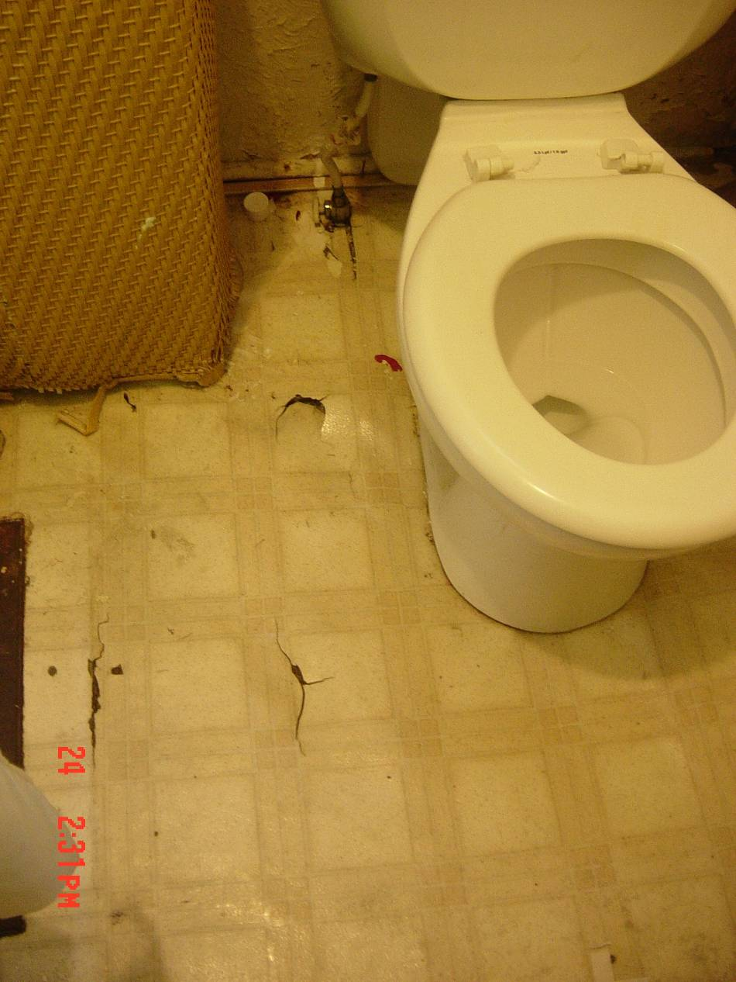
Notes:
How often are code inspectors inside the home vs. performing inspections from the outside? What prompts a code inspection for the inside of a home? If a code inspector isn’t able to get inside a property, how would they ever know these type of structurally unsafe
Would this situation cause the codes inspector to condemn the property or deem it uninhabitable until structural evaluation and repairs are made?
What appears to be the primary source of the moisture that has caused flooring deterioration (wax ring, supply line, or lack of caulking at base of tub/shower)?

Slide 34
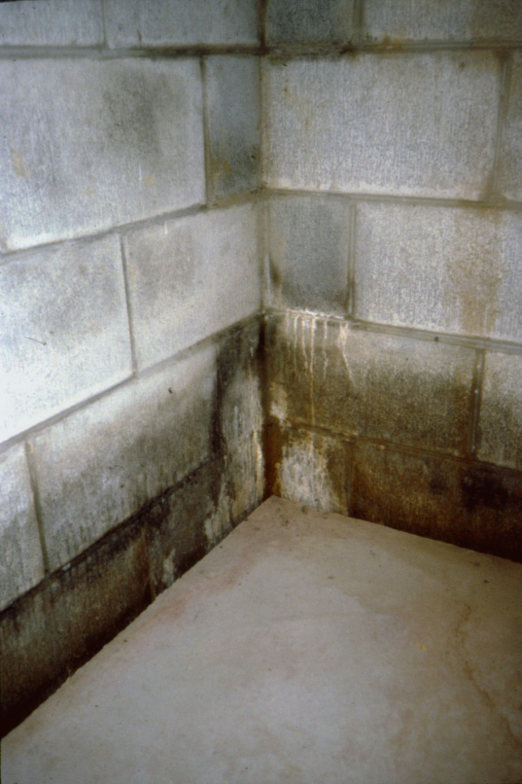
Notes:
If this is in a basement or ground floor, look for root causes of the moisture issue…where is water coming from? Could it be that the other side of the concrete block wall was not water-proofed or sealed properly? Is the earthen side of the wall protected but there is inadequate drainage at the base of the wall? Is water building up at the base on the other side? How could you fix this problem? Could you drill holes through walls and floor and collect with a sump pump?
What about an explanation for why the water stains only extend a certain height and how the moisture migrates to this height?
The water is “wicked” up the block wall via capillary action and can only travel so high up the wall before the weight of the water column and gravity prevent it from going any higher.
Also, are the stains biological, mineral or something else?
The dark-colored stains present near the floor are most likely biological in nature (mold, algae, bacteria, or some combination of the three), while the white, chalky substance located a little higher on the wall is called effluourescence, which is mineral residue that results when the water evaporates and leaves mineral deposits behind.

Slide 35
Safe and Healthy Cleaning
Pesticides, allergens, and general chemicals in the home can cause allergic reactions, asthma and asthma exacerbation, and toxic exposure effects.
Potential sources of allergens and contaminants in the home come from outdoor and indoor sources.
Keeping a home clean includes controlling the source, creating smooth and cleanable surfaces, reducing clutter, and using effective cleaning methods.
Notes:
In this module emphasize that cleaning is important. But an essential aspect of Keeping It Clean is that it be cleanable. Many surfaces are tough to clean. And corners and cubbyholes are tough to clean too. You could say that the goal is to keep it clean AND CLEANABLE.
These are steps to reduce household hazards. People are not born knowing that they must brush their teeth to prevent decay, they must learn it. So with household hazards, they must learn how to take care of themselves. Occupants know things about the building and themselves that can be learned nowhere else. Start with the people.
The second step is to keep the household in a certain condition:
limit moisture related problems,
limit dust and allergens,
limit pest borne disease,
provide local exhaust ventilation and general dilution ventilation to control unavoidable air contaminants,
provide a comfortable space by limiting hazards like slips, falls, electric shock, drowning and poisons.
Third, limit sources of contaminants like lead, asbestos, combustion fumes, VOCs (Volatile organic compounds) and radon.
Fourth, maintain the house so it continues to provide dry, clean, comfortable and safe conditions.

Slide 36
Healthy Cleaning
Don’t dry dust or dry sweep
Vacuuming:
Low-emission vacuum with beater bar
Very slowly (or use vacuum with dirt finder)
Wet cleaning:
Use “elbow grease”
Frequently change water
Notes:
It is best to avoid dry dusting or sweeping. You should use a damp cloth for dusting and mist the floor for broom sweeping.
When vacuuming, it is best to use a low-emission vacuum that has a beater bar and vacuum slowly.
It is often better to use wet cleaning methods than dry dusting. It is important to use good technique and “elbow grease” when wet cleaning. In fact it may be more important than what type of product you use. Make sure that you do not contaminate the wash water and frequently change the rinse water and cleaning rags.

Slide 37
Make buildings more cleanable
Dust walk-off systems at entryways
Dust-creating activities away from people.
Smooth, cleanable surfaces
Effective storage space
Flooring that is easy to clean
Vacuums with good filtration and easy to use
Notes:
Here is a list of what we can do to make buildings more cleanable.
Install dust walk-off systems at entryways
Keep activities which create dust away from people.
Provide smooth, cleanable surfaces
Provide effective storage space (to help avoid clutter)
Choose flooring that is easy to clean
Use vacuums that have good filtration and can be emptied quickly and thoroughly

Slide 38
Code Requirements
Code requirements related to cleanliness
305.1
302.1
307.1
503.4
General
Sanitation
Accumulation of rubbish or garbage
Floor surface
Notes:
From the International Property Maintenance Code
Review quickly but raise the question about different interpretations of clean and sanitary.
305.1 General.
The interior of a structure and equipment therein shall be maintained in good repair, structurally sound and in a sanitary condition.
Occupants shall keep that part of the structure which they occupy or control in a clean and sanitary condition.
Every owner of a structure containing a rooming house, housekeeping units, a hotel, a dormitory, two or more dwelling units or two or more nonresidential occupancies, shall maintain, in a clean and sanitary condition, the shared or public areas of the structure and exterior property.
302.1 Sanitation.
All exterior property and premises shall be maintained in a clean, safe and sanitary condition.
The occupant shall keep that part of the exterior property which such occupant occupies or controls in a clean and sanitary condition.
307.1 Accumulation of rubbish or garbage. All exterior property and premises, and the interior of every structure, shall be free from any accumulation of rubbish or garbage.
503.4 Floor surface. In other than dwelling units, every toilet room floor shall be maintained to be a smooth, hard, nonabsorbent surface to permit such floor to be easily kept in a clean and sanitary condition.

Slide 39
Pests and Pesticides
Pests/pesticides associated with variety of illnesses/diseases
Pests are a common (and contentious) issue in public housing
Who’s responsible for what?
Codes may include; insect screens, solid waste management, responsibility for pest management and control, etc.
Misapplication or application of pesticides by non-licensed professional is violation of the law
Notes:
Go over the main causes of insect accumulation…available food and water and living conditions.
Pests/pesticides associated with variety of illnesses/diseases-have the students name illnesses/diseases at this point or refer back to exercise #1 and the illnesses/diseases that were discussed.
Malaria. The foremost disease carried by insects is malaria.
Arboviruses. These diseases are caused by viruses that are biologically transmitted by the bite of mosquitoes.
Plague. Fleas are the vector for the plague (or black death), which infects man as well as rats and other rodents.
Enteric diseases. There are many bacterial diseases that are transmitted by some form of fecal contamination of food or water, either directly or indirectly.
Lyme disease. This disease is caused by an arachnid, the deer tick, which carries a bacterium called Borrelia bugdorferi.
Sleeping Sickness.
American Trypanosomiasis. This disease is also known as Chagas' Disease and invades the muscle cells of the digestive tract and heart, and sometimes also the skeletal muscle.
Who’s responsible for what? The code places responsibility on the tenant for maintaining conditions that do not attract vermin but with the owner to establish rules requiring tenant to maintain sanitary living conditions.

Slide 40
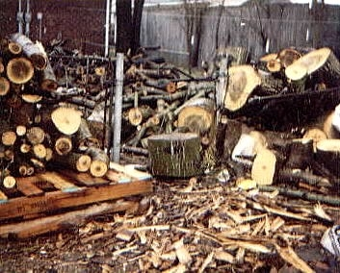
Notes:
Does this violate any codes? If so, which one(s)? What primary hazards need to be addressed? Safety and rodent hazards.
Is there a local code for wood storage? If so, how high off the ground do local codes state wood should be stored off the ground? What document cites 18” as the minimum height off the ground wood must be stored? Confirm the code for the area in which you are teaching as it seems to be different depending on the location.

Slide 41
IPMC Requirements Related to Pests
EXTERMINATION. The control and elimination of insects, rats or other pests
by eliminating their harborage places;
by removing or making inaccessible materials that serve as their food;
by poison spraying, fumigating, trapping or by any other approved pest elimination methods.
INFESTATION. The presence, within or contiguous to, a structure or premises of insects, rats, vermin or other pests.
308.1 Infestation.
All structures shall be kept free from insect and rodent infestation.
All structures in which insects or rodents are found shall be promptly exterminated by approved processes that will not be injurious to human health.
After extermination, proper precautions shall be taken to prevent reinfestation.
Notes:
Emphasize to students that Integrated Pest Management (IPM) is the preferred method of reducing or eliminating pests in a facility and that we are eliminating, generally not exterminating, pests in residences as this is safer and healthier for the occupants and has unintended benefits (moisture reduction, increasing energy efficiency). Exterminating generally implies the use of pesticides to kill such as poisons, foggers, sprays which can have unintended consequences to human occupants and pets.
Integrated Pest Management consists of:
Eliminating harborage sites (both inside and outside)
Sealing up any gaps, cracks, or other openings where pest can enter/exit the premises
Eliminate any food and water sources (primarily referring to inside the residence, however could involve the outside as well)
Targeted usage of baits, traps, and gels to minimize pests
Note: If infestation is severe, a pest management professional (PMP) may be required to knock down populations initially)

Slide 42
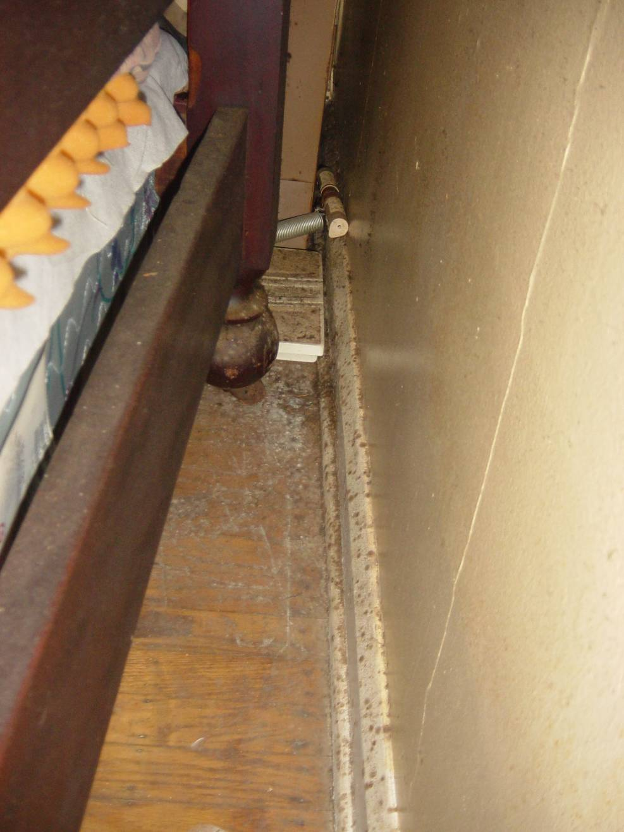
Notes:
What may be causing cockroaches to infest this area?
Insects like dark places out of the way. They are always there just out of our sight. Look behind furniture, in crawl space, attics and basements.

Slide 43
IPMC Requirements Related to Pests
302.5 Rodent harborage.
All structures and exterior property shall be kept free from rodent harborage and infestation.
Where rodents are found, they shall be promptly exterminated by approved processes which will not be injurious to human health.
After extermination, proper precautions shall be taken to eliminate rodent harborage and prevent reinfestation.
304.14 Insect screens.
During the period from [DATE] to [DATE], every door, window and other outside opening required for ventilation of habitable rooms, food preparation areas, food service areas or any areas where products to be included or utilized in food for human consumption are processed, manufactured, packaged or stored, shall be supplied with approved tightly fitting screens of not less than 16 mesh per inch (16 mesh per 25 mm) and every swinging door shall have a self-closing device in good working condition.
Notes:
This focuses on one of the principles of IPM…eliminating harborage sites for pests.

Slide 44
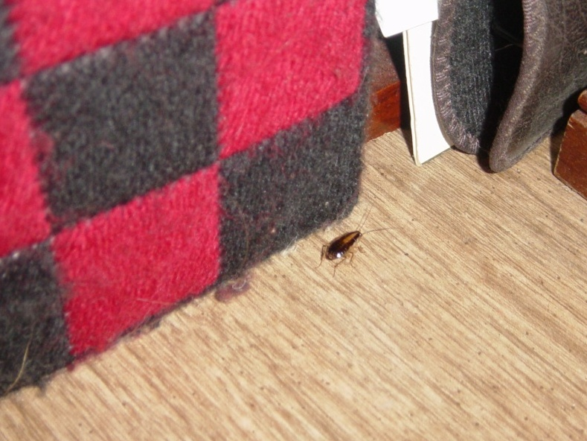
Notes:
Why is seeing a cockroach running across the floor during the daytime such a concern? What does it mean?
The photo of the dirty kitchen emphasizes the importance of daily cleaning, especially in areas where food is stored, prepared, or eaten to prevent pest infestations from occurring.

Slide 45
IPMC Requirements Related to Pests
308.2 Owner. The owner of any structure shall be responsible for extermination within the structure prior to renting or leasing the structure.
308.3 Single occupant. The occupant of a one-family dwelling or of a single-tenant nonresidential structure shall be responsible for extermination on the premises.
308.4 Multiple occupancy. The owner of a structure containing two or more dwelling units, a multiple occupancy, a rooming house or a nonresidential structure shall be responsible for extermination in the public or shared areas of the structure and exterior property. If infestation is caused by failure of an occupant to prevent such infestation in the area occupied, the occupant shall be responsible for extermination.
308.5 Occupant. The occupant of any structure shall be responsible for the continued rodent and pest-free condition of the structure.
Exception: Where the infestations are caused by defects in the structure, the owner shall be responsible for extermination.
Notes:
Ask attendees to describe any difficult or confusing situations regarding owner/occupant situations involving pests and how issue(s) was ultimately resolved?
This can be a very volatile issue and one may also be difficult to determine responsibility.

Slide 46
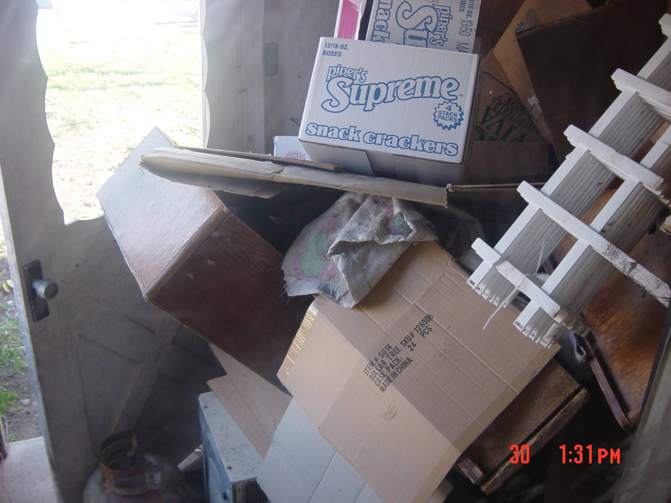
Notes:
What are the health and safety codes from a local perspective being violated in this photo?

Slide 47
Ventilation: What are we looking for?
Bath, dryer, and range exhaust fans?
Gas stove used as heater?
Windows work?
Smoke alarm goes off?
Unvented gas or kerosene heaters?
Vented hot water heater?
Furnaces, boilers, fireplaces vented?
Rooms without windows?
Lingering odors?
Stale air?
Windows fog?
Notes:
Local exhausts are easy enough to check – are they there, do they work? Because most residential buildings assume that operation of the local exhausts, wind and stack driven air flows, and operable windows provide enough general ventilation, it is more difficult to assess general ventilation. The simplest way to get an idea is to ask the occupant whether odors linger, windows fog during cold weather, or does the air seem stale?
Refer back to the conversation about checklists and what they are using to inspect the home (this is in the notes section of the top 5 citations).

Slide 48
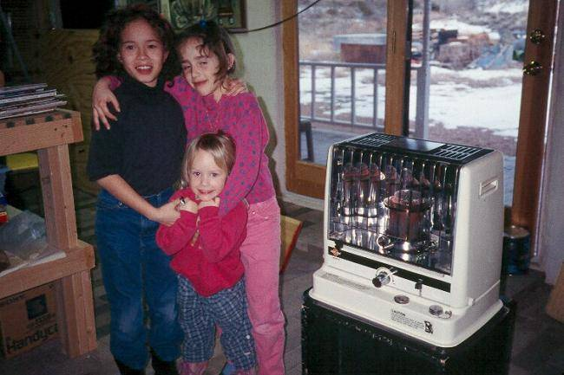
Notes:
Ask the CEOs what are their community’s codes related to operating a “ventless” combustion appliance inside a residence?
What are the primary health and safety concerns that can be identified in the photo?

Slide 49
Notes:
Ask what violations may exist in this photo? Again, what if the codes inspectors don’t have the opportunity to inspect the interior of a residence?
Asking whether or not the issue started at the top of the loose tiles or at the bottom, where the tile meets the tub usually stimulates good discussion.
What do students think about a shower being installed above the faucet? There may not be a shower installed above because of the window framing, which would make it difficult to install plumbing.
Why is window in the bathroom? Because it qualifies as ventilation under code. Will residents open this window in the winter to let steam out?
It may actually be a code violation to have the window this close to a water source.

Slide 50
Requirements Related to Ventilation
403.1 Habitable spaces.
Every habitable space shall have at least one openable window.
The total openable area of the window in every room shall be equal to at least 45 percent of the minimum glazed area required in Section 402.1.
403.2 Bathrooms and toilet rooms.
Every bathroom and toilet room shall comply with the ventilation requirements for habitable spaces as required by Section 403.1, except that a window shall not be required in such spaces equipped with a mechanical ventilation system.
Air exhausted by a mechanical ventilation system from a bathroom or toilet room shall discharge to the outdoors and shall not be recirculated.
Notes:
How do the above ventilation codes relate specifically to the previous slide?

Slide 51
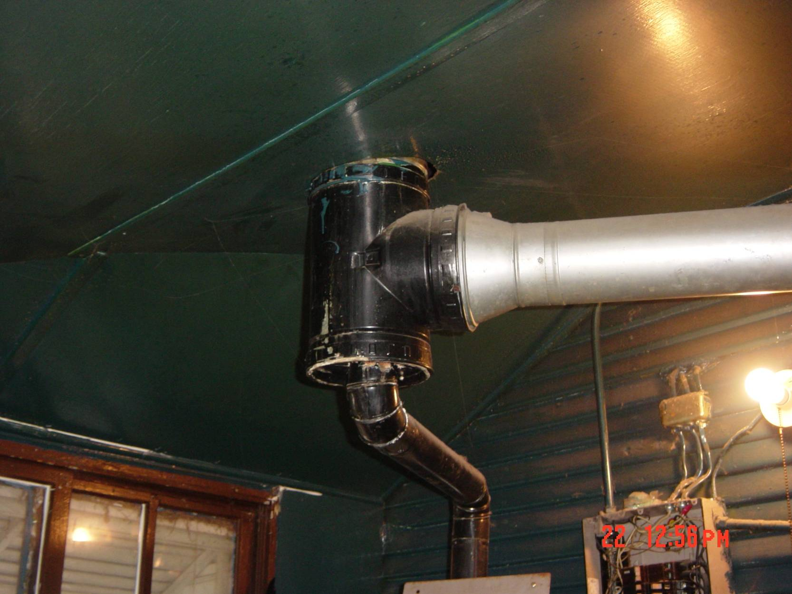
Notes:
Why does this violate codes and what code(s) are being violated?
Explain how and why the furnace exhaust (right) may overpower and prevent hot water heater exhaust from exiting the appliance/home. There may be a lot of discussion about this one. Both the water heater runs and furnace exhaust have flat runs (no rise to run ratio which should be 1 inch rise per 12 inch run).

Slide 52
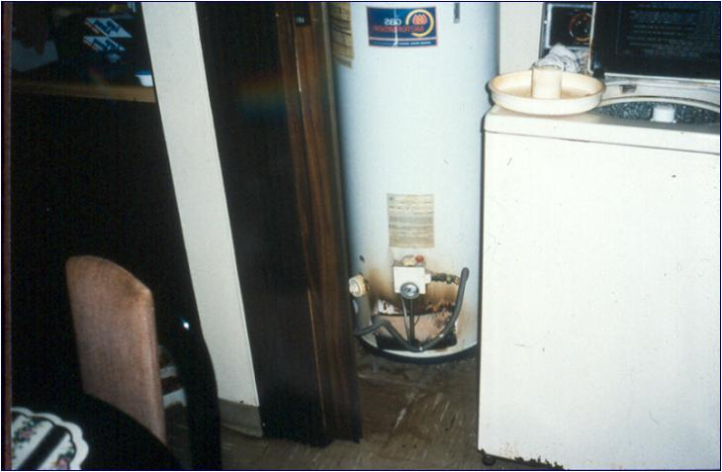
Notes:
Why does this violate codes and what codes are violated?
What could this homeowner/landlord be cited for?
Gas water heater is starved for combustion air, and when this make-up air is unavailable, it tries to pull air down the exhaust vent, which is called back-drafting or flameout.
Two primary causes why hot water heater is starved for air: closet doors are closed and or dryer being located in the same closet
Could relocate washer and dryer
Could added vents or louvers to closet doors or could always leave doors open
Could install an electric water heater as it does not need air for combustion.

Slide 53
Code Requirements Related to Ventilation
607.1 General. Duct systems shall be maintained free of obstructions and shall be capable of performing the required function.
505.4 Water heating facilities.
Water heating facilities shall be properly installed, maintained and capable of providing an adequate amount of water to be drawn at every required sink, lavatory, bathtub, shower and laundry facility at a temperature of not less than 110ºF (43ºC).
A gas-burning water heater shall not be located in any bathroom, toilet room, bedroom or other occupied room normally kept closed, unless adequate combustion air is provided.
An approved combination temperature and pressure-relief valve and relief valve discharge pipe shall be properly installed and maintained on water heaters.
603.5 Combustion air. A supply of air for complete combustion of the fuel and for ventilation of the space containing the fuel-burning equipment shall be provided for the fuel-burning equipment.
Notes:
Certainly applies to the prior slide, the water heater and dryer are located in a place that does not have adequate combustion air when the door is closed.

Slide 54
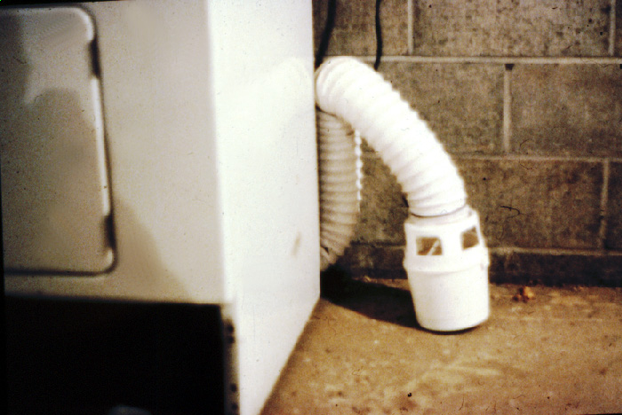
Notes:
Does this violate code and if so, what code is violated? Mention that you can see evidence of microbial/fungal growth on the concrete wall due to the lint from the dryer.
What are some of the reasons why you may see this situation in home? Why may it be OK for this device to be installed and used in a property? What stipulations do the manufacturer state must be followed to ensure “safe” operation of the dryer?
If these devices are in use, what conditions will routinely be observed in the area?

Slide 55
Code Requirements Related to Ventilation
302.6 Exhaust vents. Pipes, ducts, conductors, fans or blowers shall not discharge gases, steam, vapor, hot air, grease, smoke, odors or other gaseous or particulate wastes directly upon abutting or adjacent public or private property or that of another tenant.
403.4 Process ventilation. Where injurious, toxic, irritating or noxious fumes, gases, dusts or mists are generated, a local exhaust ventilation system shall be provided to remove the contaminating agent at the source. Air shall be exhausted to the exterior and not be recirculated to any space.
403.5 Clothes dryer exhaust. Clothes dryer exhaust systems shall be independent of all other systems and shall be exhausted in accordance with the manufacturer’s instructions.
603.2 Removal of combustion products. All fuel-burning equipment and appliances shall be connected to an approved chimney or vent.
Exception: Fuel-burning equipment and appliances which are labeled for unvented operation.
Notes:
What do your local codes state about the situation exemplified in the prior example?
IPMC code 403.5 addresses clothes dryer exhaust, read 403.5 above.
IPMC code 403.4 refers to process ventilation and the next slide with the exhaust venting to the attic.

Slide 56
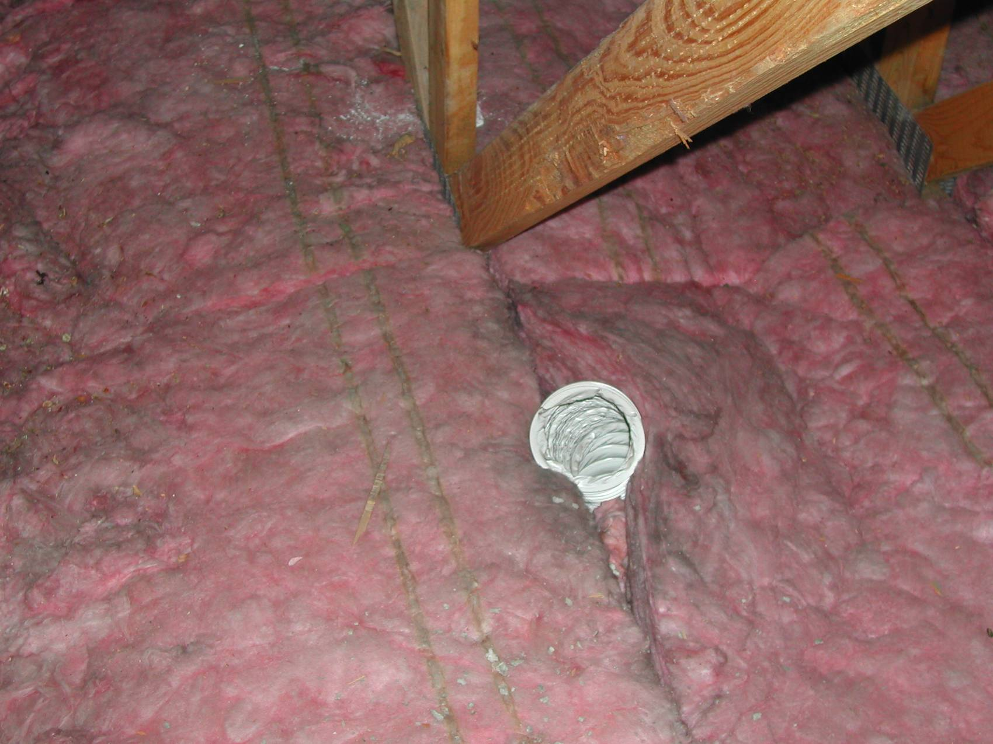
Notes:
What does that dark staining around the vent indicate? Is it mold? If it is, what is the mold growing on? (Remember that fiberglass is inorganic). Make sure they mention the dust on the insulation that would obviously be present, this is the mold food.

Slide 57
Awareness of Additional Issues
Lead-Based Paint
Asbestos
Carbon Monoxide
Radon
Chemical and biological contaminants
Clutter/unsanitary conditions
Hoarding
Notes:
For this section, we are not specifically talking about how the hazard affects health, but rather what role the code inspector plays as far as addressing these issues. Once these issues are discussed, it would be good to mention that these issues lead, CO, radon, chemicals, clutter and hoarding are examples of the core healthy home principles discussed early and in other healthy home courses.
What are considered special issues in the area that the training is being delivered in? For example…are chemical contaminants a “special issue”?

Slide 58
Lead-Based Paint
Flaking paint is a code violation…is there additional urgency when children in home?
Why is it a code violation?
EPA’s Renovation, Repair, and Painting Rule
Have local code inspectors been asked to enforce EPA’s RRP Rule?
Notes:
Mention why flaking and peeling paint is a code violation: 1) allows rot of siding materials, 2) allows water penetration into structure, 3) allows vermin an access point into building.
If children are in the home, what moral responsibility does the CEO have to refer the family to the local health department who could follow up for case management?
RRP: Have local code inspectors been asked to enforce EPA’s RRP rule? The answer to this is, “No”. Local jurisdictions do not enforce federal rules unless specifically adopted. I would NOT introduce this as one of their required tasks.>
Those enforcing the rule may be the state health department

Slide 59
Summary of Changes from RRP
“Certified Renovation Firm” Disturbs Paint
“Certified Renovators” Supervise Work
Mandatory Work Practices
Post-renovation Cleaning Verification
Documentation!
Notes:
“Certified Renovation Firm” Disturbs Paint
- EPA or State Certification
- Fees and five-year renewal (1-3 years in some authorized states)
“Certified Renovators” Supervise Work
- One-day training by certified training provider
Five-year renewal (three years in some authorized states)
Mandatory Work Practices
- Isolate work area
- Contain dust
- Thoroughly clean-up work area for debris and dust
Post-renovation Cleaning Verification Discuss who does the verification…what type of credentials? What type of equipment? What are the flaws/weaknesses to this rule?
Documentation!

Slide 60
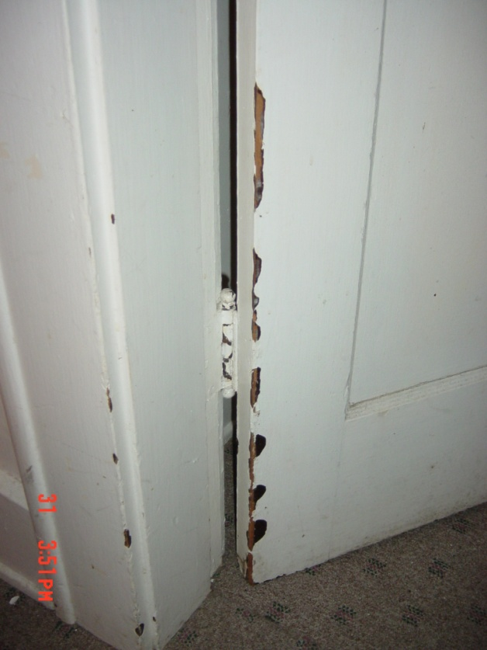
Notes:
Add that condition issues such as these are precursors to the inevitable decline in health, safety and sanitation for the overall building. Lack of maintenance such as this may be indicative of lack of maintenance overall throughout the building…especially those things you cannot see such as roof, siding, equipment, cleanliness, etc.

Slide 61
Peeling paint outside
Notes:
We can see deteriorated paint. It can be peeling, flaking, chipping or chalking.
Chalking is when paint leaves a whitish film. You may have walked alongside a building and then noticed a white film on your clothing. This is chalking. The paint was designed to do this and help keep the exterior surfaces clean. Unfortunately, the chalking can contain lead and may be present in areas where children are playing.
Again, stress that while it is a relatively minor code violation, it can indicate the interior and hidden conditions overall. How often is lead based paint cited? So, if you can only cite for exterior code violations and don’t have the ability to get into the building, what you see outside will help you to determine what may be going on inside the home.

Slide 62
Lead-Based Paint
Is there any way to verify landlords have provided lead disclosure information to tenants in pre-1978 homes?
Can the city of (state of training site) cite landlords for lack of lead disclosure?
Notes:
This slide would always reference the city that the training is being provided in.
Make sure students are aware of the lead disclosure laws

Slide 63
Asbestos
Asbestos is an inorganic fiber that causes a variety of severe health issues and is present in many older building materials
As a code inspector, it may be difficult to determine what materials contain asbestos without having the materials tested
Do not disturb any suspect asbestos-containing materials, especially if friable
Notes:
The severe health issues include mesothelioma, asbestosis, respiratory/breathing problems, lung cancer, etc.
What experiences have you had in dealing with asbestos?
Are there code requirements related to asbestos and if so, how often are they cited?
While a health issue for long term exposure, asbestos is largely exempted by the Federal rules for a single family home. There would be no code violation in finding friable asbestos. In fact, even disposal of friable asbestos is exempted from the CFRs for single family homes.
Codes Inspectors inspect single family homes as well as multi-family dwellings? Is their responsibility different when it comes to multi-family dwellings? What is the law?

Slide 64
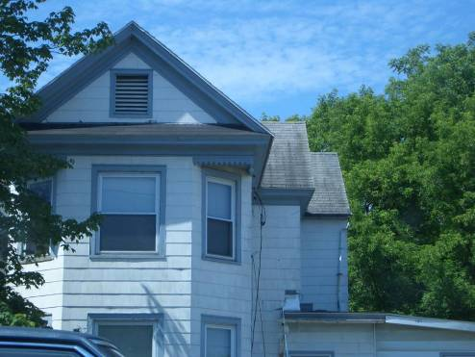
Notes:
This slide illustrate s the potential areas on the exterior of the home where asbestos may exist such as the siding of the home and the shingles.

Slide 65
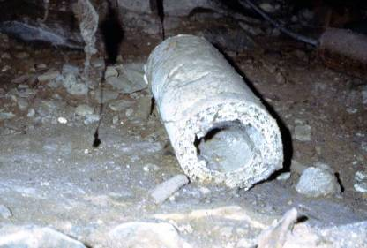
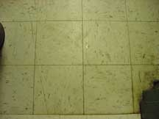
Notes:
Tell everyone what this is. The first picture is asbestos insulation for pipes, the next picture is 8x8 or 9x9 vinyl floor tiles where there is a high likelihood that asbestos may exist. Asbestos may also be found in mastic and adhesives.
Asbestos becomes a concern in single and multi-family dwellings when the materials containing asbestos are damaged and become friable, which the release of the fibers can be inhaled which creates the health threat.
CEOs should be able to notify the occupants and or landlords of the suspect material that may contain asbestos and provide educational materials and recommend a professional to inspect the material.

Slide 66
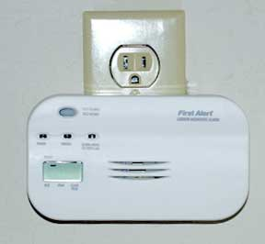
Carbon Monoxide
Significantly fewer CO detectors in residences than smoke/fire extinguishers, why?
Statewide residential CO legislation in STATE?
How often are residences/properties missing operational CO detectors?
Notes:
Known as "the silent killer," Carbon Monoxide (CO) is a colorless, tasteless, odorless gas that comes from the incomplete burning of fuel. Just about anything you might burn in or around your home -- whether it's gasoline, wood, coal, propane, natural gas or oil -- can produce carbon monoxide in the right conditions. Without enough ventilation, the gas can build up to deadly levels. And it doesn't take much fuel to be dangerous: Even small tools like chainsaws can release enough CO to make you sick.

Slide 67
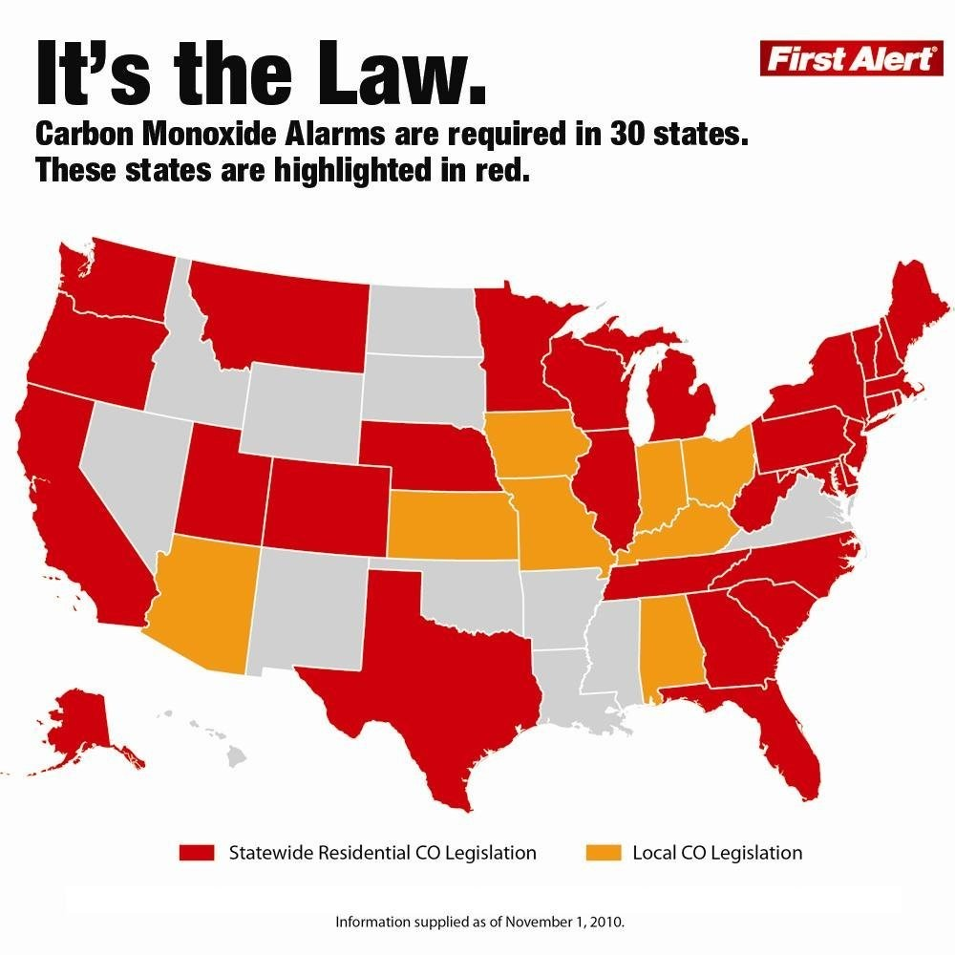
Notes:
Trainers should always verify if the state they are teaching in requires CO alarms to be installed. If it is the state law, is the law retroactive for existing homes or does it apply to new homes only?
Make sure map is updated

Slide 68
Notes:
Diagram illustrates the variety of potential sources for carbon monoxide in the home.

Slide 69
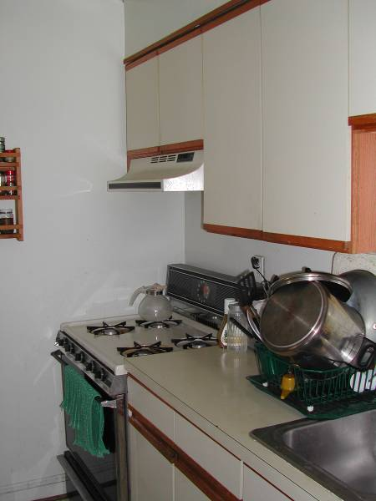
Notes:
This is an example of a range hood with a re-circulating fan rather than exhausting to the outside. The inspector should open the cabinet to verify there is not a duct venting to the outside. Also, the range hood does not extend over all the burners, which may present a problem in exhausting gases from this gas stove if an exhaust to the outside was installed.

Slide 70
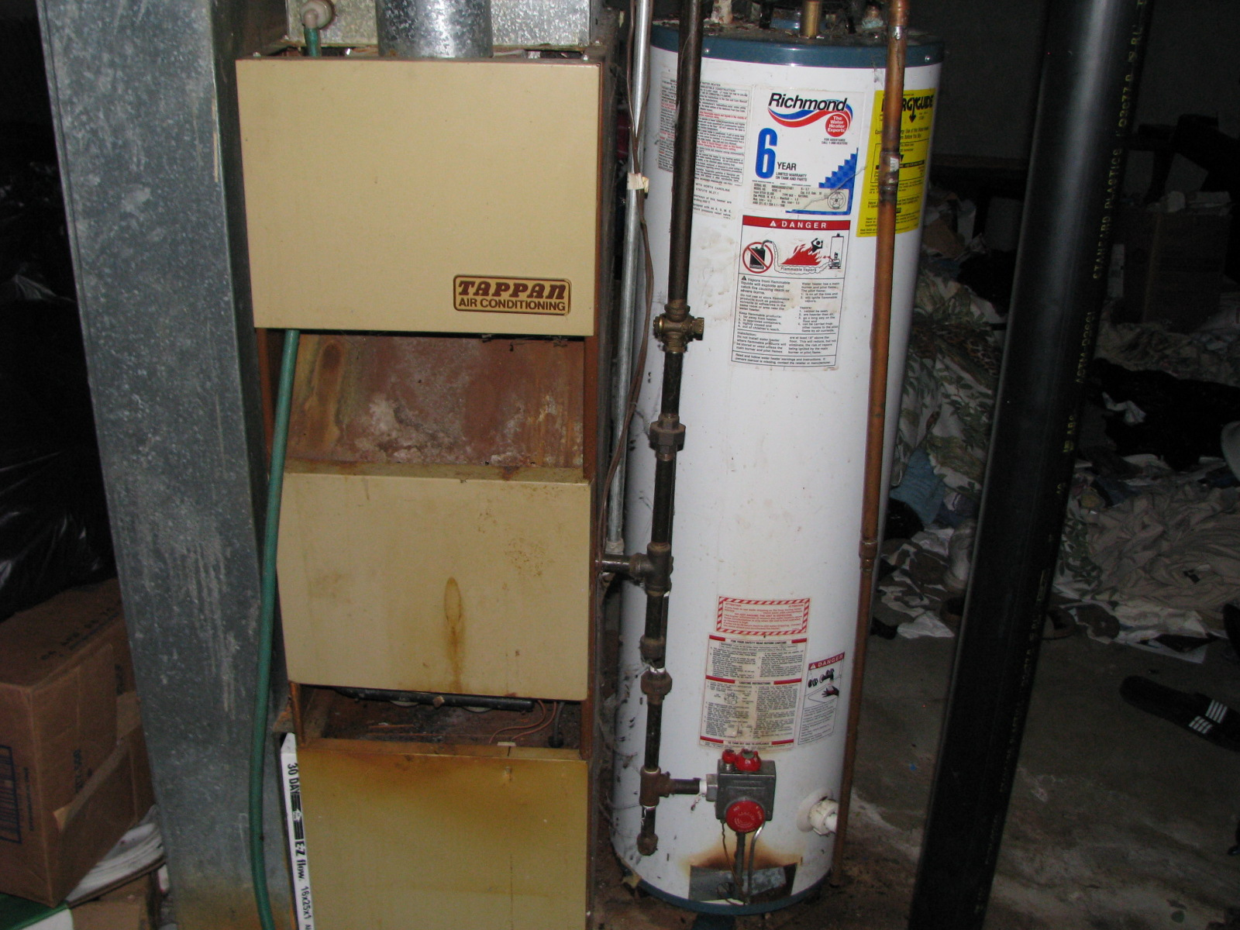
Notes:
This could be a good time to mention several things in addition to the possibility of CO…lack of ventilation and draft for incomplete combustion of gas fuel exhaust, faulty equipment, build up of rust in water heater that is transferred to domestic water supply, etc. I see several code violations hare that could be fairly serious:
Does the local jurisdiction require: 1. Gas shut off valves for one or both pieces of equipment 2) A method of collecting and draining water that would come from discharge of the Temperature/Pressure relief valve?

Slide 71
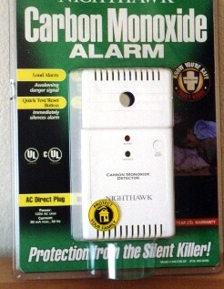
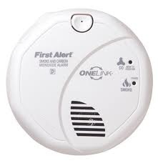
Carbon Monoxide Alarms
Consumer Product Safety Commission (CPSC) recommends:
Place near sleeping area
Put on every level of a home to provide extra protection
Do not install directly above or beside fuel-burning appliances
Combination smoke and CO alarm
Notes:
Proper placement of a carbon monoxide detector is important. If you are installing only one carbon monoxide detector, the Consumer Product Safety Commission (CPSC) recommends it be located near the sleeping area, where it can wake you if you are asleep. CO alarms should be placed on every level of the home and in every bedroom of a home to provide extra protection.
Install a battery-operated CO detector in your home and check or replace the battery when you change the time on your clocks each spring and fall. Many CO detectors are plug-ins with battery backup.
Homeowners should remember not to install carbon monoxide detectors directly above or beside fuel-burning appliances, as appliances may emit a small amount of carbon monoxide upon start-up. A detector should not be placed within fifteen feet of heating or cooking appliances or in or near very humid areas such as bathrooms.
Carbon Monoxide Detectors should not be thought of as a REPLACEMENT for proper use and maintenance of fuel-burning appliances. It is important for students to know that the technology of CO detectors is still developing, that there are several types on the market, and that they are not generally considered to be as reliable as the smoke detectors found in homes today. Some CO detectors have been laboratory-tested, and their performance varied. CO detectors are designed to alarm at 70ppm to alert occupants to get to fresh air to avoid life-threatening exposure.

Slide 72
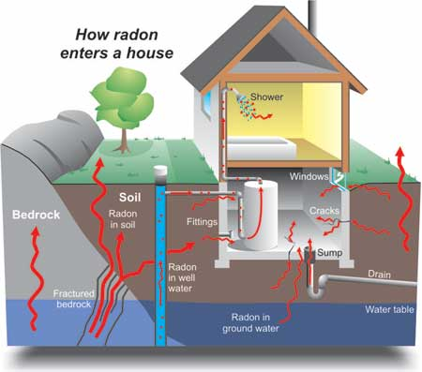
Radon
May not be a housing code issue, but rather a building code issue
Does the landlord have to notify tenants of elevated radon levels (if tested for)?
Notes:
Although it is a building code rather than property maintenance code, the CEO has a moral responsibility to handle radon issues.
This illustration is useful to an inspector to help he/she understand the mitigation process rather than focus on legal issues.

Slide 73
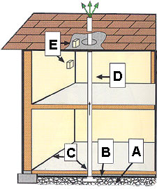
Passive Sub-Slab Depressurization System (New Construction)
A.
B.
C.
D.
E.
Gas-Permeable Layer
Plastic Sheeting
Seal and Caulk
Vent Pipe
Junction Boxes
Notes:
This slide is taken from EPA’s webpage at www.epa.gov/radon/construc.html¹⁸
This system should be used for new construction. EPA does not recommend a passive system for existing sub-slab construction.
Five important steps in a passive system:
Put a gas permeable layer beneath the slab or flooring system to allow soil gas to move freely underneath the house.
On top of the gas permeable layer, put plastic sheeting to help prevent the soil gas from entering the home.
Seal and caulk all below grade openings in the foundation and walls to reduce soil gas entry into the home.
Install vent pipe – 4 inches preferred – from gas permeable layer to roof to safely vent radon and other soil gases to the outside.
Install junction boxes to make wiring and installation of a vent fan for an active system easier. Active systems are recommended for existing homes.
For systems in crawl spaces, cover the floor with poly sheeting, lay a perforated collection pipe below the poly sheeting and connect the pipe to a radon vent riser. It is also important to close openings between the crawl space and basement or crawl space and the living areas. The recommended installation is a T- joint at the bottom of the stack with corrugated pipe running in both directions.
Please note that the pipe (stub up) must be connected to a vent pipe that goes through the interior of the house and vents to the outside. Otherwise, it is not a passive system and radon is vented in the house instead of outside or creating a situation where the pipe (stub up) could be misused for something else such as a commode. Vent pipes passing through the house are required to be labeled.

Slide 74
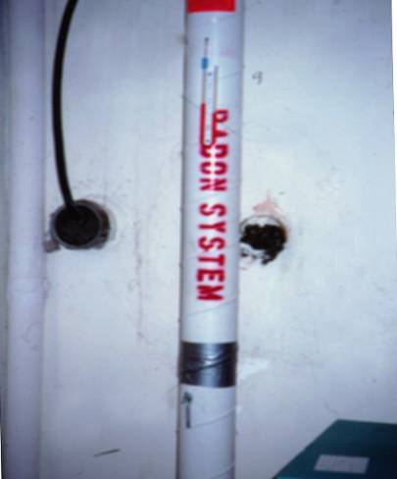
Notes:
Radon pipes must be identified so they are not mistaken for drainage or vent pipes. Make sure occupants are aware of the ‘U’ gauge so they understand the pressure inside the radon pipe is different than the pressure in the room and it let’s the occupants/landlords know the system is still operational.

Slide 75
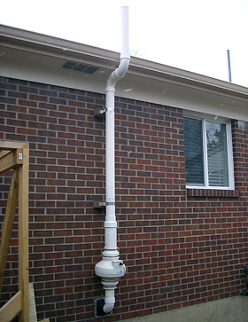
Notes:
Talk about this as the pipe that exhausts Radon from under the home to the atmosphere. Then ask why…if it so dangerous… it is safe to allow Radon into the atmosphere? The answer is that it is all around us right now. It is more harmful when trapped within the home (since our modern homes are very tight due to energy efficiency measures.
Methods of Monitoring Radon-222 in the Environment (from http://enhs.umn.edu/hazards/hazardssite/radon/radonmonitor.html)
OUTDOOR AIR - concentrations vary with soil type, meteorologic conditions and diurnally - average ambient outdoor radon levels are about 0.2 - 0.7 pCi/L - outdoor radon is a small health hazard (700 lung cancer deaths/year, US)
-21,000 lung cancer deaths/year overall according to EPA
WATER - highest concentrations in ground water compared to surface water - radon gas emanating from a residential water source produces radon progeny - inhaling/ingesting waterborne radon progeny is a very small health hazard
INDOOR AIR – RESIDENTIAL AND OCCUPATIONAL - concentrations vary with underlying or surrounding rock or soil type - occupational radon levels are highest for miners(uranium, iron and fluorospar) - residential radon levels are highest in basements and ground floor rooms - building type, construction, level of repair and ventilation effect levels - average radon level in homes is about 1.25 pCi/L - radon remediation recommended at residential levels above 4.0 pCi/L - indoor radon is a significant health hazard(3 - 32,00 lung cancer deaths/ year)

Slide 76
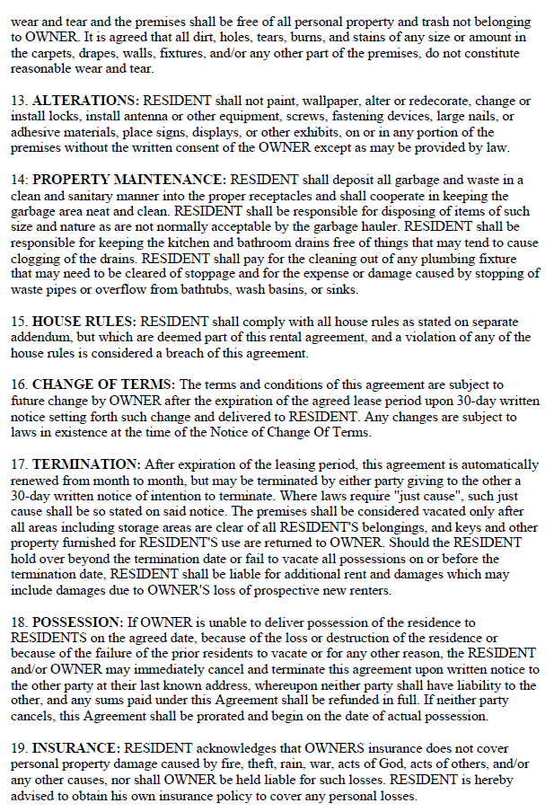
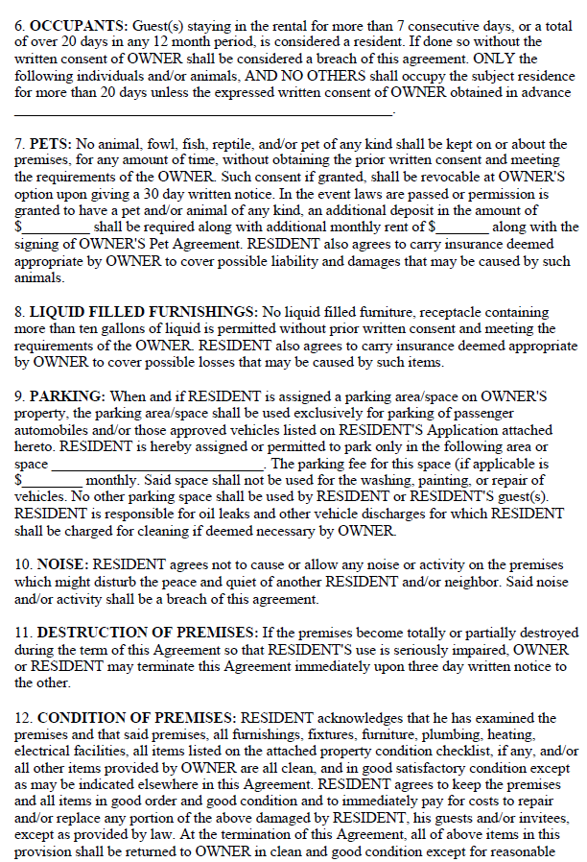
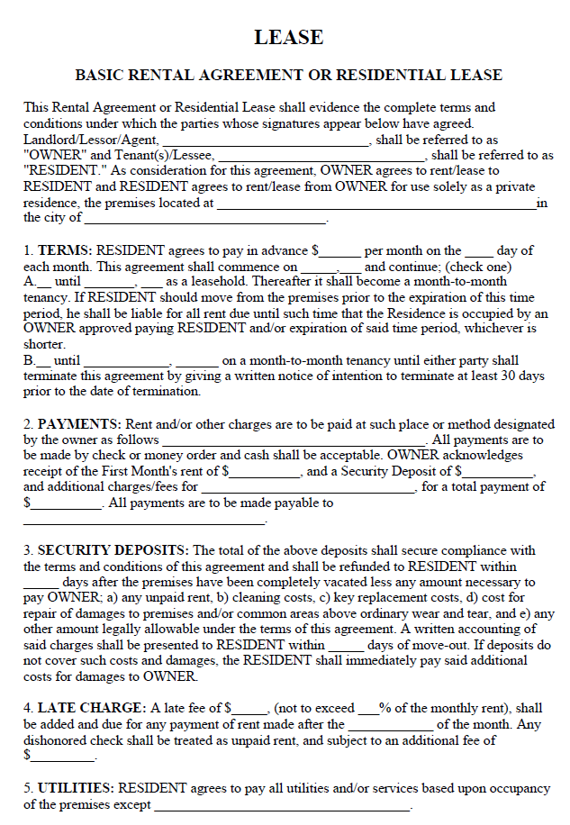
Landlord-Tenant Laws
Uniform Residential Landlord and Tenant Act (URLTA)
Established in 1972
Creates uniform standards for healthy and fair housing
URLTA has been adopted by more than 20 states.
Notes:
The following slides are primarily based on the Uniform Residential Landlord and Tenant Act (URLTA).
URLTA was completed by the Uniform Law Commission (ULC) in 1972.
The complete text of the Uniform Residential Landlord and Tenant Act can be found here: http://www.uniformlaws.org/shared/docs/residential%20landlord%20and%20tenant/urlta%201974.pdf
Currently, URLTA has been adopted by 21 states; many other states have used URLTA for guidance in drafting their own landlord and tenant laws.
(See http://www.nchh.org/Portals/0/Uniform%20Law%20Commission%20-%20URLTA.pdf)
However, it is important to be aware of the state and local laws that actually govern landlord-tenant practices in your city, because they may vary importantly from the URLTA and may provide additional protections.

Slide 77
Landlord-Tenant Laws
Rights and Responsibilities
Make repairs and keep premises in a fit and habitable condition
Keep common areas clean and safe
Maintain facilities and appliances in safe and working condition
Provide for removal of garbage and waste and maintain appropriate receptacles.
Landlords must:
Comply with building and housing codes
Provide running water, reasonable amounts of hot water and heat.
URTLA § 2.104

Slide 78
Landlord-Tenant Laws
Rights and Responsibilities
Keep premises clean and safe
Dispose of waste in a clean and safe manner
Use facilities and appliances in a reasonable manner.
Keep plumbing fixtures clear as condition permits
Not disturb neighbors’ peaceful enjoyment of premises
Tenants must:
Comply with provisions of local building and housing codes that are primarily imposed upon tenants.
URTLA § 3.101

Slide 79
Landlord-Tenant Laws
Access and Entry
To provide necessary or agreed repairs or services
ULTA § 3.103
To inspect the premises
To exhibit the property to workmen, contractors, or prospective buyers or tenants.
A landlord shall give 2 day’s notice, except in emergencies, and must enter at reasonable times.
A tenant may not unreasonably withhold consent for a landlord to enter a unit:
In case of an emergency.
Notes:
It is important to be aware of the laws governing landlord entry in your state/city.
These laws typically govern for what reasons a landlord may enter, as well as how much and what type of notice is required to enter. In some states, inspecting the property is not among those permissible reasons for a landlord to enter, even with notice.
Disputes may arise between landlords and tenants as to whether the landlord may enter with the code enforcement officer, and it may be useful for officers to be aware of the relevant law.
Worth noting: A tenant’s willingness to discuss substandard conditions openly may change radically depending on whether the landlord is present.

Slide 80
Landlord-Tenant Laws
Remedies for Breach by Landlord
Repair and Deduct: Repair or procure essential services and deduct cost from rent
Collect Money Damages: Tenant may recover damages for noncompliance with the lease
Terminate the lease where the breach materially affects health and safety.
URLTA §§ 4.101, 4.103, 4.104
Where a landlord fails to make repairs, after giving required notice, a tenant may:
Notes:
These remedies require certain specific preconditions and written notices under law so tenants aiming to avail themselves of these remedies should seek legal advice and be very careful to meet all legal requirements.

Slide 81
Landlord-Tenant Laws
Defense to an Eviction Lawsuit
In an eviction lawsuit for nonpayment of rent, tenant may:
Counterclaim for any amount owed to tenant based on poor living conditions
URLTA § 4.105
If no rent remains due after the counterclaim, tenant may remain in the unit
Notes:
If a landlord files an eviction lawsuit because the tenant did not pay rent, the tenant might be able to claim that they do not owe as much rent as is alleged if rental unit is in a poor, unsafe, or unhealthy condition. In this situation, the poor living conditions could reduce the rental value of the home and therefore lower the amount that the tenant actually owes the landlord. If the tenant is found not to owes the landlord money, the landlord will lose the non-payment eviction lawsuit and the tenant may remain in the rental unit.
A thorough inspection report may be useful evidence in court in these cases.

Slide 82
Landlord-Tenant Laws
Landlord may not increase rent, decrease services, file for eviction or threaten to evict in retaliation for a tenant:
Retaliatory Actions and Eviction
joining a tenants’ union.
complaining to government agency about code violations
URLTA § 5.101.
Retaliation is a defense to eviction.
complaining about conditions to the landlord
Notes:
Code enforcement officers may encounter tenants who are fearful of retaliatory eviction or action by the landlord. This fear may keep tenants from making complaints to landlords or from contacting code enforcement and requesting inspection, may prevents tenants from asserting the law pertaining to the landlord’s right to enter the rental unit, and keep tenants from talking freely with code enforcement officers, especially when the landlord is present.
This is a special problem for tenants who, owing to limited income or other reasons, don’t have many options for moving.
Fortunately, the law protects against this problem. However, tenants may need legal assistance or other support to effectively assert their rights against retaliation under the law. Tenants who have concerns should be referred to local legal services.

Slide 83
Landlord-Tenant Laws
Federal and state laws require landlords to make reasonable accommodations for persons with disabilities
Reasonable Accommodation
Reasonable accommodation can be:
Change in rules, policies, practices, or services so to allow enjoyment of a dwelling unit or common space
Notes:
A reasonable accommodation is a change in rules, policies, practices, or services so that a person with a disability will have an equal opportunity to use and enjoy a dwelling unit or common space.
While reasonable accommodations are required by law, a landlord is not required to make changes that would fundamentally alter the program or create an undue financial and administrative burden.
Reasonable accommodations may be necessary at all stages of the housing process, including application, during the tenancy, or to prevent eviction.
For example, individuals who hoard may have a related disabling mental health condition that merits a reasonable accommodation, for example help cleaning or or extra time to find assistance to clean and dispose of belongings in order to come into compliance.
Code enforcement may be able to facilitate improved outcomes by providing referrals to or coordination with local social, legal or health services.

Slide 84
Landlord-Tenant Laws
Inspection Report
Establish firmly that a landlord is on notice of substandard conditions
Serve as objective evidence of substandard conditions in the event of a conflict with landlord
Require repairs to be made
Inspection reports may serve many important functions, for example, they:
It is important that reports be clear and thorough.
Notes:
Code enforcement reports documenting substandard conditions serve as critical evidence well beyond the immediate code enforcement context, informing rent disputes, habitability lawsuits, and eviction cases.
These are some important functions of the inspection report:
To require repairs to be made
This is the most obvious function of the report. The most desirable outcome of the inspection is for quality repairs to be made promptly, before any more damage accrues to the heath and safety of the occupants and before the property deteriorates any further. When this doesn’t occur, the document itself is an important tool for at least two reasons:
To establish firmly that a landlord is on notice of substandard conditions.
To serve as objective evidence of substandard conditions
This need for evidence may arise when a tenant withholds rent in order to repair and deduct; during an affirmative habitability lawsuit or constructive eviction case; in security deposit disputes; or to defend against an unlawful detainer suit. [And in rent control jurisdictions, in rent adjustment cases]
Some types of evidence are better than others.
The inspection report is particularly important because there is an assumption that he report gives the complete picture and provides objective information.
Where inspection reports do not clearly evidence code violations that are present, a tenant may find themselves in the undesirable position of explaining to a court or hearing officer why substandard conditions that they claim were present do not show up in the report.
If the inspection is a limited scope inspection (i.e., only looking at a limited subset of housing conditions) then it is useful for the inspection report to indicate this clearly, to alleviate any confusion or apparent contradiction between the report and tenant complaints.

Slide 85
Landlord-Tenant Issues
Some Closing Thoughts
Tenants are not bad housekeepers or unsanitary just because their homes lack the amenities of wealthier households.
Tenants at all income levels are entitled to healthy housing.
Notes:
It is important that code enforcement officers not identify tenants as being ‘bad housekeepers’ or cite them for code violations simply because homes may not have the same amenities as homes occupied by wealthier families. For example, families without storage units or garages or specialized storage module may have homes that contain more belongings than families who have these storage amenities. However, this alone does not merit a citation. The presence of older or worn furniture should not be taken to indicate that tenants do not care for their homes. It is important not to mistake trappings of poverty with poor tenant behavior or poor sanitation.
On the flip side, low income families are entitled to healthy housing and shouldn’t be required to live with structural violations any more than wealthier families. It is important to be equally stringent in citing structural violations regardless of the wealth or other living conditions of the family.

Slide 86
Landlord-Tenant Issues
Some Closing Thoughts
Many low income tenants do not have savings available to pay for a security deposit when required to move on short notice; this can be a significant obstacle to re-housing.
In addition to the negative consequences of unhealthy housing, there are negative health consequences associated with displacement and homelessness.
Notes:
In the worst instances where code enforcement activity results in ‘red-tagging’ of a property/displacement of a tenant, it is useful for code enforcement officers to be informed of any applicable relocation ordinance and able to refer tenants to the appropriate municipal department for help under the relocation ordinance. Many low income tenants do not have savings available to pay for a security deposit when required to move on short notice; this can be a significant obstacle to re-housing if relocation funds are not immediately available.
In addition to the negative consequences of unhealthy housing, there are negative health consequences associated with displacement and homelessness.

Slide 87
Legal Aid of (state of training here)
Provides legal assistance for landlord-tenant and housing issues.
Eligibility for services based on household income.
Legal Aid can assist with housing cases that threaten public benefits or health
Notes:
Instructor will have to research legal aid in the respective city where they will be teaching. If Legal Aid offers services for the area, include those services here-ef

Slide 88
Referral Process for Legal Services
Tenants may contact Legal Aid for assistance:
Online at
By phone at
Other means of contact?
Notes:
If Legal Aid is offered in the city where you are teaching, include information about the referral process here.-ef

Slide 89
Remain Standing if…..
Notes:
Move it further down
Understanding Behavior Change (this is a good exercise to help the audience to be more empathetic with the clients they serve). Also helps with engaging students and a way for them to participate in the learning process.
Read aloud (while keeping your eye open for the first 2-3 people
who sit down):
· Remain standing if you always wear a seat belt when you are
driving a car.
· Remain standing if you brush your teeth at least twice a day.
· Remain standing if you eat at least 2 servings of fruit each day.
· Remain standing if you get a well women’s/men’s check up as
recommended.
· Remain standing if you do not smoke.
· Remain standing if you exercise (walking, running, aerobics,
yoga etc.) at least 3 times a week.
· Remain standing if you always wear a seat belt when you are a
back seat passenger in a car.
· Remain standing if you drink alcohol in moderation or less.
· Remain standing if you wear sunscreen when in the sun for
prolonged periods of time.
· Remain standing if you floss your teeth every day.
Comment favorably if anyone is left standing at the end!
Lead a discussion of what just occurred:
· If appropriate, ask a specific member, “When you had to sit
down after the first [or second, or third] statement, did you know
that we’re all supposed to wear a seat belt when driving?”
· If s/he answers yes, ask, “Why do you think some people don’t
follow that safety practice?”
Ask the Team, “Why do we all omit things we know we should
do and do things we know we shouldn’t?”
Answers should include:
We don’t always have time; we’re rushing.
It’s something unpleasant — like flossing.
We don’t like to feel that we’re being told to do something.
We like to feel free to do what we want, when we want to.
We don’t think we’re ever going to get sick or die.
· Ask the Team, “If all it took was KNOWLEDGE, knowing the
healthiest or safest thing to do, would people smoke? Eat sugary
snacks a lot? Have unprotected sex?”
Answer: Probably not!
Ask for a volunteer to scribe for the next activity, recording key
words.
Brainstorm things that influence our health other than “knowing
better.”
Answers should include:
Denial of our situation despite knowledge of the right things
to do and be
Our belief that we can change the behavior whenever we want
to or “have to”
Our perception of the risk to us
Our experience with trying to or actually changing our
behavior
Our skills / our confidence in our skills
Our support systems (partner, family, friends, professionals,
etc.)
Our environment (physical, social, cultural, emotional mental, spiritual)

Slide 90
Resources
Help Yourself to a Healthy Home Book
CDC HH Ref Manual CD, pests/rat/bed bug resources
Housing code checklist example (Linn County, IA)
www.epa.gov/lead
http://portal.hud.gov/hudportal/HUD?src=/program_offices/healthy_homes/outreach (for fact sheets)
Notes:
More resources that inspectors can use for more knowledge and to educate tenants-ef

Slide 91
Key Messages
Code inspections provide a way to holistically assess a home and the potential hazards that may exist.
There are codes that currently exist to help identify and resolve housing related hazards
Legal Aid and other agencies can be a valuable resource when dealing with code violations
There are a variety of resources that exist to help code inspectors meet the needs of the clients they serve
Notes:
Good review at end of section
There is a link between housing and health
Certain groups are at greater risk for adverse health effects.
There are basic public health and housing principles that can help us understand the link between housing and health.
The “Healthy Homes” movement is a holistic approach to promote health through better housing.
Codes and regulations are tools that can help you achieve healthier housing in your community.

Slide 92
Learning Objectives
Describe the importance of a holistic code inspection to identify hazards
Explain the legal aid referral process and how to refer clients to other agencies for assistance and resources
Identify three types of codes that can be used to address health concerns

