Slide 1
HHRS Train-The-Trainer
Course Developer Meeting

Slide 2
Issues requiring clarification
Pre-requisites for participants
Qualifications of trainers teaching the Train-the-Trainer
Skills assessment of participants
Post-course requirements

Slide 3
Plan of action
Review course approval form submitted to Curriculum Committee
Review stated course objectives
Discuss options for resolution of issues listed on previous slide

Slide 4
Some “T” terminology
We are looking at the HHRS Train-the-trainer course approval submittal.. i.e., the HHRS “T3”
Participants who complete the course should be able to train others on how to use the HHRS
We are also identifying qualifications of people who can teach the Train-the-trainer course.. i.e., “T4” or Train the Train-the-trainer
Trainers who meet these qualifications should be able to deliver the T3 course

Slide 5
HHRS train-the-trainer (t3) course: details from new course application form
Issue #1: Pre-requisites for persons attending Train-the-Trainer (T3)
Issue #2: Qualifications of Trainers teaching the Train-the-Trainer (T4)
Notes:
Session 30 min.

Slide 6
HHRS t3 course: details from new course application form
Additional details cut off from 24a. Describe E-learning method: Delivery is synchronous, live, instructor led. First delivery used GoToMeeting, but future deliveries will use a platform such as GoToTraining to incorporate additional student participation.
Issue #2: Qualifications of Trainers teaching the Train-the-Trainer (T4) – online delivery

Slide 7
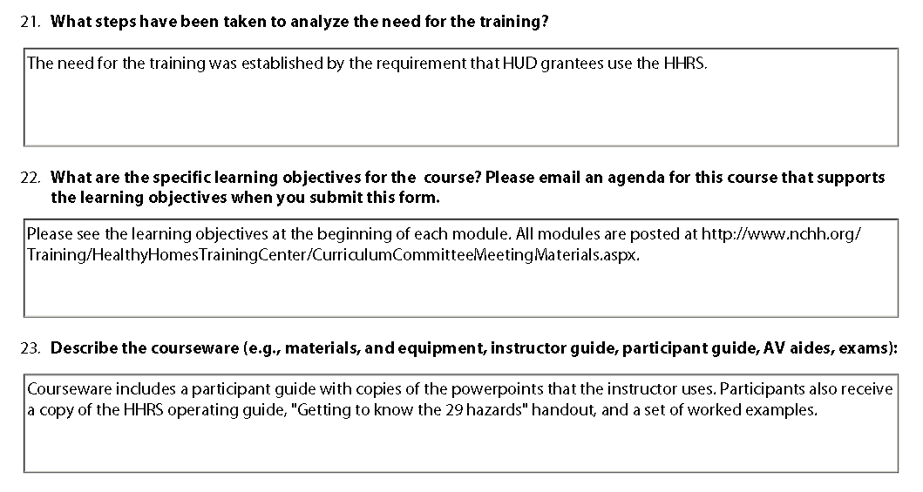
HHRS t3 course: details from new course application form
On following slides..

Slide 8
Course Goals
Enable students to:
Interpret and apply the principles of the Healthy Homes Rating System (HHRS),
Choose appropriate corrective action options to eliminate or reduce hazards
Communicate their findings in a HHRS Assessment Report
Notes:
Session 30 min.

Slide 9
Student Learning Outcomes
Interpret housing-related health hazards using evidence-based likelihood and spread of harm data
Calculate hazard scores and identify hazard bands
Identify and prioritize effective corrective actions
Produce a Healthy Homes Rating System Assessment Report
Notes:
Session 30 min.

Slide 10
Module 1:
Describe the purpose of the HHRS
List four steps included in the HHRS process
Define four common HHRS terms
Identify two important HHRS resources
Determine assessment purpose and goals
Describe links between deficiencies and hazards
Summarize detailed information to be collected
Explain timeframe to be considered when evaluating deficiencies
Identify currently available inspection methods
Evaluate unique considerations for different dwelling types
Module 2
Notes:
Session 30 min.

Slide 11
Module 3:
Explain the importance of the following four terms to the HHRS: element, ideal, hazard, deficiency
Use the 29 hazards chart and the Operating Guidance, identify vulnerable populations and explain their significance
Describe the relationship between deficiencies and hazards using specific examples
Module 4:
Describe the purpose of using the HHRS rating system to rate hazards
Determine the likelihood and spread of harm outcomes of a hazard
Use the HHRS formula to determine the hazard score.
Evaluate the severity of the hazard score to prioritize appropriate interventions

Slide 12
Submitted assessment and rating (Module 6)
Module 5:
Use the hazard score to determine appropriate actions
Provide justification for selected actions
To complete the course successfully, do the following in the next 10 days:
Inspect a property
Complete the reporting form for this assessment
Submit report to your trainer for his or her review
Attain a score of 70% for the submitted report

Slide 13
Module 6: Evaluation criteria and percentage of points
Description of property 10%
List of deficiencies 15%
List of hazards identified 20%
Hazard rating and band 20%
Justifications 25%
Presentation 10%

Slide 14
Module 6: Re-take
If you don’t reach a 70% score, do the following:
Consult your trainer about problems with your first report
Carry out an assessment and scoring of a second (different) property
Submit a report for the second property within 10 days of consulting with the trainer
Attain a mark of 70% for the second submission

Slide 15
Module 6: Other matters
Trainers will score the submitted survey and assessment forms within 5 working days of receipt.
Certificates will be issued within five days after scoring is completed.

Slide 16
HHRS t3 course: issues to resolve
Pre-requisites for participants
Qualifications of trainers teaching the Train-the-Trainer
Skills assessment of participants
Post-course requirements

Slide 17
T3 Participant Pre-requisites
Options | Steps / decision points
Home Assessment experience Attended HHRS course Healthy Homes Specialist? Other professional designations? Years of experience or number of homes assessed? | Attend HHRS and score minimum 90% on assessment Attend Essentials course Minimum 2 years involvement in home assessments (performing and/or teaching)
Training experience NCHH courses HHRS course Other adult ed experience | Minimum 2 years adult education experience
Acceptable substitutions Training center partner involved in course development | Professional certification and/or education in field will be considered in lieu of Essentials on case by case basis

Slide 18
T4 Trainer Qualifications
Options | Steps / decision points
NCHH Involvement Training center partner who has attended a HHRS T3 course and/or participated in development of the HHRS T3 Approved by NCHH and Solutions | NCHH Involvement Training center partner who has attended a HHRS T3 course and/or participated in development of the HHRS T3 Approved by NCHH and Solutions

Slide 19
T3 Participant Skill Assessment
Skills | Steps / decision points
1 Train participants on how to recognize deficiencies Explain the methodology for identifying hazards using the operating guidance Clearly articulate the likelihood and spread of harms concepts Communicate effectively as an instructor | Teachback during course or evaluate another participant’s teachback NEED TO PUT TEACHBACK INTO CURRICULUM ( CAN BE ONLINE)
3- Determine whether or not course participants can correctly calculate the hazard rating Evaluate a written justification provided by a participant Grade their student’s progress and implement corrective actions if needed | Grade assessments as part of the course Understand the assessment evaluation process (2nd assessment if needed) Provide feedback to their students NEED ASSESSMENTS FOR GRADING EXERCISE NEED GUIDANCE FOR TRAINERS ON HOW TO SCORE PARTICIPANT AND PROVIDE FEEDBACK
2- Analyze the ability of the participants to choose appropriate corrective actions and modify the hazard rating Assess the effectiveness of the written report submitted by the participant | Use the worked examples to choose interventions and rescore the hazard rating NEED EXERCISE WITH WORKED EXAMPLES

Slide 20
NEXT STEPS
NEED ASSESSMENTS FOR GRADING EXERCISE – Jack/Susan/Erica will look in files and “clean up” assessments to use during exercise.. Pick some “bad” ones
NEED EXERCISE WITH WORKED EXAMPLES – Participants will have to choose corrective actions for the assessments they evaluate and rescore
NEED TO PUT TEACHBACK INTO CURRICULUM (CAN BE ONLINE) – Susan will look at how to incorporate into curriculum
NEED GUIDANCE FOR TRAINERS ON HOW TO SCORE PARTICIPANT AND PROVIDE FEEDBACK – get templates from trainers that have been teaching the course and develop consensus

