Slide 2
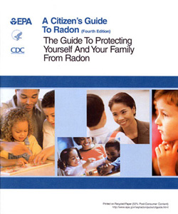
Radon
Fixes for Existing Housing:
Seal floor and cracks
Vent from below slab
Fan sucks air – active system
Sump suction reduces entry
Notes:
EPA’s “Consumer’s Guide to Radon Reduction” (EPA-402-K-03-002, February 2003, pg 9-12).
The most common system is “subslab suction,”
a vent pipe system and fan, which pulls radon from beneath the house and vents it to the outside.
This system, known as a soil suction radon reduction system, does not require major changes to the home.
Sealing foundation cracks and other openings makes this kind of system more effective and cost-efficient. Similar systems can also be installed in houses with crawl spaces.
Radon contractors can use other methods that may also work in a home. The right system depends on the design of the home and other factors.
Resources
https://www.epa.gov/sites/production/files/2016-02/documents/2012_a_citizens_guide_to_radon.pdf
https://www.epa.gov/sites/production/files/2016-12/documents/2016_consumers_guide_to_radon_reduction.pdf
_______________________________________________________
Additional Information
Active subslab suction (also called subslab depressurization) is the most common and usually the most reliable radon reduction method. One or more suction pipes are inserted through the floor slab into the crushed rock or soil underneath. They also may be inserted below the concrete slab from outside the house. The number and location of suction pipes that are needed depends on how easily air can move in the crushed rock or soil under the slab, and on the strength of the radon source. Often, only a single suction point is needed.
A contractor usually gets this information from visual inspection, diagnostic tests, and/or experience. A radon vent fan connected to the suction pipe(s) draws the radon gas from below the house and releases it into the outdoor air while simultaneously creating a negative pressure (vacuum) beneath the slab. Common fan locations include attics, garages and the exterior of the house.
Passive subslab suction is the same as active subslab suction except it relies on natural pressure differentials and air currents instead of a fan to draw radon up from below the house. Passive subslab suction is usually associated with radon-resistant features installed in newly constructed homes. Passive subslab is generally not as effective in reducing high radon levels as active subslab suction.
Some houses have drain tiles or perforated pipe to direct water away from the foundation of the house. Suction on these tiles or pipes is often effective in reducing radon levels.

Slide 3
Finding a Qualified Radon Contractor
Contact EPA
https://www.epa.gov/radon/find-information-about-local-radon-zones-and-state-contact-information#radonmap
Contact a private national proficiency programs
http://aarst-nrpp.com/wp/
http://www.nrsb.org/
Notes:
EPA recommends that homeowners use a state-certified and/or qualified radon mitigation contractor trained to fix radon problems.
The homeowner (or you) can determine a service provider's qualifications to perform radon measurements or to mitigate the home in several ways.
First, check with your state radon office.
Many states require radon professionals to be licensed, certified, or registered, and to install radon mitigation systems that meet state requirements.
Most states can provide you with a list of knowledgeable radon service providers doing business in the state.
Second, in states that do not regulate radon services, ask the contractor
if they hold a professional proficiency or certification credential, and
if they follow industry consensus standards such as the American Society for Testing and Materials (ASTM) Standard Practice for Installing Radon Mitigation Systems in Existing Low-Rise Residential Buildings²¹, or
the U.S. EPA's “Radon Mitigation Standards” (EPA-402-R-93-078, April, 1994).
Third, you can contact private proficiency programs for lists of privately-certified professionals in your area.
Such programs usually provide members with a photo ID, which indicates their qualification(s) and the ID-card's expiration date.

Slide 4
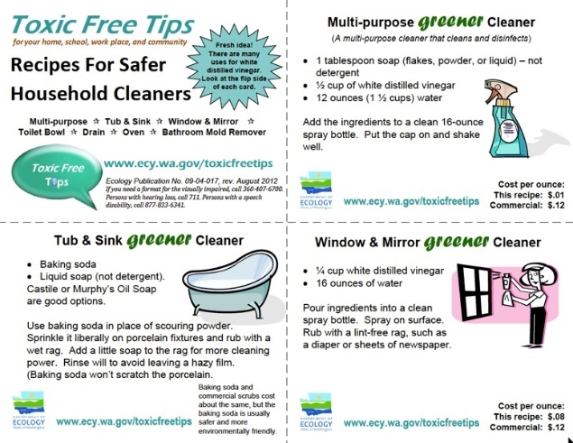
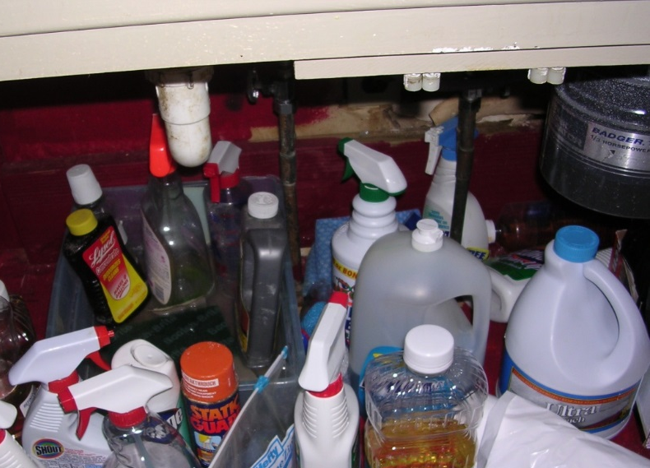
Volatile organic compounds
Educate for these simple steps:
Don’t use it if you don’t have to.
Substitute a better product.
Store materials properly.
Ventilate.
Notes:
The same principles that were applied to the management of pests, dirt and moisture can be applied to other sources as well.
First, keep it out - Don’t use it at all.
Second, substitute something less likely to cause problems. Consider the risks for contaminants released by the product itself, the use and maintenance of the product, and how badly can things go wrong in the event of an accident.
Substitute with a product that has:
low VOC and particle emission
low toxicity and irritancy characteristics
low risk of chemical reactivity
low risk of fungal contamination
low maintenance requirements
Store Materials Properly
Keep containers sealed
Store away from air intake
Remove unwanted products from home
4. Ventilate
Open doors and windows

Slide 5
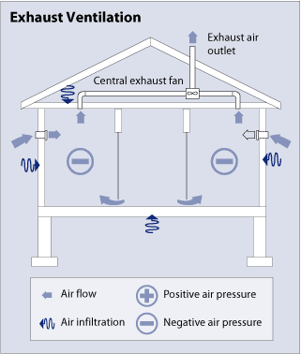
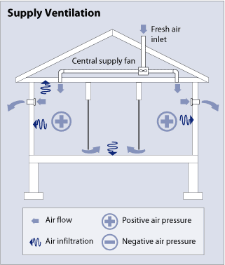
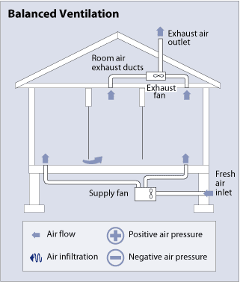
Keep it Ventilation - strategies
Supply Only
Balanced
Exhaust and Supply
Exhaust Only
Notes:
NEED to expand topic
• Create a discussion on ventilation strategies and methods and the impact on the occupants.
• Does it need to be measured – what method. Compared to what standard?
• Discussion should include older homes vs newer homes
• Post construction installation
• Maintenance of installation

Slide 6
Keep it Maintained Interventions
General maintenance is essential
Addressing lead-based paint is critical.
Notes:
Instructor – transition slide

Slide 7
EPA Renovation Repair and Painting Rule (RRP)
Firms performing renovation, repair or painting projects that disturb lead-based paint in homes, child care facilities and pre-schools built before 1978 must:
Have their firm certified by EPA (or an EPA authorized state),
Use certified renovators who are trained by EPA-approved training providers and
Follow lead-safe work practices.
Essentials
Manual
Notes:
There are three things that firms who do renovation, repair or painting projects must do if they disturb lead-based paint in certain facilities that were built before 1978.
They must have their firm certified by EPA,
use certified renovators who are trained by EPA approved training providers and
follow lead-safe work practices.
paint testing is not required by the regulation, but unless a firm has documentation that the paint is NOT lead-based, then the requirements of the RRP rule apply.
If the firm or the firm’s client chooses to have the paint tested prior to renovation, testing must be done on all surfaces to be affected by the work, by the appropriate qualified professional. See EPA’s web site for this information.
• Reference - Essentials for Healthy Home Practitioners Manual – “References” at the back of the manual is the EPA Lead Renovation, Repair and Painting Rule (RRP)

Slide 8
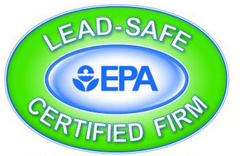
Firm certification
Firms that require certification:
Anyone paid to perform work that disturbs paint in housing and child-occupied facilities built before 1978 must be certified.
Examples:
Residential rental property owners / managers
General contractors
Special trade contractors
Notes:
Instructor – as noted in the previous slide, the first step for a firm doing renovation, repair or painting is to get certified by EPA.

Slide 9
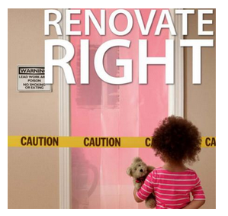
Lead-safe Work Practices
BEFORE renovation, firms must distribute EPA’s Renovate Right booklet
DURING renovation
Examples of requirements:
Work area must be contained to prevent dust and debris from leaving the work area
There must be a thorough clean up followed by a procedure to verify that the work area is free of lead contamination.
Notes:
Instructor – before a renovation takes place, the firm doing the work must provide EPA’s Renovate Right booklet to the occupant of the facility they are renovating. Here are some specific examples of the lead-safe work practices that firms must use during the renovation project. Note that you have a copy of the Renovate Right booklet in your manual.

Slide 10
What is your Responsibility as an HHE?
Know if a house was built before 1978,
Identify whether the property has deteriorated paint,
Educate the resident about the RRP requirements
Notes:
You must be able to identify if there is a possible problem with lead-based paint. And
if there is, to be able to educate the resident about the RRP requirements so their health is protected.

Slide 11
Keep it Pest-free Interventions
Integrated Pest Management (IPM)
The best approach to managing pests
HUD, CDC, EPA, the National Pest Management Association all consider it the best practice in managing pests
Not new, unproven or radical
HUD has implemented IPM since 1995
Notes:
the first thing to know about Integrated Pest Management (IPM) is that it is THE best practice in managing pests.
The next slide explains what IPM is.

Slide 12
What is IPM?
Integrated – IPM uses multiple methods that work together, and have the least risk to people and the environment.
Pest – IPM is used for many pests. We’ll cover cockroaches, mice, rats and bedbugs.
Management – you can’t get rid of pests forever but you can successfully manage them.
Notes:
here is a general definition of IPM. The next slide digs deeper into the definition.

Slide 13
The concept Behind IPM
Water
Food
Conducive Conditions
Nest/
Hide
Notes:
all pests need three things:
food,
2. water, and
3. a place to next and hide (harborage).
Remove these things and you can prevent the pests from coming into a house.
Or if they’re already in, make your house very inhospitable to them so they want to leave!

Slide 14
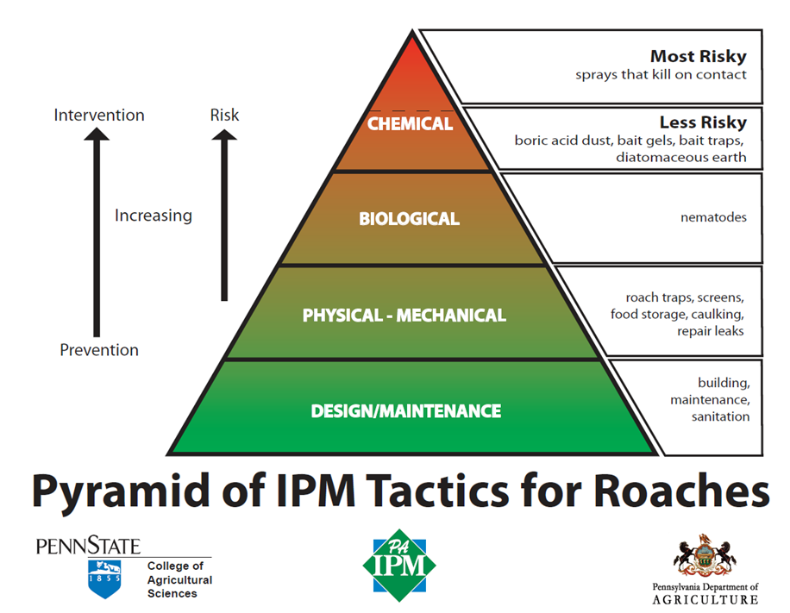
Example: Handling Roaches the IPM Way
Notes:
Instructor – this is an example of applying IPM to manage cockroaches. The basis of effective cockroach control is at the base of the pyramid: making the structure roach-proof, and ensuing sanitation to deny the roaches food. The second stage is eliminating sources of moisture, and keeping up with new repairs, proper food storage, and other standard procedures – so no “deferred maintenance”.
There are not good biological controls for cockroaches indoors – except in the semi-tropics, where lizards are fond of them. While the pyramid lists nematodes – introducing microscopic parasitic worms into buildings has not been popular in practice.
Biorational controls mean tools that are toxic to a pest such as a cockroach but relatively low toxicity for people. For cockroaches, we include the use of inert dusts in enclosed spaces (usually within walls where the insects nest), baits, gels, and insect growth regulators.
Conventional kill-on contact sprays, aerosols and foggers in the tip of the pyramid are seldom used in IPM, except for “emergency” applications. An aerosol might be appropriate to eliminate a stinging insect nest over a school door. A liquid spray crevasse application might be used in a boiler room to eliminate a population before the crevasse is sealed. All pesticide applications must be done only by licensed pest control applicators.

Slide 15
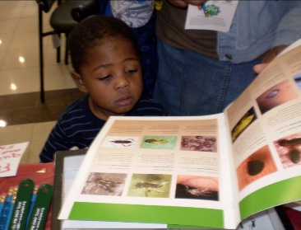
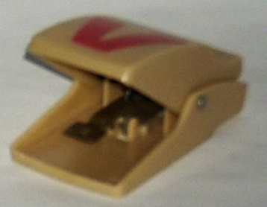
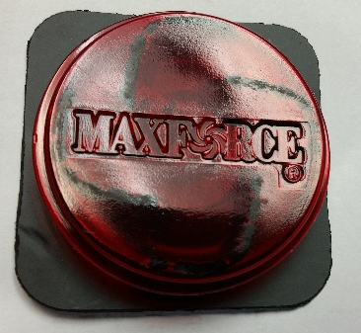
What is IPM?
The IPM approach includes multiple, integrated tools:
Educational tools – educating residents to change behaviors so no available food, water or hiding places for pests in their house.
Physical tools – preventing pests from getting into a house (e.g. sealing up cracks in a foundation and / or using snap traps)
Chemical tools – using low-toxicity pesticides with limited exposure to people when using (e.g. cockroach bait stations)
Notes:
Instructor – here we go further into what IPM means

Slide 16
The Six Steps of IPM
Steps | Description
1. Inspection and Identification | Inspect the property and identify the pests.
2. Exclusion | Keep the pests out of the house.
3. Educate residents | Help residents understand their important role in managing pests.
Notes:
• The six steps in implementing IPM. Here are the first three.
1. Inspection and Identification
2. Exclusion
3. Educate residents

Slide 17
The Six Steps of IPM
Steps | Description
4. Sanitation | Make sure food, water and hiding places are not available to pests.
5. Physical and Chemical Control | Use glue traps (cockroaches), snap traps (mice), and rat traps. Use bait stations for cockroaches and insecticide dusts.
6. Monitoring | Use glue traps and snap traps to control pests and monitor property to make sure they haven’t returned.
Notes:
4. Sanitation
5. Physical and Chemical Control
6. Monitoring

Slide 18
Primary Benefits of IPM
It’s Safer
By their very nature, pesticides are toxic. IPM minimizes the use of pesticides so people, animals and the environment are much less likely to be harmed.
It Works
For insects, conventional pest control primarily utilizes spraying, and sometimes fogging. The problem with these methods is that they only kill the insects they touch. What about those that are hidden?
Notes:
Instructor – there are several benefits to IPM that cannot be overemphasized. First, pesticides and poisons are designed to kill – and that means that they can be toxic not just to their intended targets – pests – but also to unintended targets such as children, pets and wildlife.

Slide 19
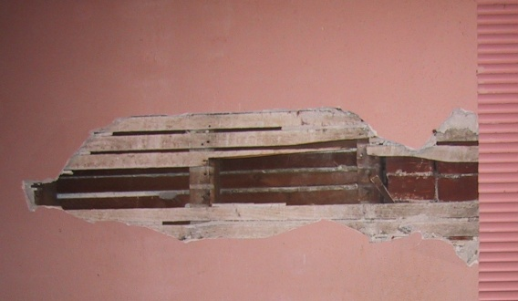
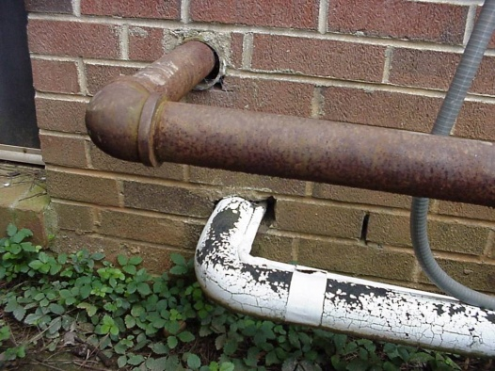
1. Inspection & Identification
Thorough inspection
Identification of pests found
Notes:
Instructor: Applying IPM begins with a through inspection. Begin with the exterior of buildings, looking for ways that pests can enter. They can enter under doors, through unscreened open windows, through pipe penetrations – in fact, through any penetration of walls, especially any hole ¼” in diameter or wider – the minimum size for a mouse to squeeze through!
Interior inspection is looking for the same points of entry, plus harborages (cracks and crevices behind cabinets and baseboards, inside appliances, etc.), food sources (crumbs, litter, garbage, pet food or feces…), and water sources (leak, drips – under the kitchen sink, for instance).
Focus areas are areas of concentrated pest activities. In apartments this may be stoves, refrigerators, or trash cans. In multi-unit buildings some units may be the source of infestations in other units. Trash chutes, compactor rooms, or foodservice facilities are other common focus areas. Unique issues may be identified for a particular property: every building is different, as are the occupants!
The correct identification of pests is essential. If you misinterpret the signs you see and treat for a pest that’s not actually the problem, your treatment is likely to fail. Different species of the same pests sometimes have different behaviors as well and that should be taken into account as you implement treatments. Cooperative Extension services in each state will identify insects for free; many universities or pest control companies have a Board Certified Entomologist (BCE) to help.

Slide 20
Identification Resources
National Pest Management Association’s (NPMA) Field Guide app for identifying pests. Go to Apple Store or Google Play Store to download (costs $4.99).
For cockroach identification, go to https://ecommons.cornell.edu/handle/1813/43848, click on “found-cockroach-bro-NYSIPM.pdf” under VIEW/OPEN.
The University of Minnesota Cooperative Extension at: http://www.extension.umn.edu/garden/insects/find/insects-by-category/#household.
The University of Kansas at: http://entomology.k-state.edu/extension/insect-information/household-pests.html
Notes:
Instructor – here are some resources for pest identification.

Slide 21
What to Look for and Where to Look
What to look for:
The pest (dead or alive)
Pest body parts (yes, eww)
Droppings (also eww)
Nests and burrows
Where to look:
Near food and water sources
Hidden places (e.g. behind an appliance)
Near entry holes
Notes:
Instructor – as you assess a home, think about what you’re look for that is a sign of a pest problem. Also consider where to look. Keep in mind that pests are usually prey species, so they are uncomfortable when out in the open.
Here’s a few more additional details:
Look where there is likely to be good food – under sinks, kitchens, trash bins
Hidden places can include inside walls, under/behind cabinets, basements/crawlspaces/attics, waste bins, under baseboards
Near entry holes (from exterior inspection)
Warm cavities for insects can include inside TV’s, computers, and smoke alarms
The EPA Region 9 IPM for schools manual has fairly detailed information on many common species.
“See the creature, be the creature”

Slide 22
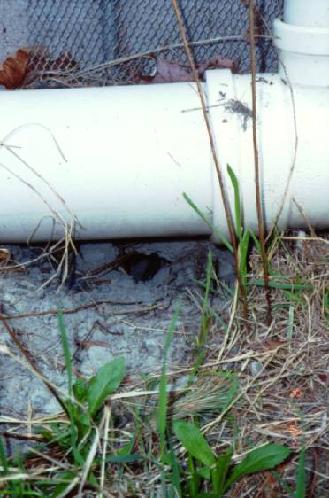
Rat proofing did not work here…
Get down on the ground and look under the pipe…
Rat burrow entrance
Notes:
Instructor – here’s an example in terms of looking for nests and burrows. Notice an ineffective effort to block the original entry point. Burrowing rodents may tunnel downward for several feet.

Slide 23
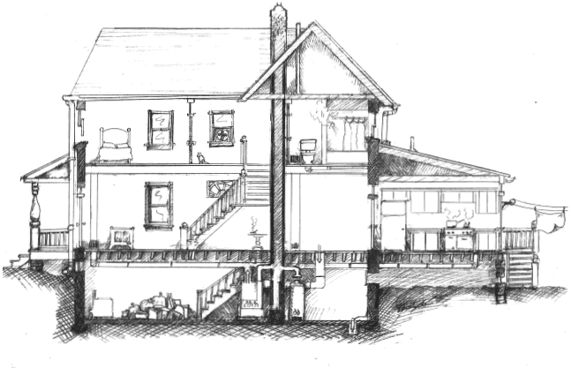
A Person’s View
Notes:
Instructor – here’s another way to think about where you look – particularly in terms of finding cockroaches. This is a person’s view of a house and on the next slide . . . .

Slide 24
A Cockroach’s View
Notes:
Instructor – this is a cockroach’s view of a house.

Slide 25
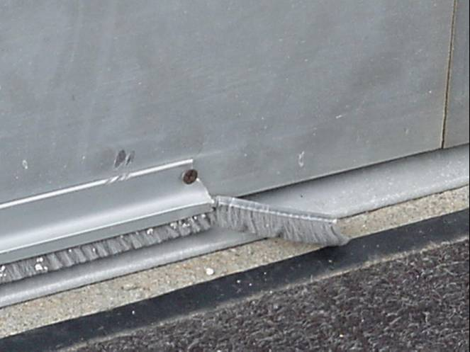
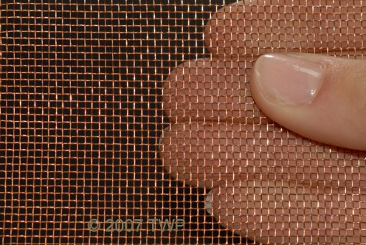
2. Exclusion
Examples:
Install door sweeps.
Seal cracks and crevices with silicone caulk.
Pack larger crevices with copper or stainless steel mesh.
Use expanding spray foam for larger holes.
Notes:
Instructor – exclusion means identifying and in some way sealing up pest entry ways found during inspection. Here are some examples:
1. Door sweeps are an easy fix – without them, mice will squeeze right under doors. They do need periodic replacement, as the photo shows!
2. All cracks and crevices should be sealed with silicone caulk (more durable than acrylic or latex, and also water-proof, heat-resistant, and gnaw-resistant). Note that any crevice more than ¼” wide will need to be packed with copper or stainless steel (rust resistant!) mesh before sealing with caulk, spackle, patching concrete, sheet metal, or other material. This helps prevent rodents from gnawing through the patch.
3. Expanding spray foam (“Stuff –It” or other brands) can help fill larger holes, such as in basement walls or behind kitchen cabinets.
For information on designing buildings that are more resistant to common pests, see Pest Prevention by Design Guidelines (http://www.sfenvironment.org/sites/default/files/fliers/files/final_ppbd_guidelines_12-5-12.pdf) produced by the San Francisco Department of the Environment in November 2012.

Slide 26
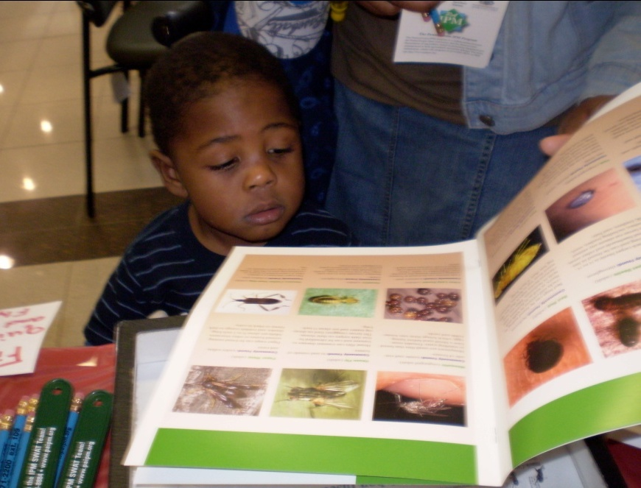
3. Educate Residents
Residents can make or break an IPM effort
Facilities staff and pest management professionals are important for multifamily buildings
Notes:
Instructor - we can work on excluding pests from a house, but it’s what people do that determines whether pest control is successful. For a single family house, you (the HHE evaluator), the resident and potentially a Pest Management Professional (PMP) or Pest Control Operator (PCO). For a multifamily building, the residents, facilities staff and PMPs are ALL very important. Facilities staff are on the front lines of monitoring pest problems and control efforts. PMPs need to genuinely understand IPM and be contracted to carry out accepted IPM practices.
Residents are a particularly key part of the IPM approach. Uninformed residents may disturb or even throw out glue boards, snap traps, and other control measures, They may use inappropriate chemicals that interfere with control – for instance spray pesticides act as repellents, and will keep cockroaches from feeding on baits, such as Combat. This can be a major cause in the failure of baits and gels to eliminate cockroaches. Residents also must practice good sanitation in order to keep food and water out of the reach of pests and to avoid providing hiding spaces for them.
Residents and building staff should understand why IPM methods are being used, and that the safety of their family, pets and home are primary decision factors, and that more familiar methods have higher risks and may also interfere with IPM controls. Foggers are a good example of a very high risk product (they both coat the inside of the home with pesticides, and are explosive!) AND can make other controls ineffective.

Slide 27
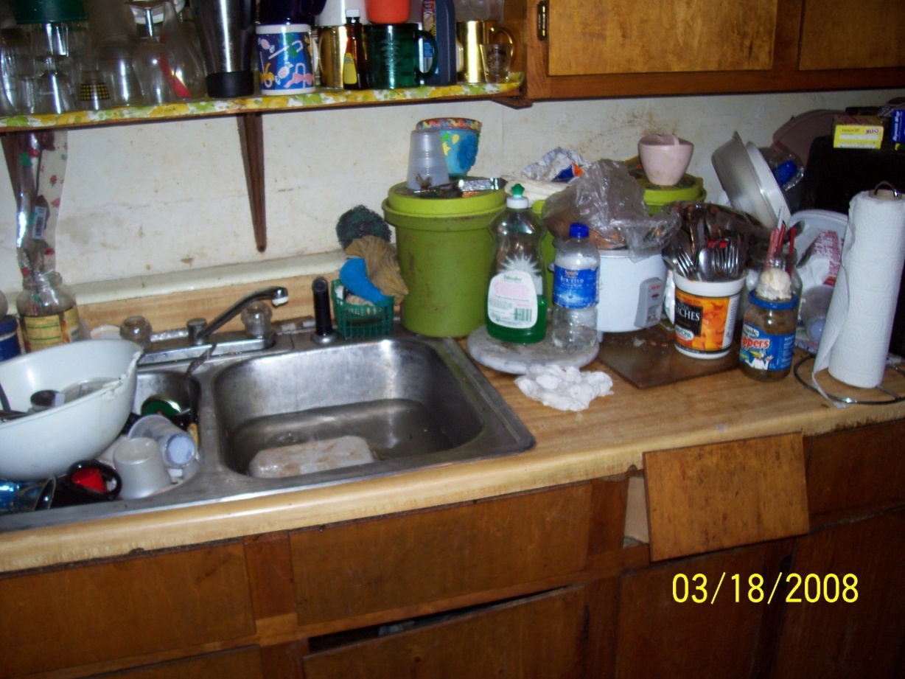
4. Sanitation
Photo: City of Houston Bureau of Children’s and Environmental Health
Food
Water
Harborage
Notes:
Instructor – as mentioned just previously, residents can make or break an IPM effort, and their sanitation practices are key to this. Remember, the practice of keeping food and water inaccessible to pests isn’t just about having a clean house, it’s about removing the conducive conditions for pests. Residents need to be sure to keep food stored in tight containers, make sure garbage cans are covered, pick up pet food dishes, keep water out of a variety of places including the kitchen sink and plumbing leaks. They also need to clean up clutter that could be hiding spaces for pests.
Think of it this way: how much food does a cockroach need? A mouse?? A drop of grease will feed 20 roaches. A mouse eats only 1/10th of an ounce a day. Potato chip crumbs in front of the TV? Yum!
A couple of extra notes: counters and floors must be clean and grease free; grease is a preferred, and superior, food source for cockroaches, mice and rats.
Also, trash cans are another huge food source for pests. In many cases, residents may not have covered kitchen trash cans …or even trash cans at all. Outdoor garbage cans should have tight fitting lids, and ideally should be metal - rats and squirrels easily gnaw though plastic.

Slide 28
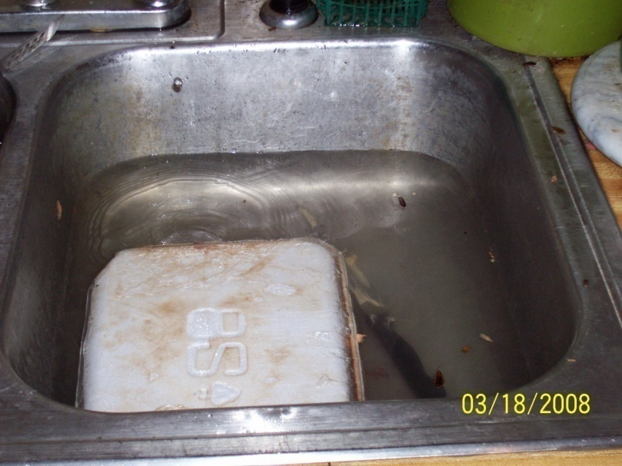
A Note on Water
Essential for insects & rats, but not for mice or bedbugs
Mosquitoes
Structural damage
Photo: City of Houston Bureau of Children’s and Environmental Health
Notes:
Instructor – most creatures can’t live without drinking water, and with a couple of exceptions, that’s true of pests as well. Most insects need to drink water as do rats.
Mice and bedbugs are the exceptions to this. Bedbugs survive on blood meals so they do not need water. Unlike rats, house mice can survive with little or no free water, although they readily drink water when it is available. They obtain their water from the food they eat. An absence of liquid water or food of adequate moisture content in their environment may reduce their breeding potential. (http://icwdm.org/handbook/rodents/HouseMice.asp – Internet Center for Wildlife Damage Management, Cornell, Clemson, Univ of NE-Lincoln, and Utah State Univ).
Residents should be aware of all the potential sources of water, including gutters and roofs, leaks from outside, plumbing and other interior leaks and sink traps. Leaks from condensation are also major sources of water. Many sinks drip from the drainpipe under the sink – result of simple condensation. Warm air in a cabinet holds moisture which condenses on the cold pipe, just as water droplets form on a cold drink in summer. This drips, and can rot the plywood bottom of the cabinet, providing harborage as the plywood buckles, and food – the rotting cellulose & glue of the plywood.
Most people know that mosquitoes are, of course, dependent on standing water outdoors – eliminate sources, or, if that’s not possible, use mosquito “dunks” – “pucks” or briquettes impregnated with a bacteria that parasitizes mosquito and fly larvae exclusively. Non toxic to fish, or anything except insects, this bacteria is a very effective and low-risk control.
Always remember that water damage can attract pests, both for water and shelter.

Slide 29
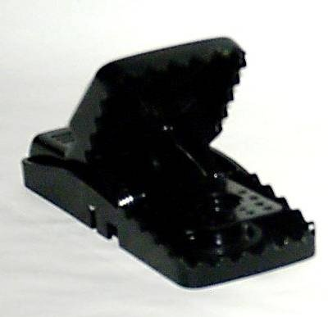
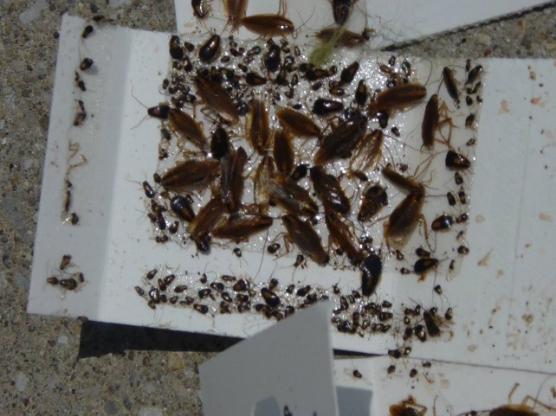
5. Physical control
Traps
Baits and gels
Inert dusts
Insect growth regulators
Notes:
Instructor – there are a variety of physical and chemical controls that you can use to manage pests. After basic prevention – that is removal of conditions conducive to pests: food, water and shelter – control efforts begin. The methods used will be specific to the pest.
Traps, ranging from glue traps for roaches to snap or “curiosity” traps for mice are a vital tool. Cockroach control was transformed in the early ‘90’s by the availability of baits and gels, which can be 100% effective in two weeks or so, as opposed to conventional spray pesticides which only affect cockroaches in the open – no more than 20% of any given population. Baits and gels are carried back into walls where cockroaches live, and poison all the roaches through a domino-effect: roaches eat each other’s feces, and dead roaches, spreading the poison. When eggs hatch, the babies (nymphs) feed on the dead adults, and the colony crashes, usually within two weeks.
Inert dusts (that is dusts that do not contain an active pesticide, including boric acid and diatomaceous earth (DE) are also effective control for most bugs. They work by dying out (“desiccating”) the insect; DE also scratches the cuticle (skin) of the insects, accelerating desiccation. Dusts are very fine, and although inert dusts have low toxicity to people, they are respiratory problems, especially for people with asthma or other respiratory problems. Dusts should never be used in exposed piles, lines, cups, or on mattresses; they should instead be puffed into enclosed voids (behind cabinets, into walls, etc), where they will contact the bugs, not us.
Insect Growth Regulators interfere with the insects’ ability to shed its skin – necessary for it to grow. They therefore cannot mature or reproduce: colony collapse occurs. The immature and affected bugs continue to grow inside their too-small skin, and are crushed by their own growth.

Slide 30
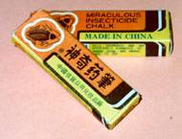
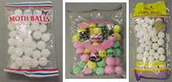
Be Aware of Illegal and Risky Pesticides
Pesticides that look like candy - mothballs
“Miraculous” Chinese Insecticide chalk
“Tres Pasitos”
Many pesticide have been withdrawn
candy!
Notes:
Instructor - When conducting your assessment, you should also look for illegal pesticides in the home. Illegal pesticides are often much more toxic than registered pesticides (those that EPA has approved).
Illegal naphthalene moth repellent products – Mothballs pose a hazard to young children. Mothballs can be easily mistaken for candy, or simply tempt young children to touch and play with them. Recent studies have linked naphthalene to illnesses, including nasal cancer. Widespread sale and distribution of these products make illegal mothballs a particular concern.
Illegal Insecticide Chalk is also known as "Miraculous Chalk" or "Chinese Chalk." You may have seen the chalk in a neighborhood store or sold on the street for about $1 a box. It is mostly imported illegally from China and often bears a label in both English and Chinese. Sometimes the manufacturer claims that the chalk is "harmless to human beings and animals" and "safe to use." These claims are untrue and dangerous.
"Tres Pasitos" is imported illegally from Mexico and other Latin American countries. Its name means "three little steps" in English, because after eating it, this is all mice can muster before dying. The active ingredient (or the chemical that actually kills the pest) in "Tres Pasitos" is a chemical called aldicarb. EPA considers aldicarb to be a very toxic chemical - and one that should never be used in your home. Children are especially vulnerable to poisoning by aldicarb when it is sprinkled around the home to control roaches, mice and rats. Exposure to high amounts of aldicarb can cause weakness, blurred vision, headache, nausea, tearing, sweating, and tremors in people. Very high doses can kill people, because it can paralyze the respiratory system. What "Tres Pasitos" does to pests, it can also do to you.

Slide 31
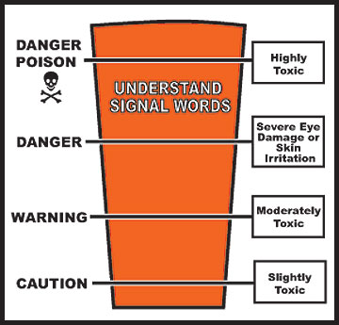
EPA Signal Words for poisons 
CAUTION means the pesticide product is slightly toxic if eaten, absorbed through the skin, inhaled, or it causes slight eye or skin irritation.
WARNING indicates the pesticide product is moderately toxic if eaten, absorbed through the skin, inhaled, or it causes moderate eye or skin irritation.
DANGER means that the pesticide product is highly toxic by at least one route of exposure. It may be corrosive, causing irreversible damage to the skin or eyes. Alternatively, it may be highly toxic if eaten, absorbed through the skin, or inhaled.
If this is the case, then the word “POISON” must also be included in red letters on the front panel of the product label.
POISION

Slide 32
6. Monitoring for Cockroaches
Keep looking to spot reinfestations
Place glue traps in corners
Behind appliances
Under sink
Under cover!
Date and mark
Don’t disturb
Notes:
Instructor - the glue traps you use to trap cockroaches can also be used for identifying pests, identifying the extent of an infestation, and to monitor any possible return of the pest. The bottom photo shows an example: German cockroaches, in a large breeding population, with a nest near where the bottom edge of the monitor was placed.
Insect monitors come in many styles; most fold up into a covered shape to protect the sticky trap from dust. Monitors should always be dated, and have the trap location marked. Place against walls, in corners, behind and under cabinets, appliances, etc. Use 3-6 per kitchen, and at least one in each other room, including bedrooms. Check within 48 hours during the initial clean-out operations; replace as needed. When the population is controlled, check monthly to be sure reinfestation isn’t happening. If new pests are observed on the monitors, begin control again, but do not apply controls unless the monitors show the need!

Slide 33
6. Monitoring for Rodents
Use snap traps
Place in corners, along runways and in tight dark spaces
Check daily
Increase trapping if monitors indicate activity
Always have monitors for insects and rodents in place
Notes:
Instructor – for rodents, use snap traps. Glue traps can be used but they don’t kill rodents – mouse may struggle for a while or escape
Place in corners, along runways, in tight dark spaces
Check daily
Increase trapping if monitors indicate activity
Always have monitors for insects and rodents in place & check often!

Slide 34
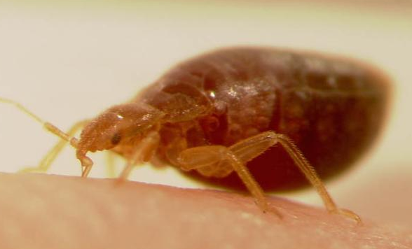
The Panic of Bed bugs
Can be avoided and eliminated
Every skin irritation or bite is not bed bugs
You can see them.
Do not cause or spread diseases.
Notes:
Instructor – bed bugs can cause some panic, but they CAN be avoided and eliminated. Follow an IPM approach with this pest as well. Here are some other myths to dispel about bed bugs. First, remind people that not every skin irritation or bite is from a bed bug – just like with other pests, making an accurate identification of the pest is the first step in eliminating it – and you CAN see bed bugs so they can be identified. Second, bed bugs do not cause or spread any diseases – they haven’t been found to trigger asthma, for example. However, they can cause stress and insomnia.

Slide 35
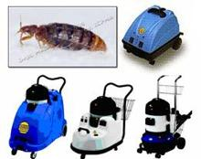
Bed bug - Treatment
Inspection
Vacuum
Heat or cold
Pesticides by PCO only
Re-inspection and retreatment
Encasements and interceptors
Notes:
Instructor – we don’t expect you to become a professional in controlling bed bugs but you should be familiar with the basics of how a bed bug problem is treated. Bring in a professional to help you if you suspect bed bugs. Here is some basic information to know:
Inspection is the key to bed bug treatment and control. Bedbugs hide. Finding them is a challenge. They prefer cracks and crevices as thin as a credit card; their eggs are only 1 millimeter – 1/28th of an inch - long. Inspection means examining and disassembling, as necessary, the bed and associated systems, bedside furniture, baseboards and carpets, and possibly closets, clothes, etc. Remember that beds are not the only place people sleep – recliners, couches, wheel chairs, and all upholstered furniture will need checking. Inspection – and only inspection - guides treatment!
Vacuuming is very useful for removing lots of bugs quickly. Because the eggs are glued into remote and tiny locations, vacuuming is unlikely to remove all the eggs, and is not effective for total control, but it is very useful. Heat – or cold – treatments are the current “gold standard.” Temperatures below freezing (32 ˚ F) or over 120˚F, for more than 20 minutes will kill bedbugs and their eggs. Remember to consider insulation, and how much time you may need – but anything you can put in a hot dryer for 30 minutes will be fine. Steamers are also effective, but need to be professional-grade, low pressure and low vapor; application rate is 4 feet a minute – or 1 foot every 15 seconds! Bed bug treatment takes time, and labor; that’s why it’s expensive. Pesticides, if necessary should be applied only by a licensed pest management professional; aerosols and foggers should never be used.
Most control requires at least 2, usually 3 treatments 2-3 weeks apart: reinspection needs to be part of every treatment plan. Follow through on decluttering, laundering, and other PMP recommendations is essential. While reinfestation is possible at any time, encasements and interceptors are important prevention and monitoring tools and should be left in place.

Slide 36
Review . . . What do you remember?
What are the two major resources for interventions that we discussed?
Name three interventions related to Keep it Clean.
What is the definition of IPM?
Notes:
Instructor – divide the class into two groups. Encourage them to think of a name for their team! This competition will be like an “It’s Academic” format. Each team gets a question. If they answer it correct, they get a point. If they answer it incorrectly, the other team gets a chance to answer and can get a point. If neither team can get it, you (the trainer) can provide the correct answer. You are the arbiter of correct answers! (e.g. you can decide if the definition of IPM is acceptable!)
You will click on the box for each question to uncover the next question.
TWO DETAILS FOR THIS GAME:
Tell the students that you will keep score for the two teams.
Give each team a maximum of 15 seconds to come up with their answer (you can adjust up or down for various questions if you think it needs it). Use your phone to keep track of the seconds – one that sounds an alarm after the time ticks down is best.
Questions:
What are the two major resources for interventions that we discussed?
Name three interventions related to Keep it Clean.
What is the definition of IPM?

Slide 37
Review . . . What do you remember?
What are the two primary benefits of IPM?
What are the six steps of IPM?
Name one example of a tool used in the exclusion step of IPM.
Notes:
Instructor – continue with these questions.
Questions:
What are the two primary benefits of IPM?
What are the six steps of IPM?
Name one example of a tool used in the exclusion step of IPM.

Slide 38
Review . . . What do you remember?
Name two examples of good sanitation practices in an IPM approach.
Name two physical controls that may be used in an IPM approach.
Name two effective treatments for bed bugs.
Notes:
Instructor – continue with these questions.
Name two examples of good sanitation practices in an IPM approach.
Name two physical controls that may be used in an IPM approach.
Name two effective treatments for bed bugs.

Slide 39
Review . . . What do you remember?
Name four Keep it Safe Interventions.
Name two Keep it Safe interventions targeted to young children.
What makes a sub-slab depressurization system for radon active (rather than passive)?
Notes:
Instructor – continue with these questions.
Name four Keep it Safe Interventions.
Name two Keep it Safe interventions targeted to young children.
What makes a sub-slab depressurization system for radon active (rather than passive)?

Slide 40
Review . . . What do you remember?
What does RRP stand for?
What is the name of the document that renovation firms must provide to occupants in pre-1978 houses?
What is one of the goals of lead-safe work practices?
Notes:
Instructor – continue with these questions.
What does RRP stand for?
What is the name of the document that renovation firms must provide to occupants in pre-1978 houses?
What is one of the goals of lead-safe work practices?

